Slide 2
New OFSTED Framework
Pilot - Ivybridge Primary February 2019

Slide 3
Safeguarding
Nothing much has changed! Judgement is still effective/not effective
If you are part of the pilot this is the only thing that could be reported externally…
Focus is on school having effective systems for identifying pupils at risk, what you do to support them eg. engaging with other agencies
How the curriculum supports safeguarding
Management of systems and procedures eg. Recruitment, staff training

Slide 4
Sorry – can’t talk about the methodology!
Schools will receive a phone call by 10am, the inspector will arrive at the school by 12.30pm
The inspector will not have done any prep before arriving in school, not even looked at the website, IDSR, previous inspection report etc.
The first afternoon is preparation and planning for the inspection.
Short inspections will last 2 days rather than the current 1 day, starting the following morning
Focus is very much on “Quality of Education” which has replaced Teaching, Learning and Assessment and Outcomes for Pupils.

Slide 5


Slide 6
Some reading……
This framework is clearly based on the outcomes of research which has been taking place.
Education Inspection Framework – overview of research. OFSTED Jan 2019
The Education Inspection Framework – draft for consultation. OFSTED Jan 2019
Powerpoints from inspector training…..available online (www.slideshare/OFSTEDnews)

Slide 7
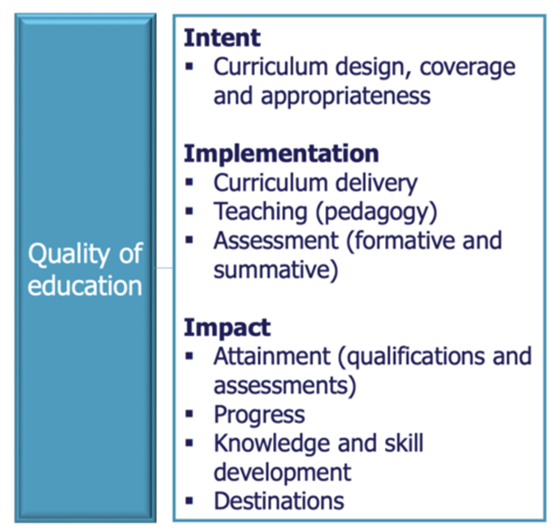

Slide 8
Main Focus
Curriculum intent, implementation and impact.
Intent – what underpins your curriculum – values, school context… as John Yates has been saying for years “why you teach what you teach….”
Implementation – overall curriculum framework, what you intend to teach, when and how.
Impact – progress being made by pupils, attainment
No expectations as to what form plans etc take as long as there is consistency

Slide 9
From the research…Quality Curriculum
Subject disciplines even within a topic based approach
Breadth and depth of content
Seeing the curriculum as the progression model
Clear purpose for assessment
Ongoing review and evaluation of curriculum design
Clear curriculum leadership and ownership
Considering local context and filling gaps from pupils’ background

Slide 10
Main question
Is the curriculum designed overtime to maximise the likelihood that children will remember and connect the steps they have been taught?

Slide 11
Broad and Balanced
Looking at the offer as a whole – not just timetabled lessons
Early reading (phonics) and maths at EYFS & KS1
Looking for a broad curriculum throughout the school, particularly at KS2
Looking for connections across the curriculum (subjects and time)
Focus is on pupils’ work across the curriculum – not on internal data

Slide 12
Reading
Focus on teaching of reading throughout the school
Focus on teaching phonics
Recognition of the impact limited vocabulary has on attainment
Looking at key groups eg. those who didn’t achieve phonics at Yr1, those who just missed expected at KS1

Slide 13
Assessment and Data
IDSR
Not interested in internal progress and attainment data
Conversations about assessment frequency and purpose
Discussion on quality assurance
Concern about over testing, impact on teacher work load

Slide 14
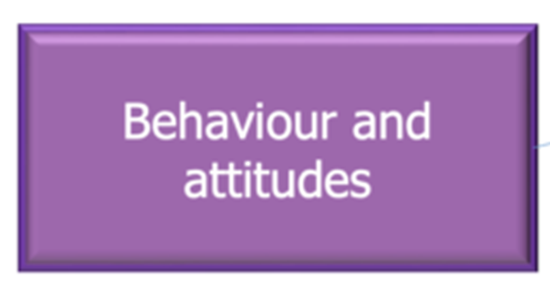
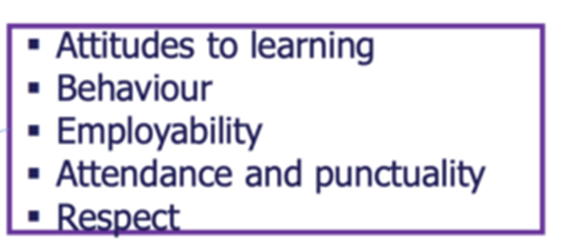

Slide 15

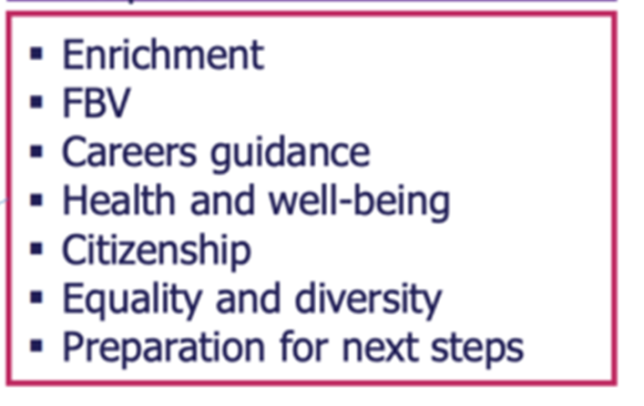

Slide 16


Slide 17
Leadership implications
Research on effective management – distributed leadership
Implications for the role of middle leaders/subject leads
SLT invited to observations but subject leads working with the inspector…
Ability of governors to talk about the curriculum
Lesson observations are core activity
Many discussions with leaders at all levels
Lots of discussions with pupils
Lots of looking at books

