Slide 1
SEND Briefing
Primary Partnership Meeting
Thursday, 14th March 2019 Annita Cornish - Head of SEN & Disability

Slide 2
Aims of the session
Share SEND vision, strategy and key strategic priorities
Sharing SEND SEF, the SEND reforms, where are we?
Preparing partners for the SEND inspection
Update HEP on SEND Service key contacts

Slide 3

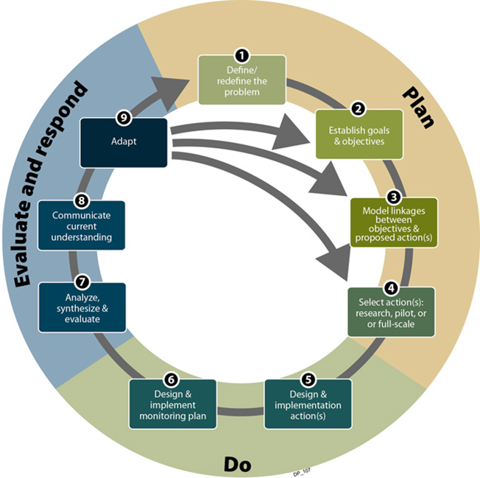
SEND implementation- where are we?
Securing a sharp Monitoring Evaluation and Review Cycle

Slide 4
KEY STRATEGIC PRIOROITES FOR SEND TO IMPROVE OUTCOMES FOR CYP
 | Strategic priority
1. | To place children who have SEND and their families at the heart of decision making about the education, social care and health provision needed to ensure successful preparation for adult life
2. | To secure effective arrangements for strategic co-production so that children and young people who have SEND and their parents and carers are fully consulted about and involved in the planning, delivery and monitoring of services
3. | To ensure that all children and young people who need it, will have smooth access to appropriate therapies services, wherever they are educated, from the ages of 0 to 25
4. | To ensure consistently timely identification and assessment of children and young people who have autism, attention deficit and other neurodevelopmental difficulties so their needs are met early, leading to improved outcomes
5. | To secure effective transition and meet the needs of young people with SEND from the ages of 16 to 25, ensuring that young people are routinely able to access to full-time provision and the health and care services required to make good progress and prepare successfully for adulthood
6. | To ensure professionals across the local area consistently benefit from the two-way communication, training and support needed to play an effective role in implementing the SEND reforms
7. | To maximise the use of funding and resources to secure suitable education, health and care provision that meets needs and leads to improved outcomes for 0 to 25 year olds
8. | To ensure that children and young people who have SEND and their families have routine access to the high-quality information advice and guidance needed to ensure they are well informed and receive the help they need to participate fully in decision making to secure effective provision

Slide 5
What you will find…strengths
Outcomes
Children and young people in Hounslow with SEND achieve well and make good progress at most points of assessment compared to their peers in London and nationally

Slide 6
What you will find…strengths
Joint working between Council and CCG
Designated Clinical Officer for SEND strong links to local and National Networks
Good governance through Children's Delivery Group

Slide 7
What you will find…strengths
Highly valued services
Portage service highly valued by parents
Good schools across the borough
SEN/ D provision- all 5 special schools good or outstanding by OfSTED
Intensive Behaviour Support (BICS) positive outcomes for CYP with challenging behaviour
Effective use of data MIT/ SEND team

Slide 8
What you will find…developments
EHC assessment pathway
Co-production/ person centred planning/ timeliness
Revised workflow and EHC process
Improved advice forms with person centred approaches
Rapid Improvement Project

Slide 9
What you will find…developments
EHC assessment pathway
Co-production/ person centred planning/ timeliness
Revised workflow and EHC process
Improved advice forms with person centred approaches
Rapid Improvement Project

Slide 10
What you will find…developments
Joint commissioning of health/ care services on EHC plans
New children and young people’s panel to launch April 2019
SEN placement demand programme
Training to social care and health colleagues
Process for ‘social care’ assessment for all referrals

Slide 11
What you will find…developments
Therapy provision
Patchy service 0-25 which is confusing
Jointly commissioned single provider by 2019/ 20
Co-produced specification

Slide 12
HOW DOES IT WORK?
The Call
DCS called on Monday confirming the inspection the following week
How Long?
1 week ‘Local Area’ Inspection
The Inspection Team
OFSTED & CQC
What will it look at?
How well is Local Area implementing SEND duties in the Children & Families Act 2014
Focus on 3 key aspects:
The effectiveness of the arrangements for:
- Identification of children & young people who have SEND
- Assessing & meeting the needs of children & young people who have SEND
- Improving outcomes for children and young people who have SEND

Slide 13
THE INSPECTION WEEK
Inspection fieldwork - Discussions with:
Elected member
key local area officers from health, education and social care
meetings with leaders of early years settings, schools, colleges, and specialist services.
Visits to settings and services: - Focusing on:
their understanding of and participation in meeting the areas’ responsibility
Their impact on improving outcomes for CYP
Review a sample of children and young people's files to inform inspection findings
Views of Service users – Strong emphasis on gathering the views of young people, and parents and carers, involving:
meetings during visits to early years settings, schools and colleges
meeting with established parent and carer groups
meeting with any reference groups established in the local area
a webinar for parents and carers during the inspection

Slide 14
HOW WILL INSPECTORS REPORT THE FINDINGS?
At the end of the inspection, the inspection team will evaluate all the evidence gathered
Ofsted and the CQC will write a joint inspection outcome letter. The letter will explain the main findings and make recommendations for improvement
It will also highlight any strengths that inspectors identify to help other services and areas develop and improve
These letters will be published on the Ofsted website and on the CQC website

Slide 15
Visits to providers, services and stakeholders
Inspectors will visit education providers to:
Gather views of children, YP and parents
Sample student files or other sources of information
Discuss with staff, leaders and managers contribution to and understanding of local area’s evaluation (p13 Inspection Handbook)
parents and children who inspectors could speak to

Slide 16
Focus groups
These will be chosen by inspectors and can cover any aspect of SEND
Learning from the experience of others and thinking about the Hounslow context these are the suggested focus groups:
SEND strategy/ SEF
Early years
EHC assessment
Assessment and meeting needs
CAMHS
CDT
Joint commissioning
CLA/ health
Universal nursing services
0-25 disability team/ short breaks
Therapies
Preparing for Adulthood
Independent advice and support
Evidence and impact outcomes
Early identification
Can you help?

Slide 17
SEND Demand: some of the data
Increase in special school places
65 from 520 in 2017/18 to 585 in 2018/19
additional 11 fte places as in-year growth resulting in of 591 fte places.
LBH special schools been occupied by 581 fte pupils or an occupancy rate of 98.3%.

Slide 18

EHCPs
88% since 2012
19% in 12 months
54% for post 16s in 12 months

Slide 19
SEND Service contacts
Head of SEN and Disability: Annita Cornish
Team | Function | Team Manager
EY SEN | SEN support to PVIs | Anne Doran Anne.doran@Hounslow.gov.uk
0-25 Disability Team | Social work team for CYP0-25 with disabilities | Mandy O’Donoghue Mandy.odonoghue@Hounslow.gov.uk
SEN Assessment Team | EHC assessment pathway | Sandra Morrison Sandra.morrison@Hounslow.gov.uk
EPS | Educational psychology service | Helen Booth Helen.booth@Hounslow.gov.uk
Placement and Monitoreing | AP Post 16 commissioning Monitoring of placements FAP | Cherisse Macsorely Cherisse.macsorely@Hounslow.gov.uk

Slide 20


Close
Thank you for listening.

