Slide 1
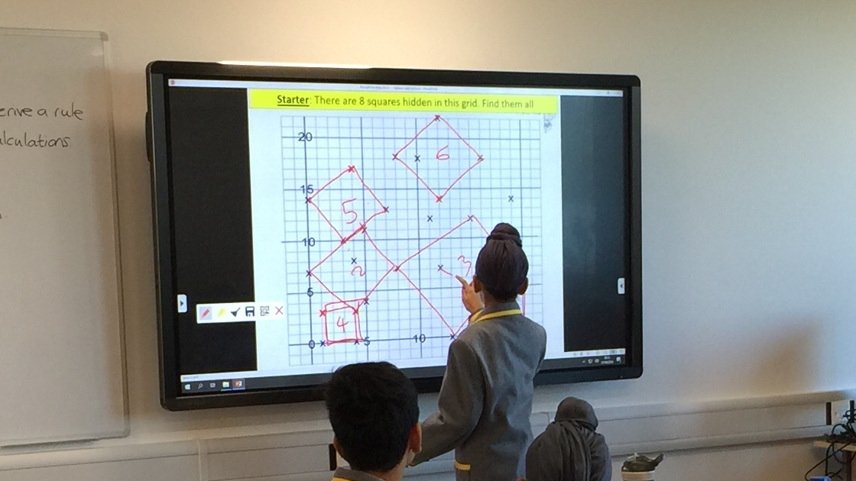
Hounslow Headteachers' Conference 2019
Planning a subject's curriculum

Slide 2
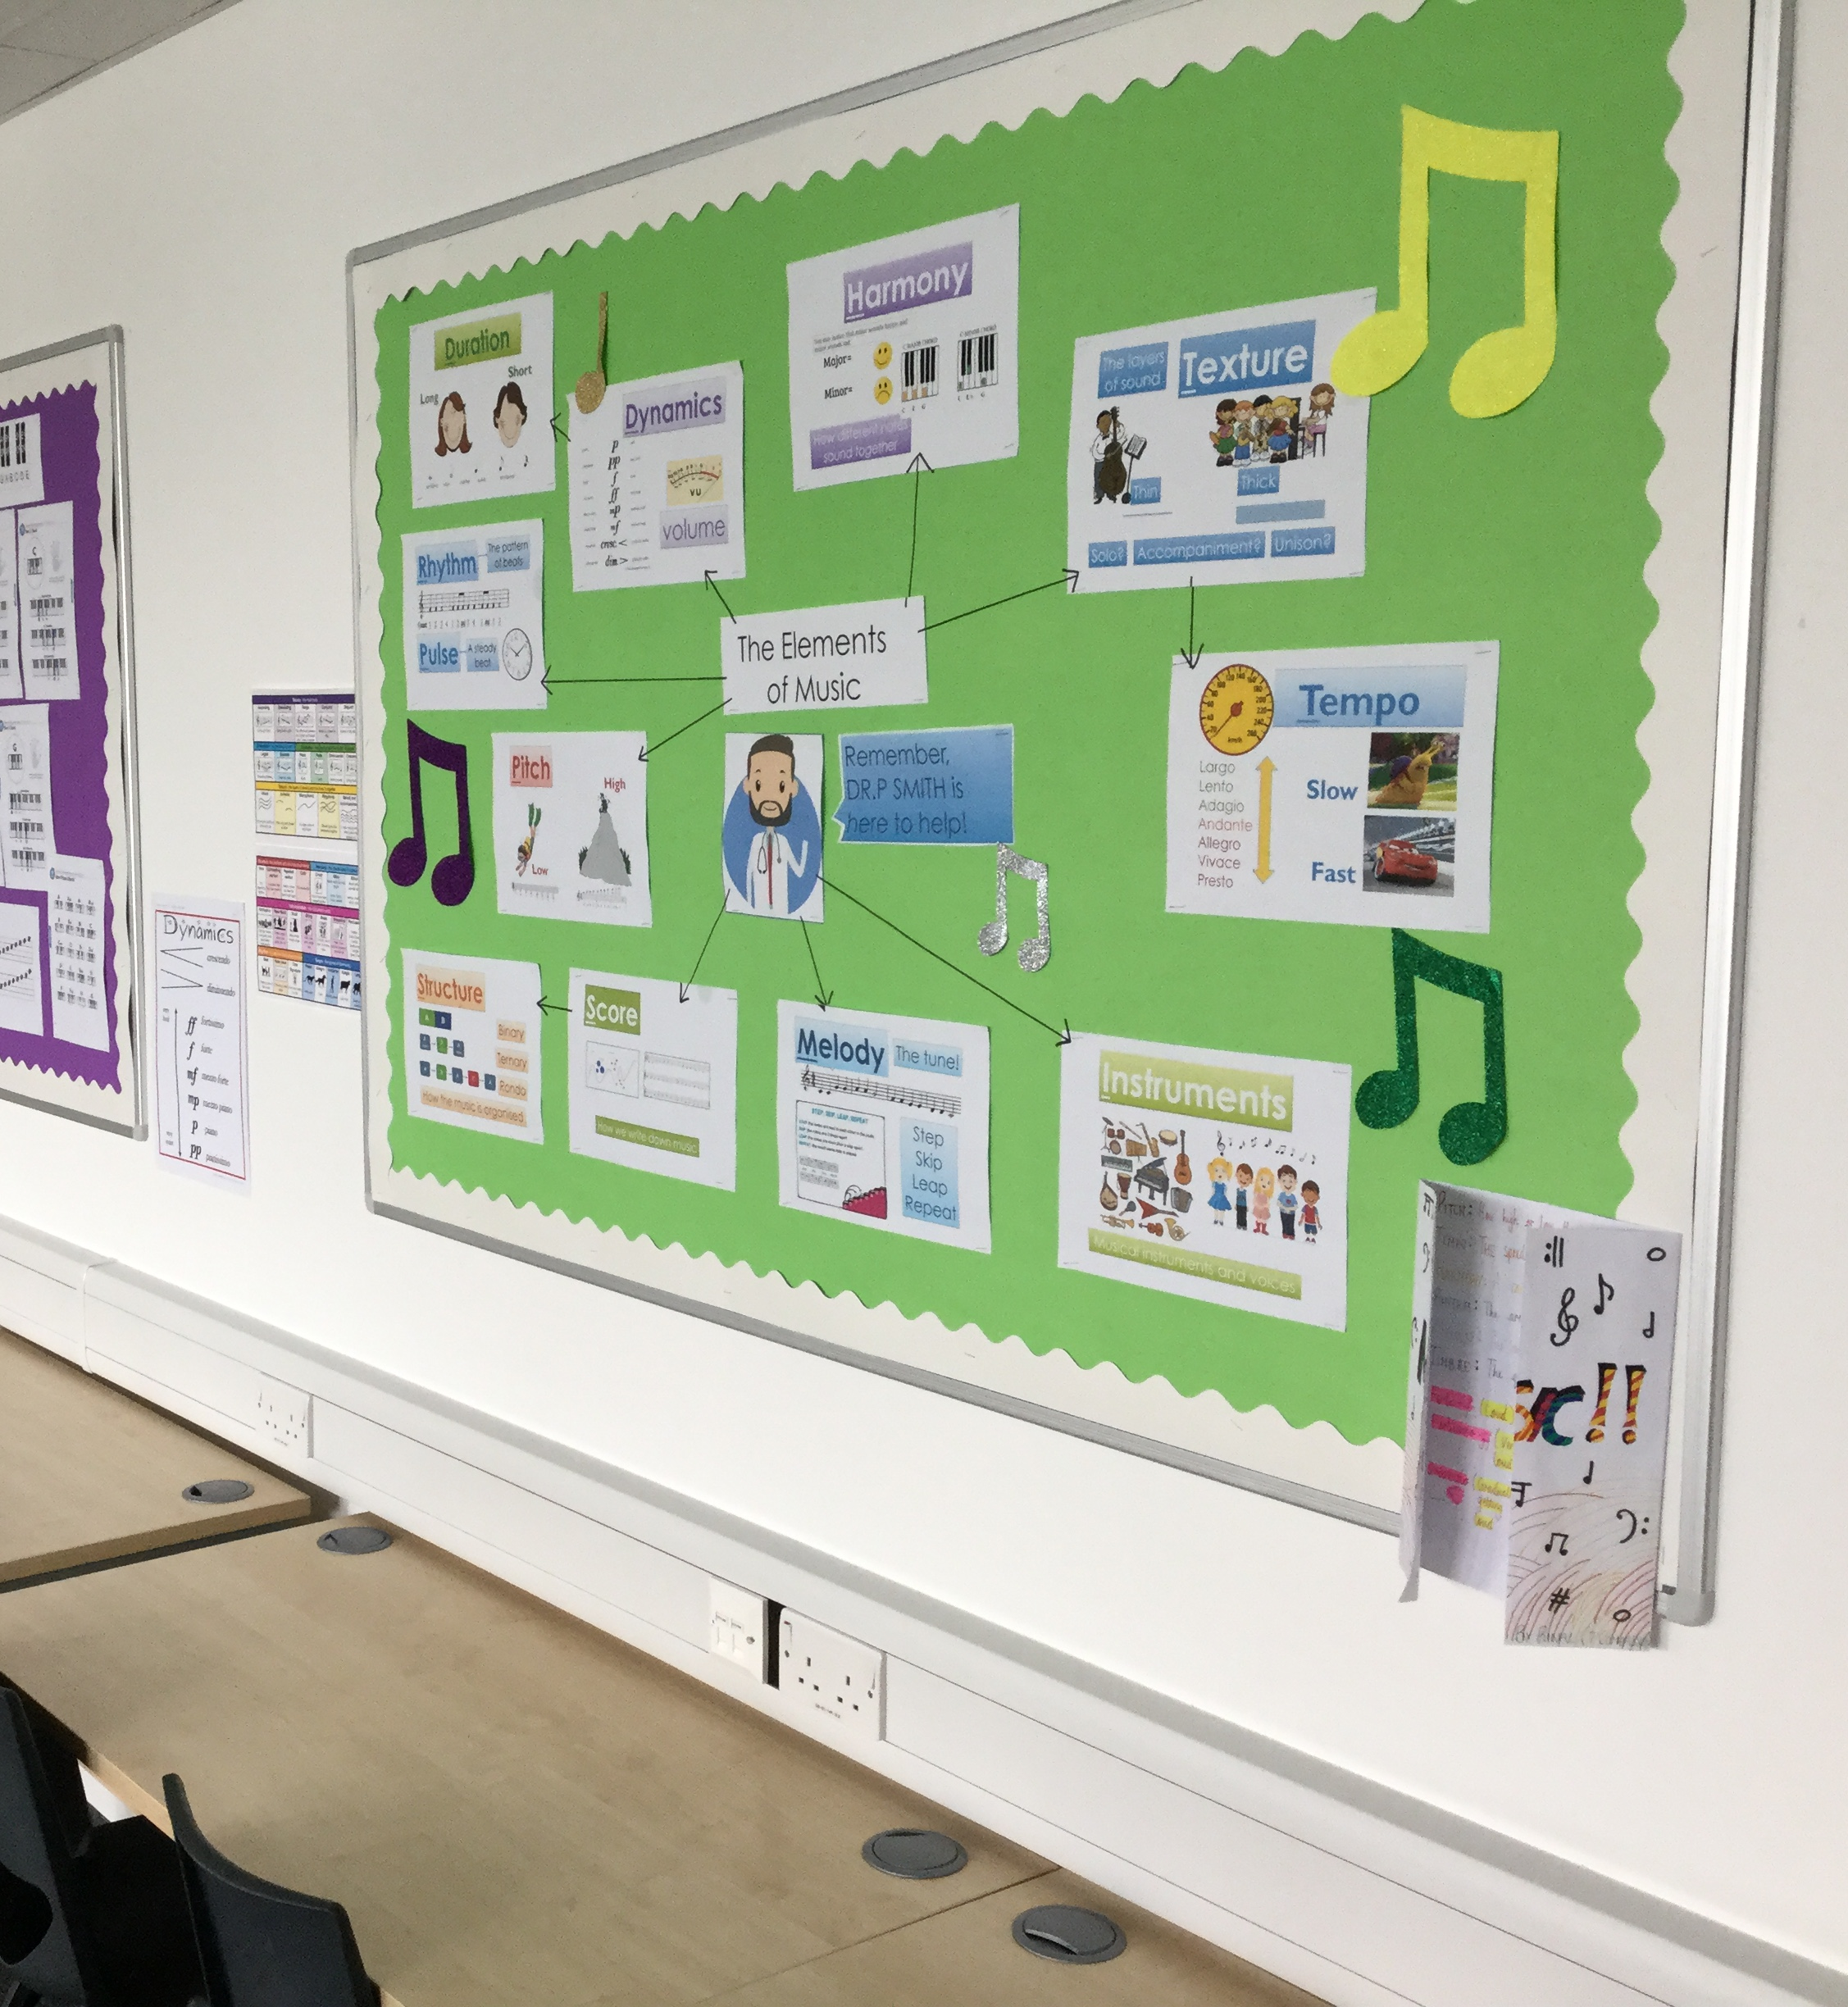
Session Aim
To provide a blueprint for planning long-term success in any curriculum area

Slide 3
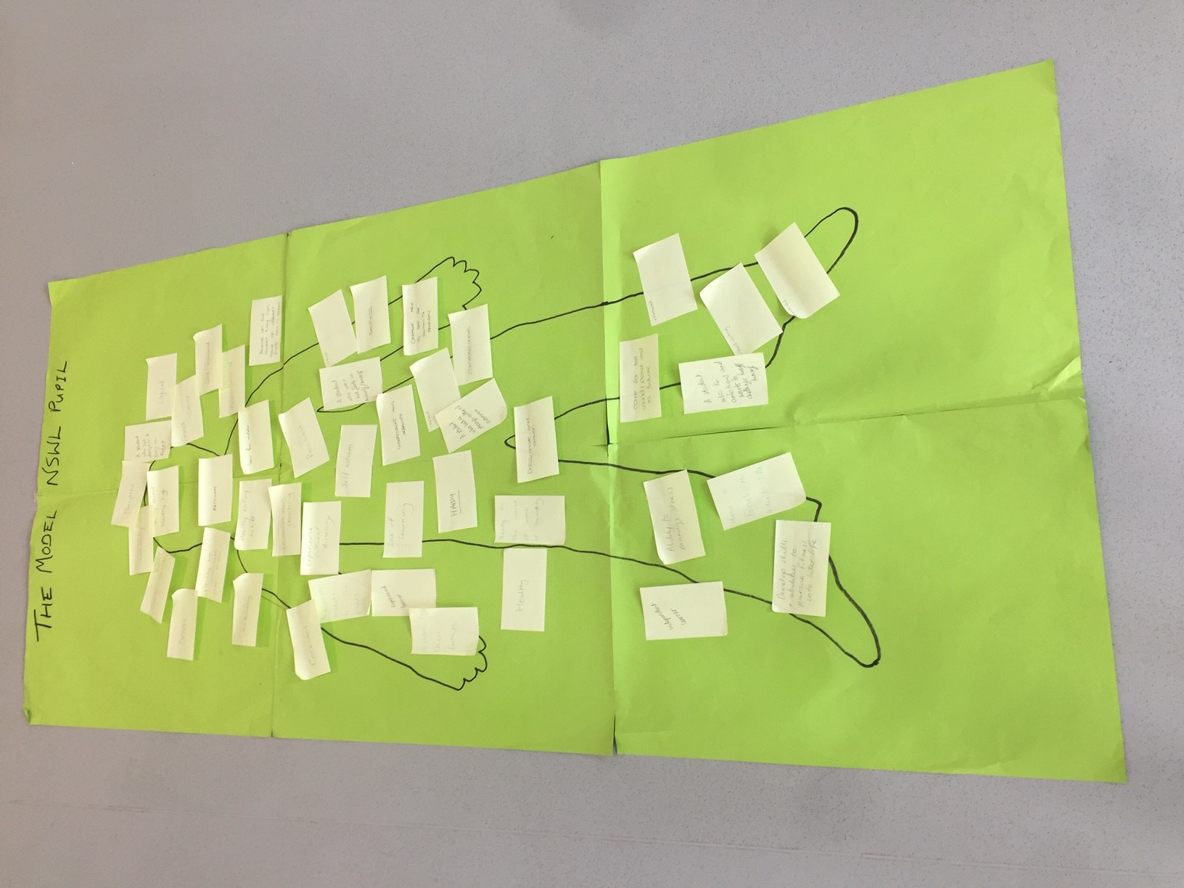
Curriculum intent
What do we want our learners to look like?
What are our USPs?
What is our vision?
Questions for curriculum 'architects'

Slide 4

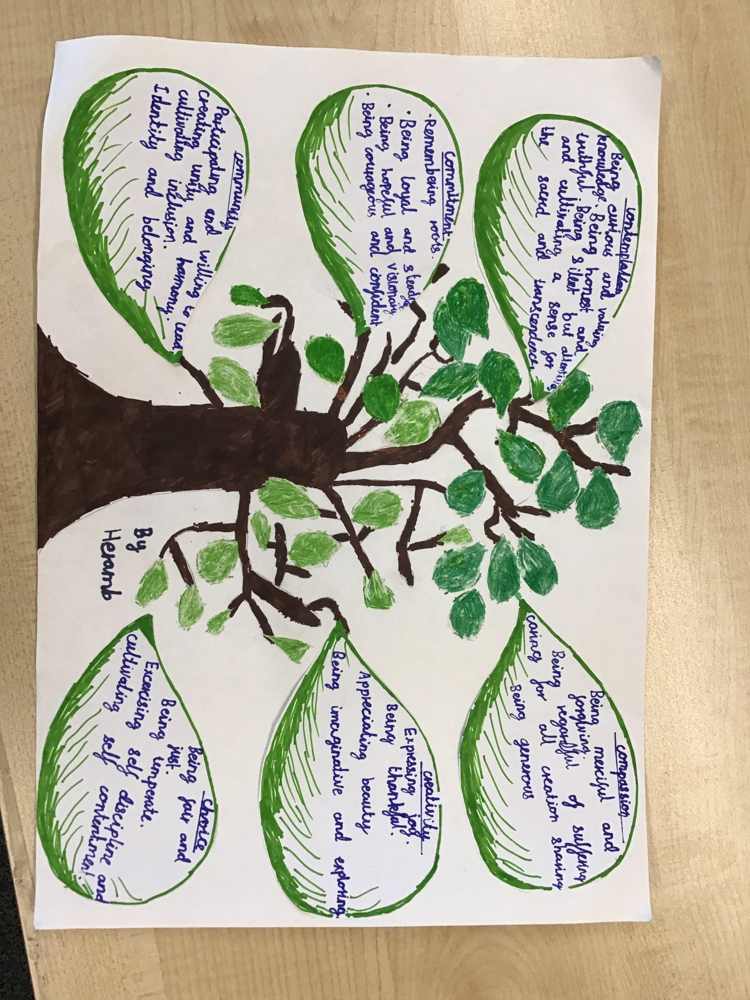
Curriculum implementation
Research task
Curriculum overviews
Schemes of Learning

Slide 5
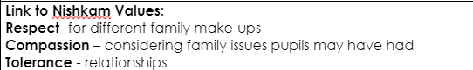
Curriculum implementation – Schemes of Learning

Slide 6
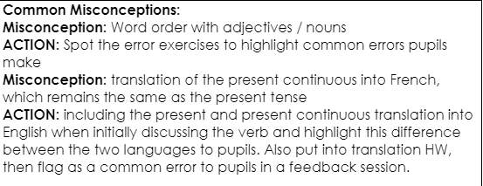
Curriculum implementation – Schemes of Learning

Slide 7

Curriculum implementation – Schemes of Learning

Slide 8
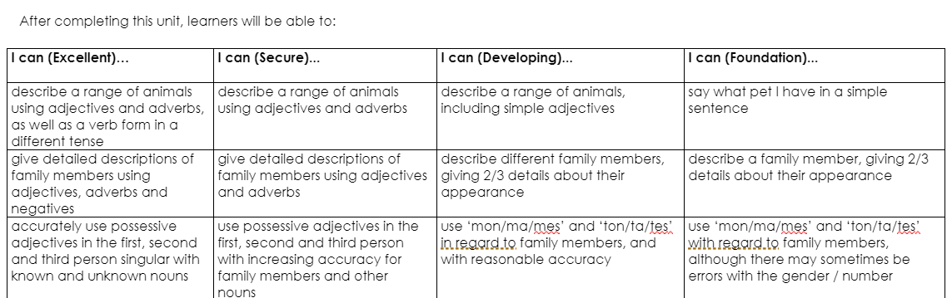
Curriculum implementation – Schemes of Learning
Plan back from excellence

Slide 9
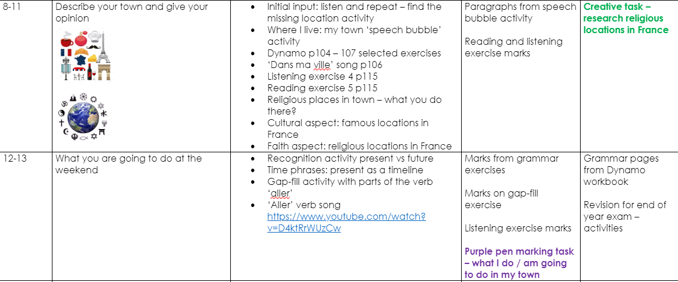
Curriculum implementation – Schemes of Learning
Creative homework task
Cultural aspect
Faith aspect
Purple pen task

Slide 10


Slide 11
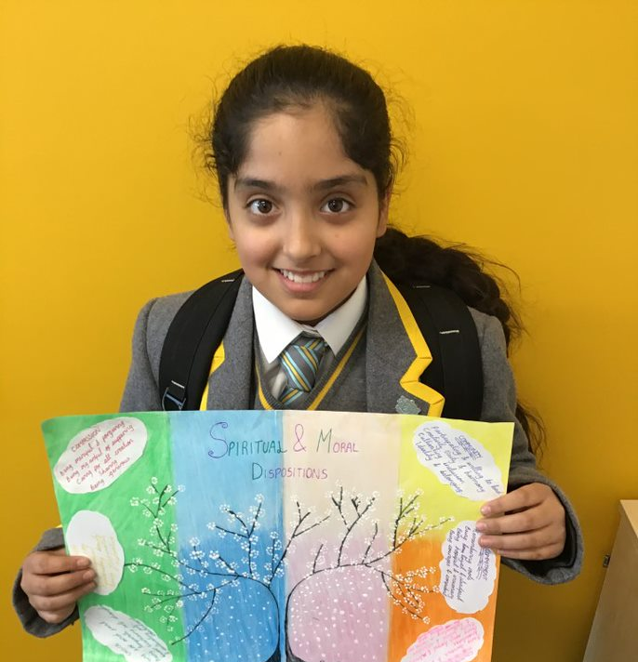
Curriculum implementation - Delivery
Engagement & inspiration
Excellence
Relevance
Every child can and will achieve

Slide 12

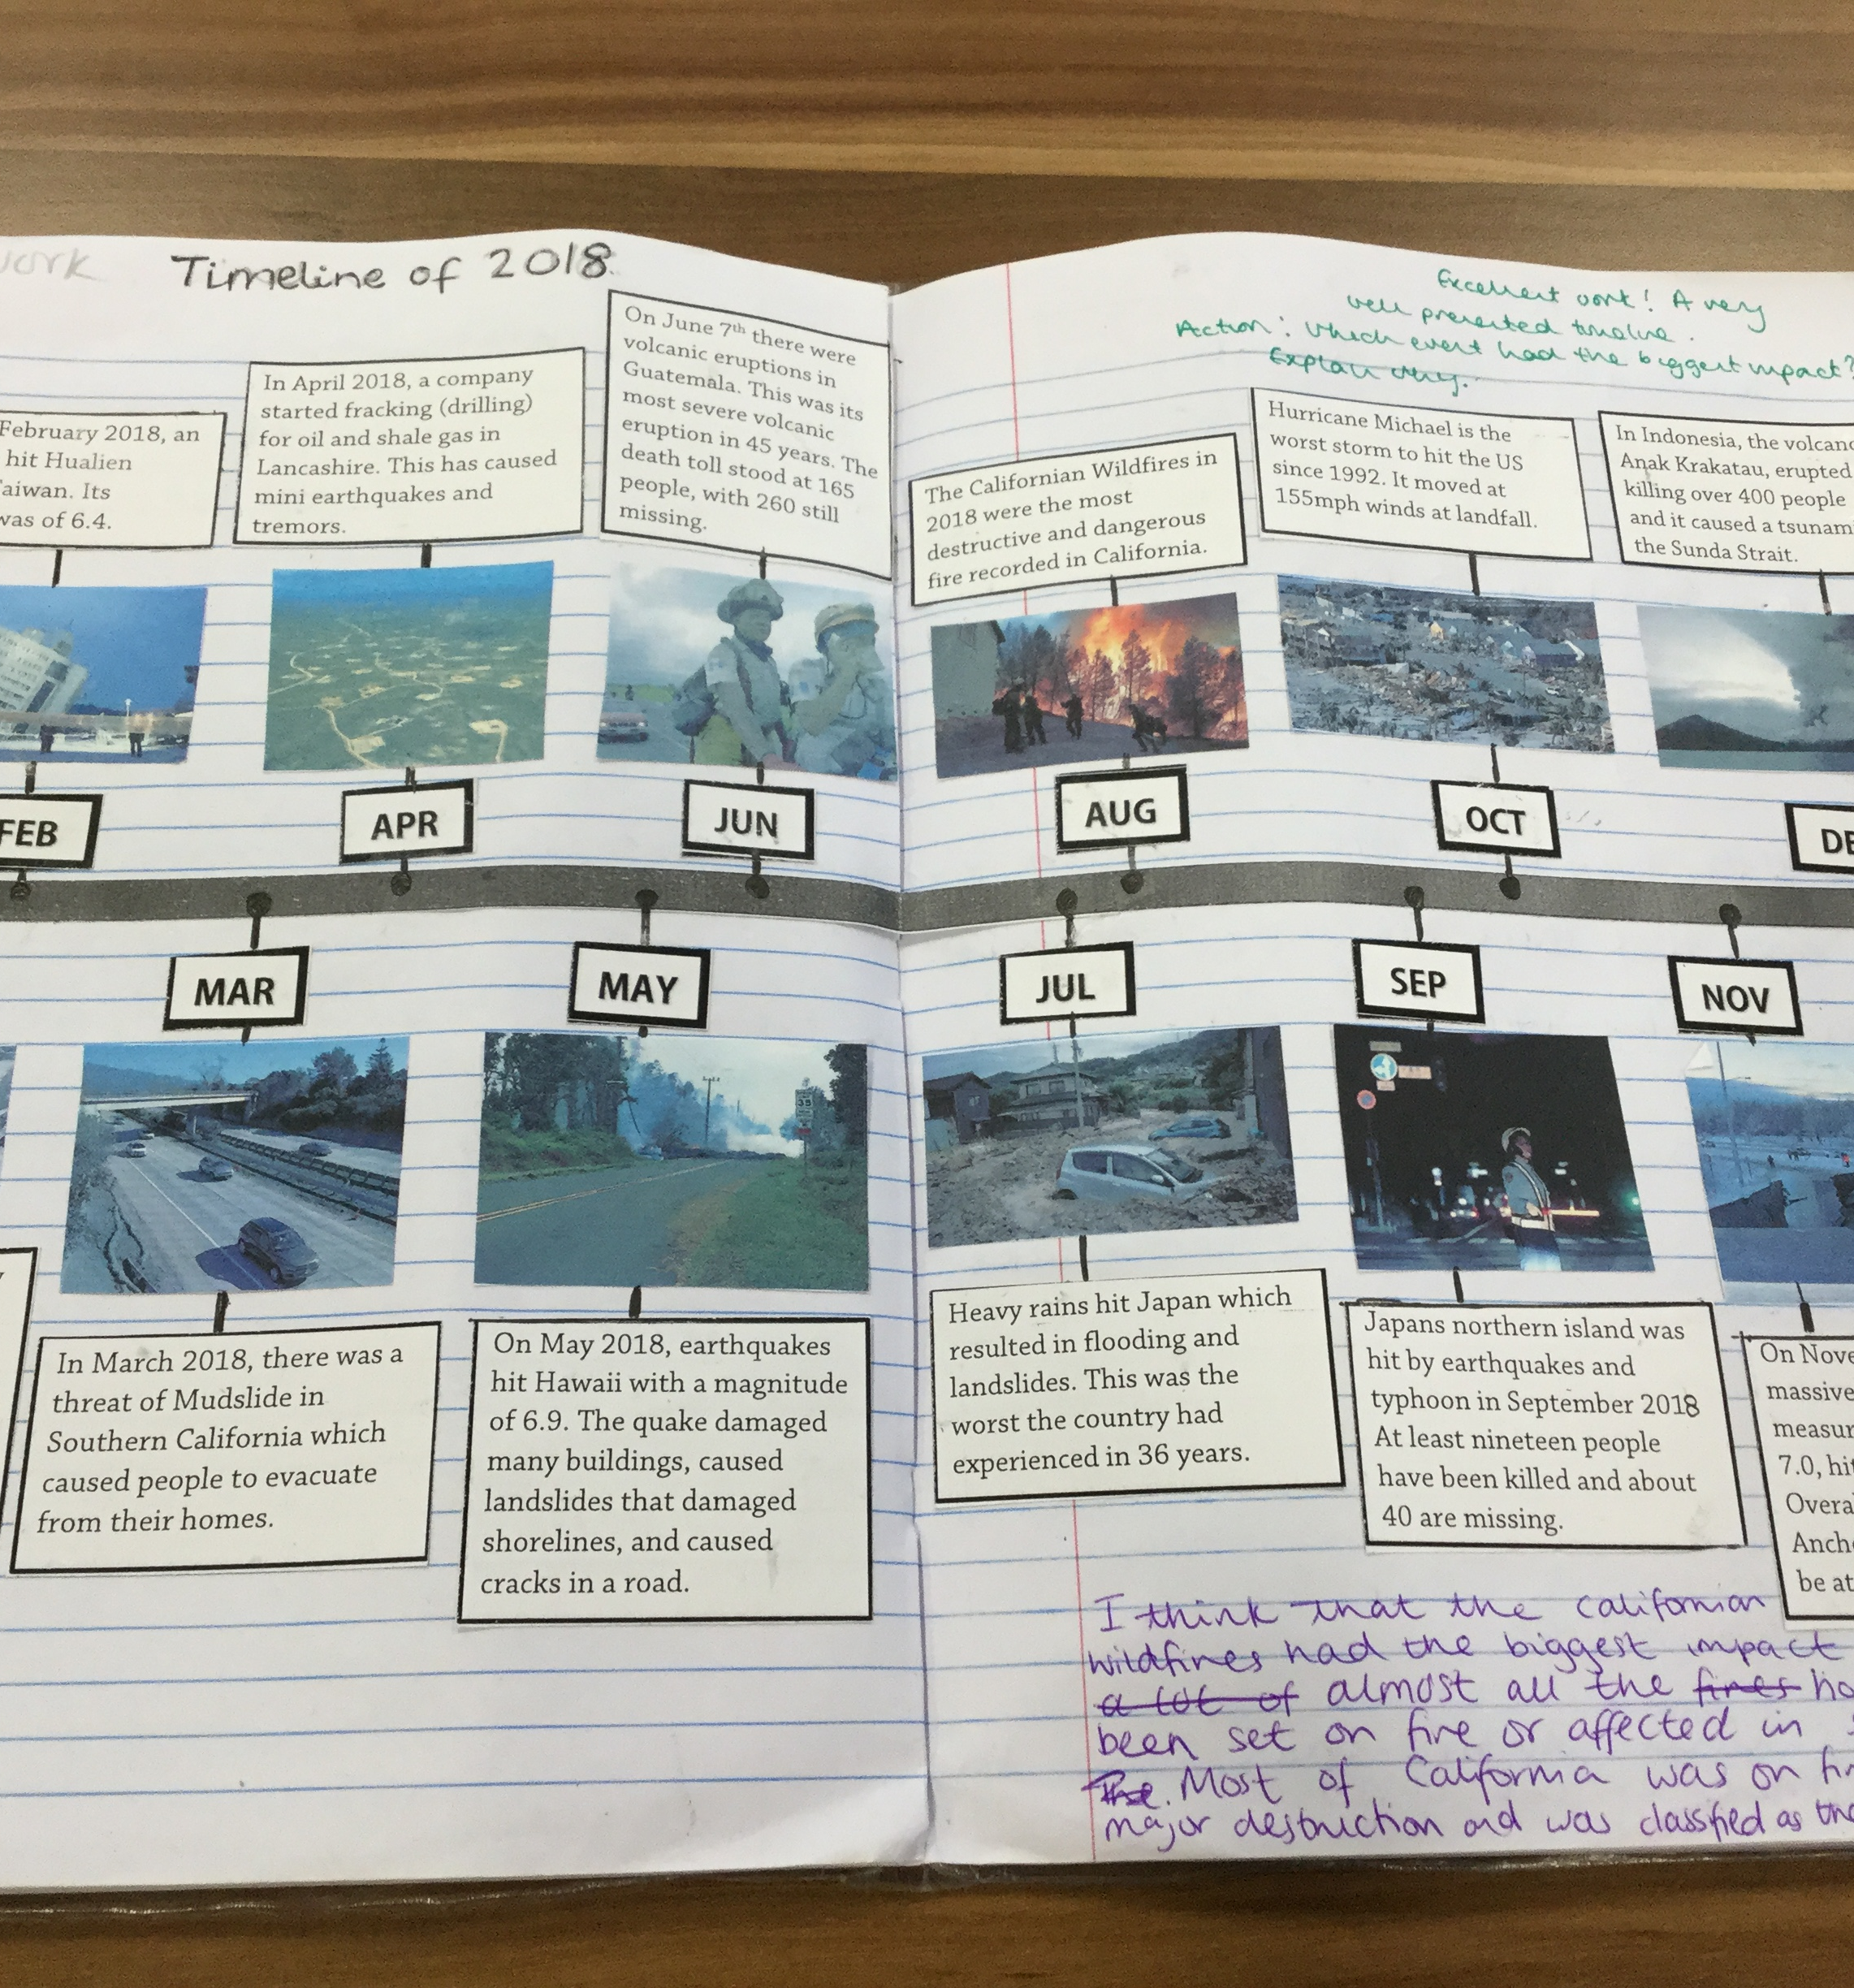
Curriculum impact
Quality assurance of assessments
Moderation across two schools
Marking and feedback

Slide 13
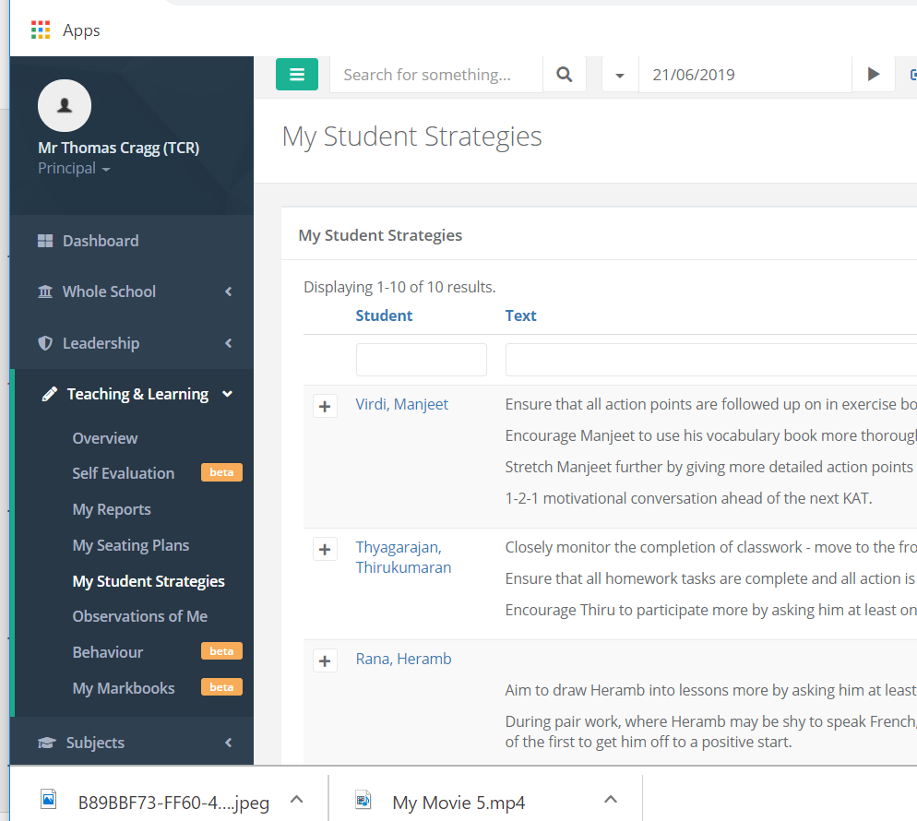
Curriculum Impact - Intervention
Pupil progress meetings
'My Student Strategies' on PAM

