Slide 1
Back On
TRACK

Slide 2
Why have you been moved site?

Slide 3
Our service expectations
Be ready to learn
Find an adult to talk to if you are feeling unsettled
Attend every day and be in the right place at the right time
Wear the right clothing for learning
Put in 100% effort

Slide 4
Our service expectations
Be respectful
Use kind words
Listen to others
Breathe in deeply at least once before you speak to someone
Look after property and the school building
Keep to social distancing where you can

Slide 5
Our service expectations
Be safe
Find an adult to talk to if you feel uncomfortable or unsafe about anything in school, out of school or online
Breathe in and out deeply three times if you feel yourself getting upset or angry
Keep your hands, feet and unkind words to yourself
Walk around the building calmly
Eat & drink in the right places

Slide 6
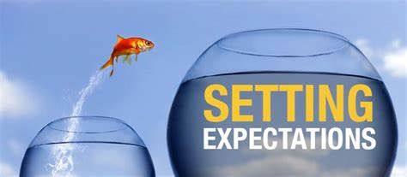
Our service expectations
Let's go back over each expectation and work out together which ones you are achieving and which ones you need help with.

Slide 7
Our service expectations
Be ready to learn
Find an adult to talk to if you are feeling unsettled
Attend every day and be in the right place at the right time
Wear the right clothing for learning
Put in 100% effort

Slide 8
Our service expectations
Be respectful
Use kind words
Listen to others
Breathe in deeply at least once before you speak to someone
Look after property and the school building
Keep to social distancing where you can

Slide 9
Our service expectations
Be safe
Find an adult to talk to if you feel uncomfortable or unsafe about anything in school, out of school or online
Breathe in and out deeply three times if you feel yourself getting upset or angry
Keep your hands, feet and unkind words to yourself
Walk around the building calmly
Eat & drink in the right places

Slide 10
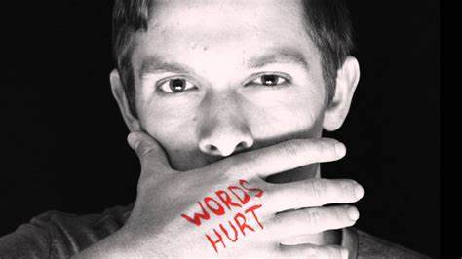
What exactly have you been doing that has upset others?
In the Back-on-Track booklet – complete the first two pages:
What have you done?
Who has been affected?
How have they been affected?
How did what you did, make these people feel?

Slide 11
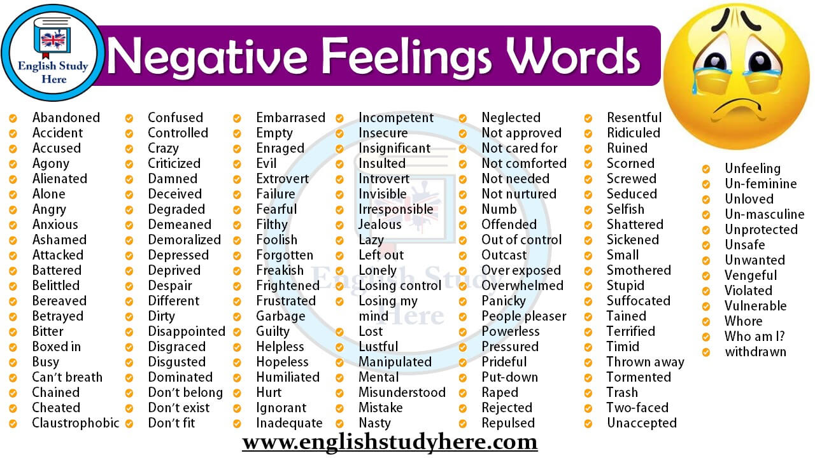
How could others been feeling because of your actions?

Slide 12
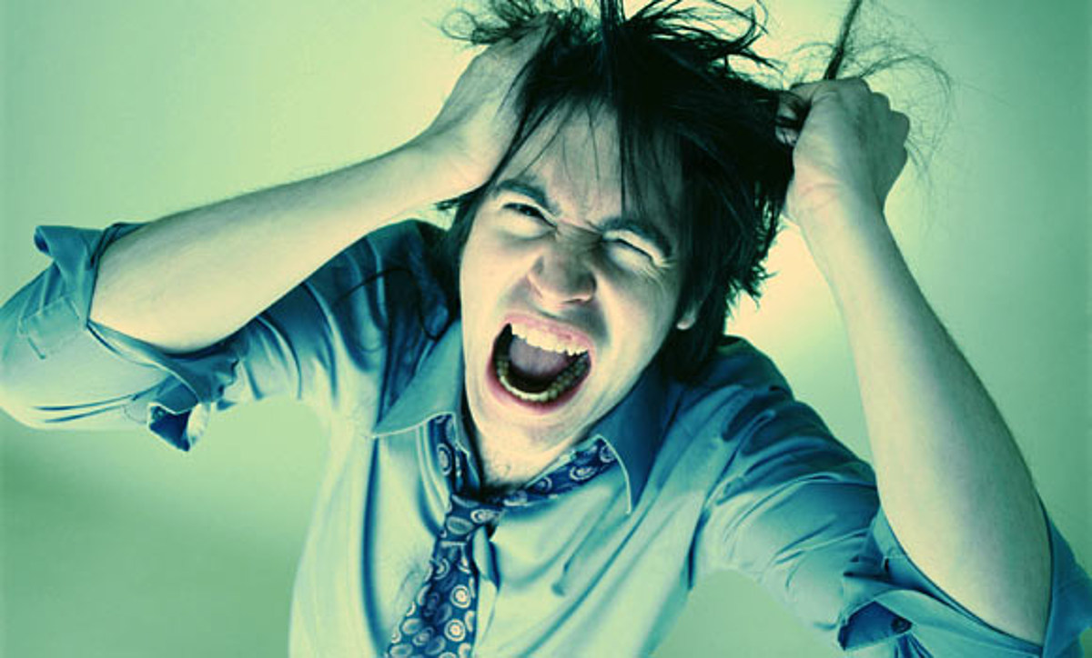
How to deal with anger that comes from inside

Slide 13
How to deal with anger that comes from inside

Slide 14
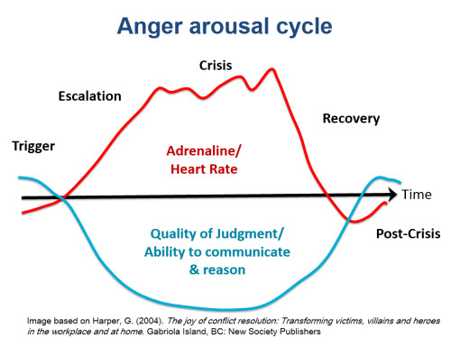
How to deal with anger that comes from inside
Most of the time people are never really angry at what is in front of them – the anger comes from inside and bursts out when something triggers it

Slide 15
When do you really lose control?

Slide 16
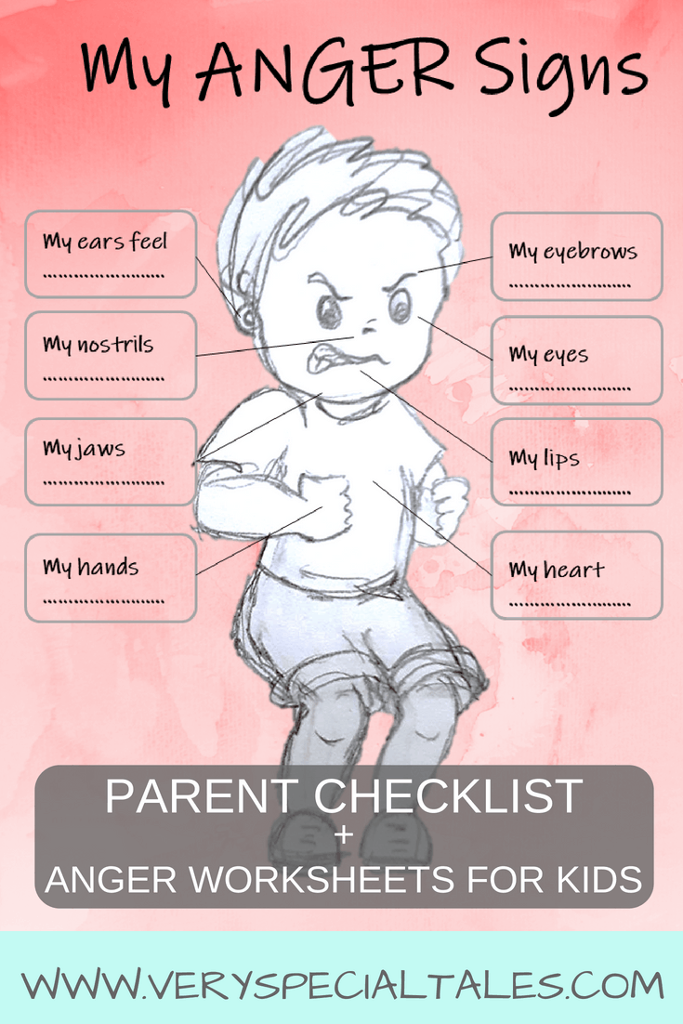
What do you notice in your body when you start to get angry?
Can you feel the rage inside building up?
Or do you suddenly flip without warning?

Slide 17
What helps you calm down?
When you are starting to get annoyed / angry – what can you do to calm yourself down again?

Slide 18
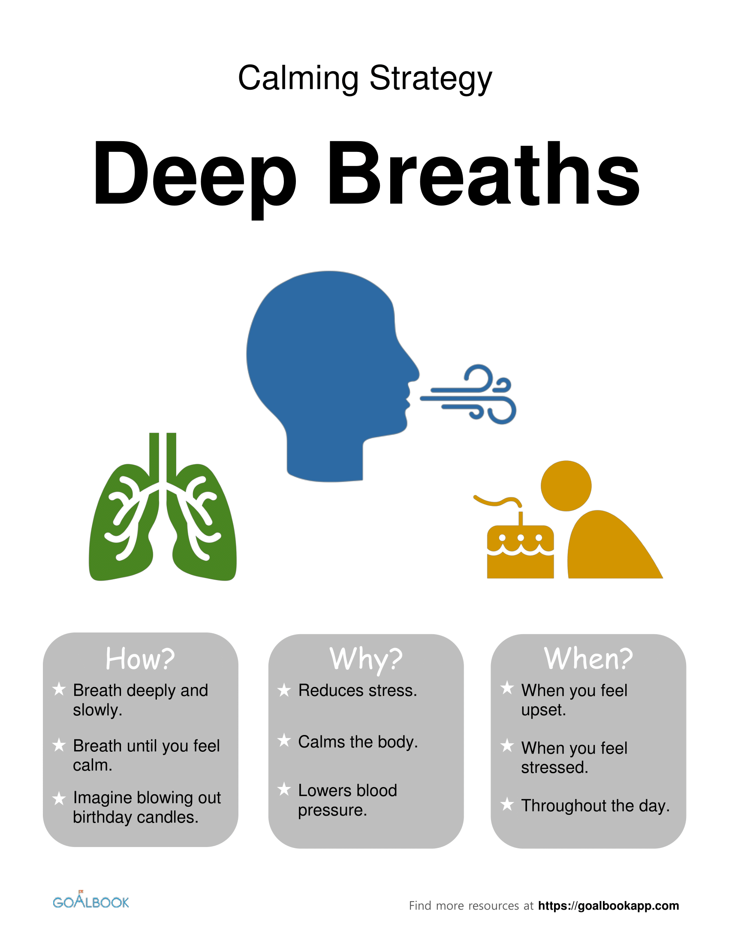
Calming strategies

Slide 19
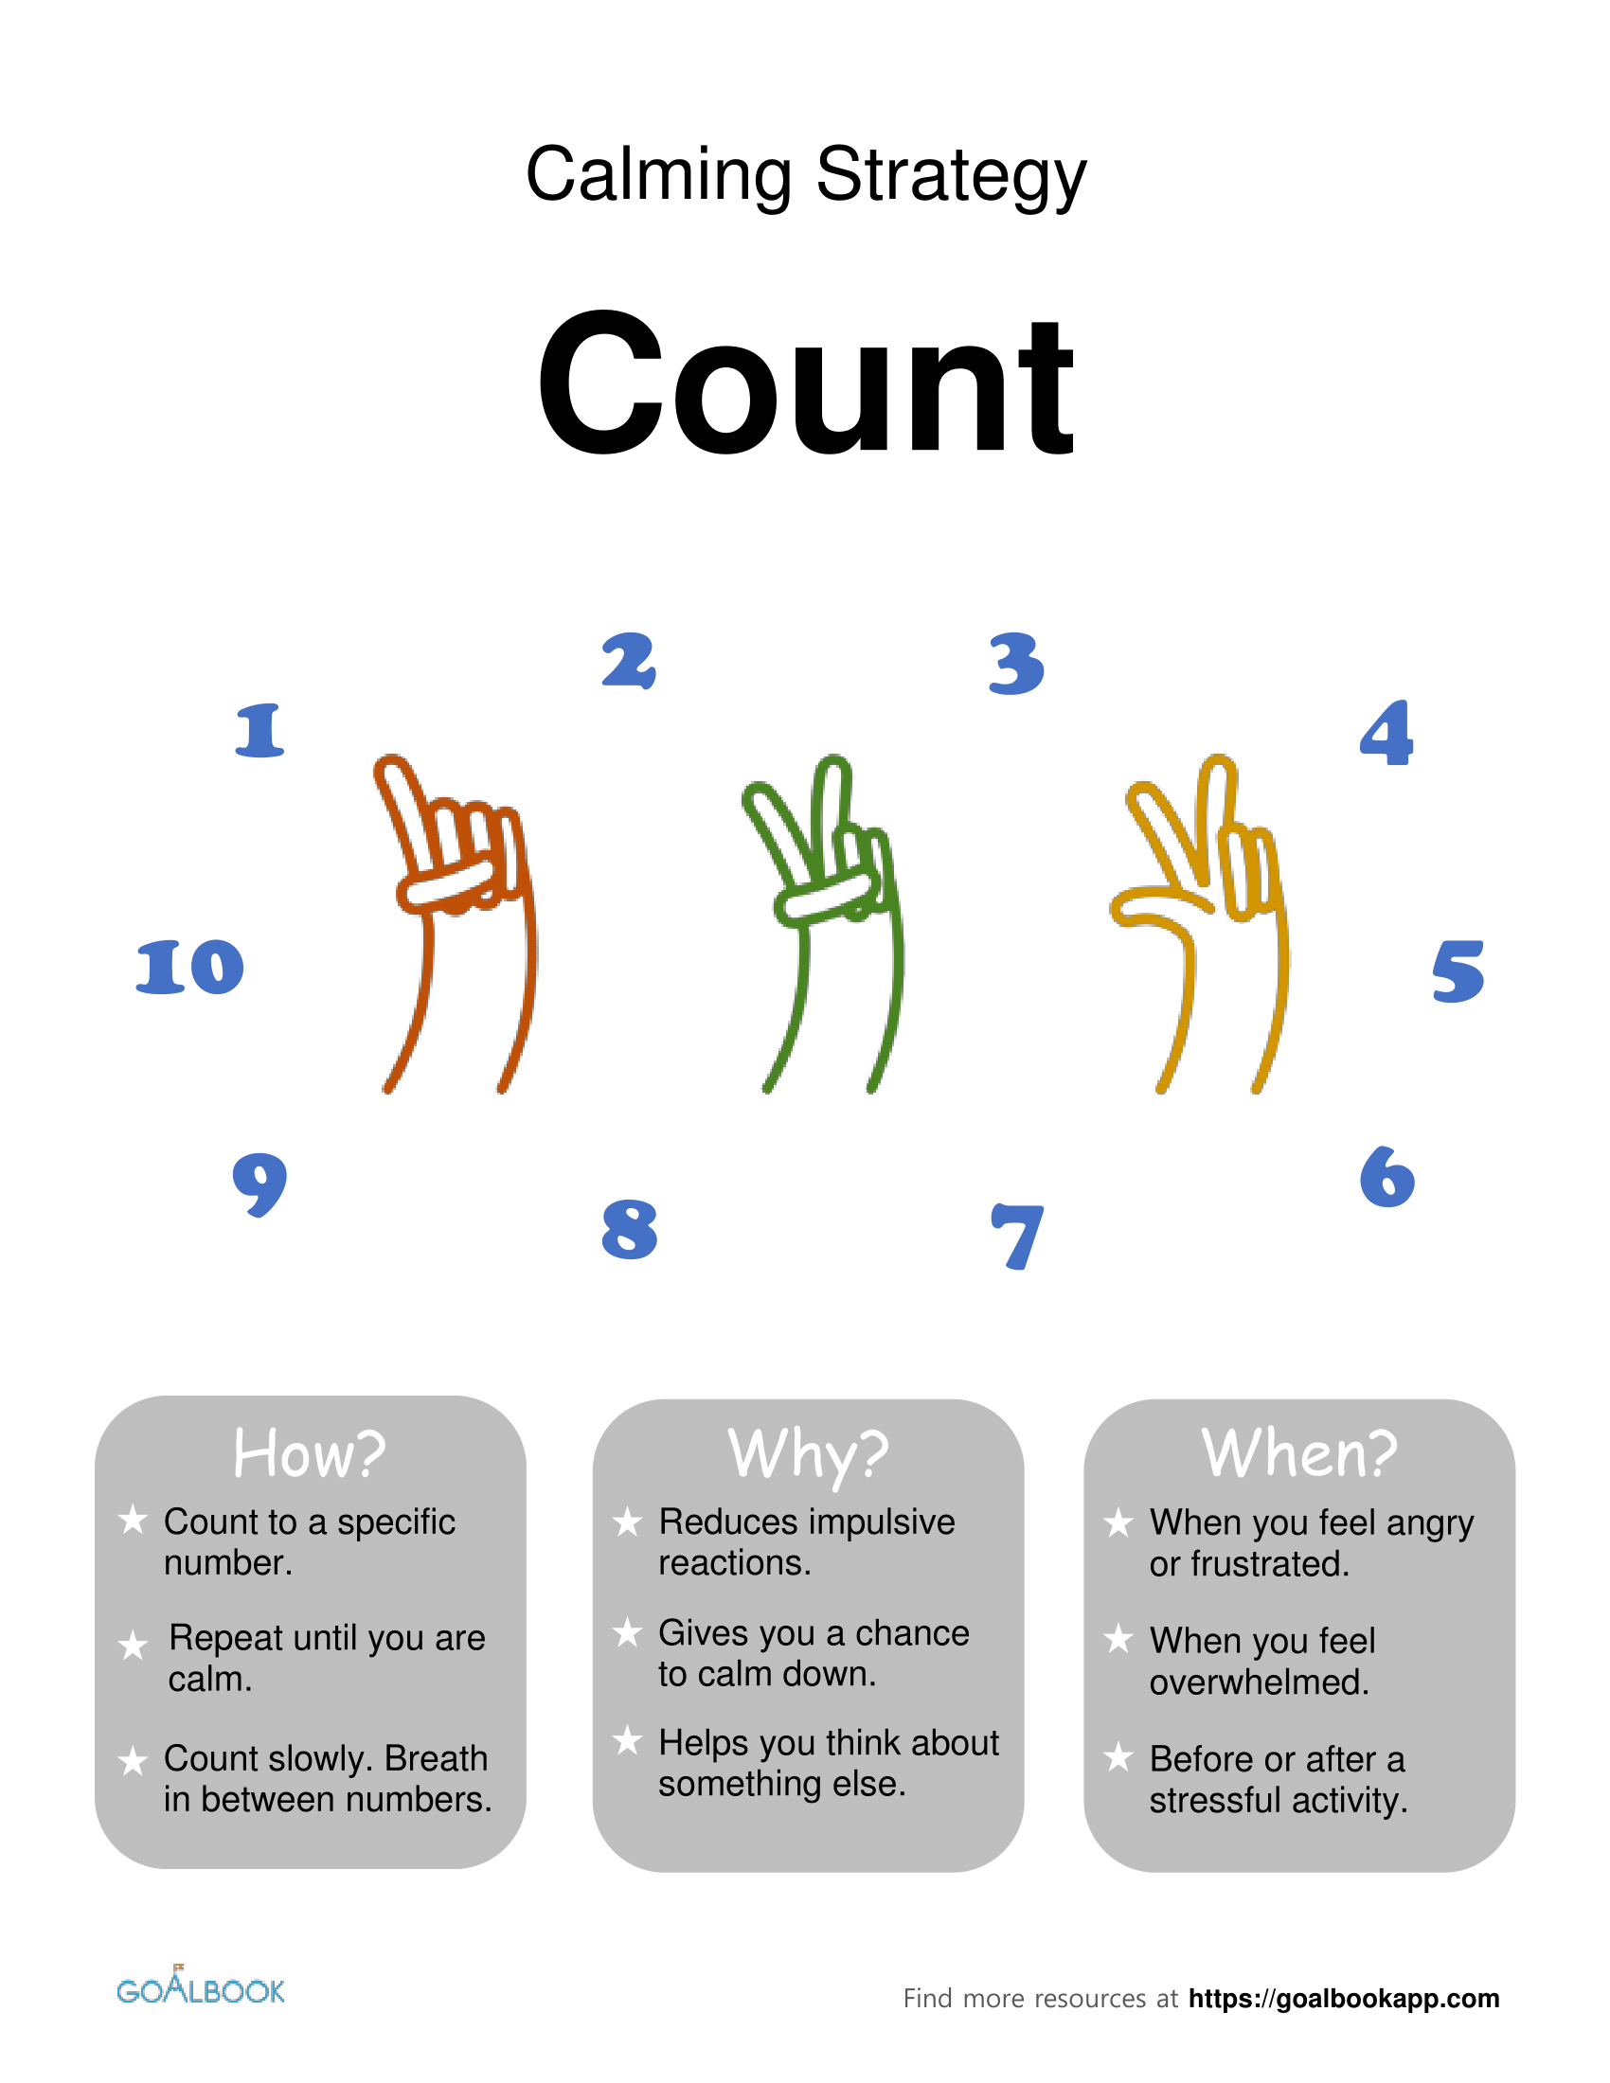
Calming strategies

Slide 20
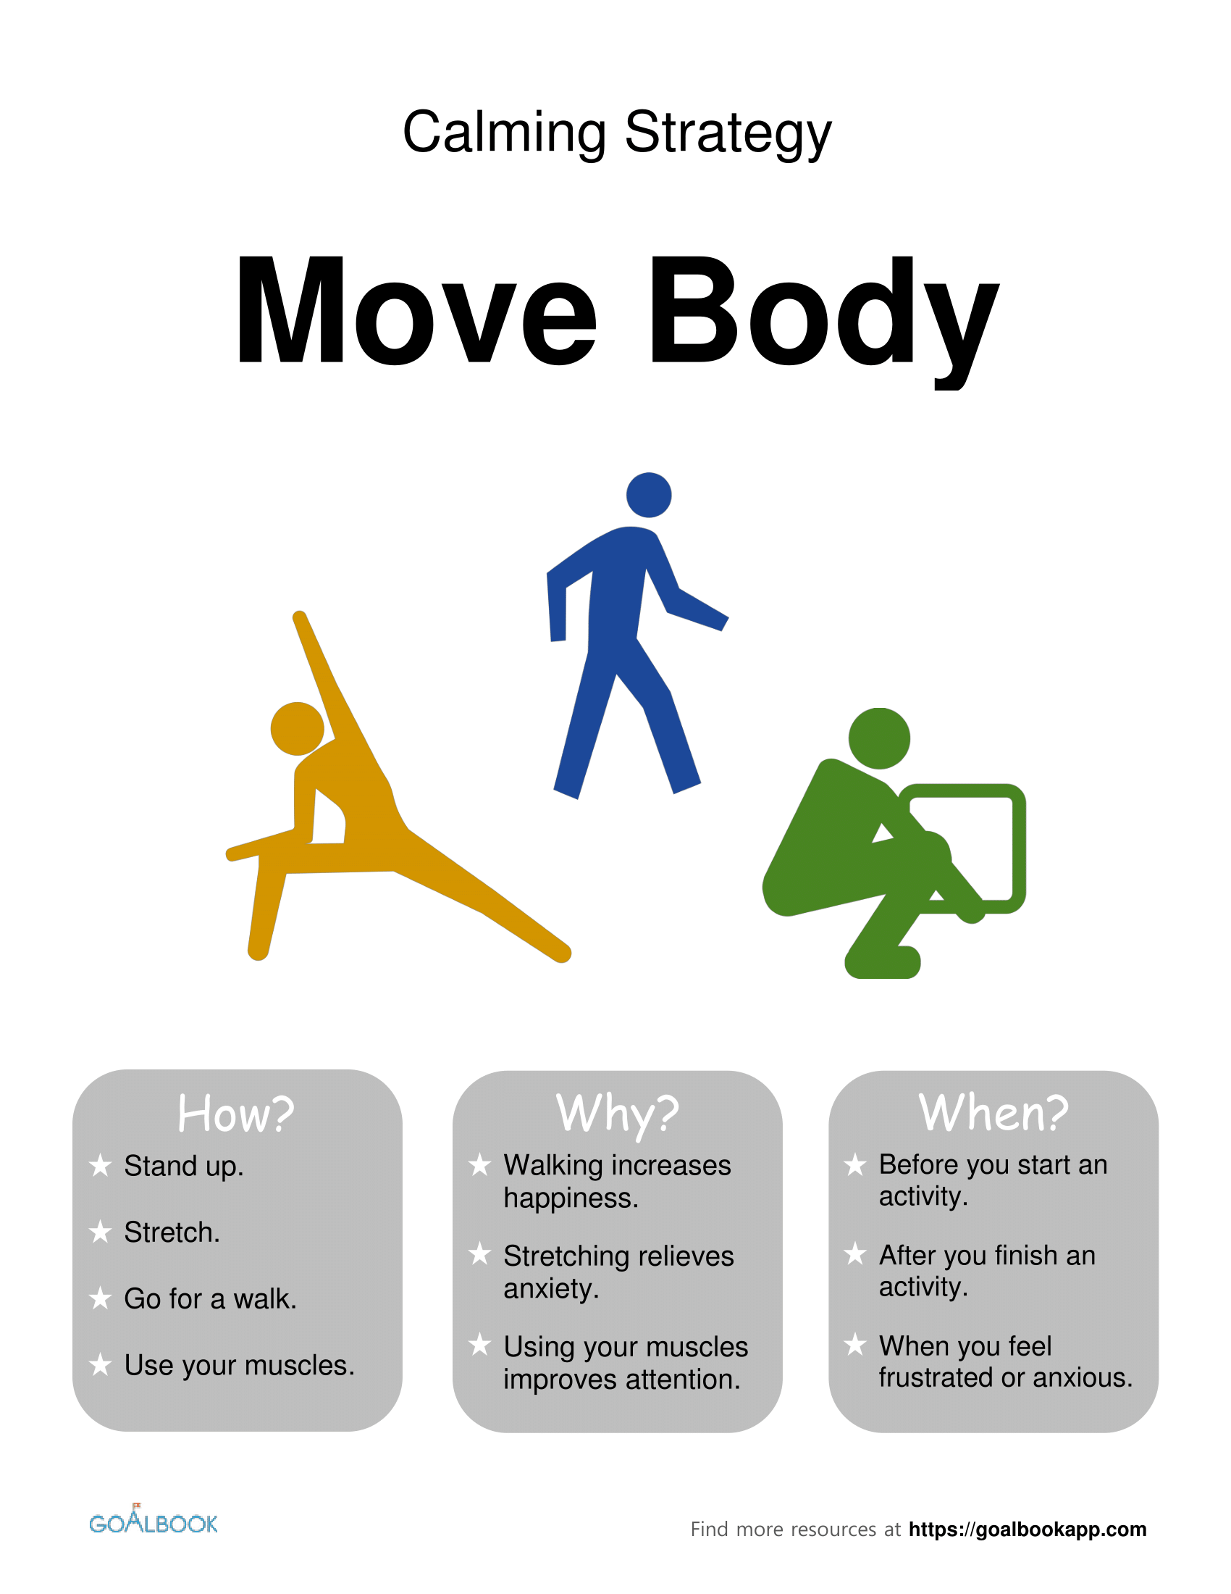
Calming strategies

Slide 21
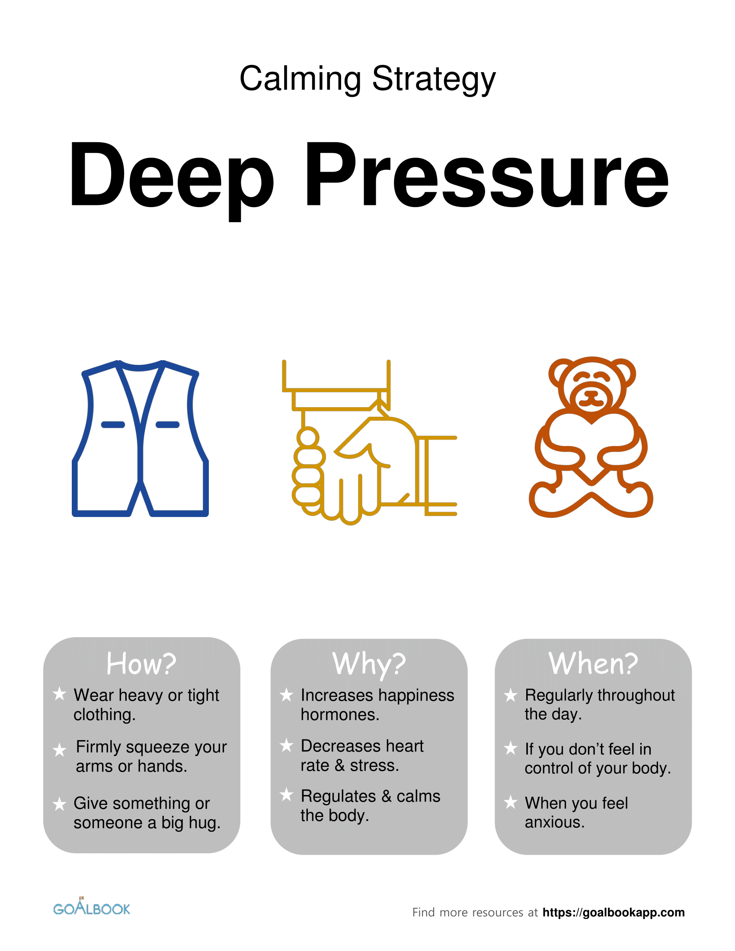
Calming strategies

Slide 22
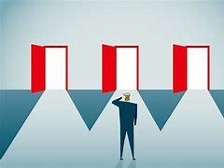
Managing my feelings
A feeling is a reaction to something. Usually a feeling comes from a thought. We think something as a reaction to something witnessed, said or done to us or around us.
Change your thoughts – change your feelings.
You get to choose the thoughts in your head!

Slide 23
Managing my feelings
How are you going to make sure that negative thoughts don’t cause negative feelings?
How are you going to control your feelings so that you don’t get wound up and explode with anger?

Slide 24
Managing my feelings
You need to focus on the ‘trigger’ and ‘escalation’ zones of the anger cycle:

Slide 25
Managing my feelings
What are you going to do here to stop losing your cool?

Slide 26
Calming strategies

Slide 27
Calming strategies

Slide 28
Calming strategies

Slide 29
Calming strategies

Slide 30
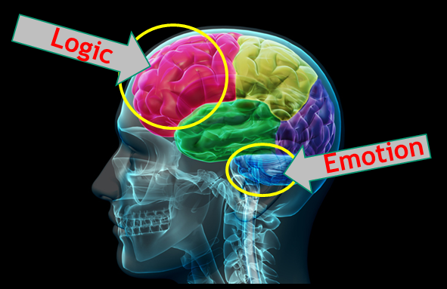
Understanding the brain
Pre-frontal cortex
Helps you problem solve, think things through before you react, be logical, be rational
Flight or flight – fear response – physical reaction to strong feelings
amygdala

Slide 31
Amygdala Hijacking
Pre-frontal cortex
This part of the brain is not activated first, so the person does not have time to think things through or plan how to react – there can be no regulation.
A problem / issue triggers a reaction here first – leading to fight, flight or freeze.
amygdala

Slide 32
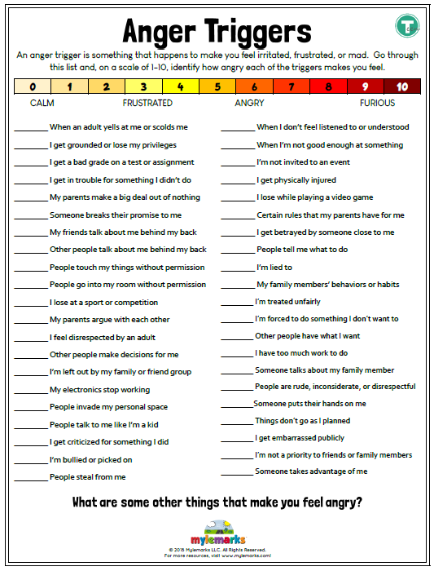
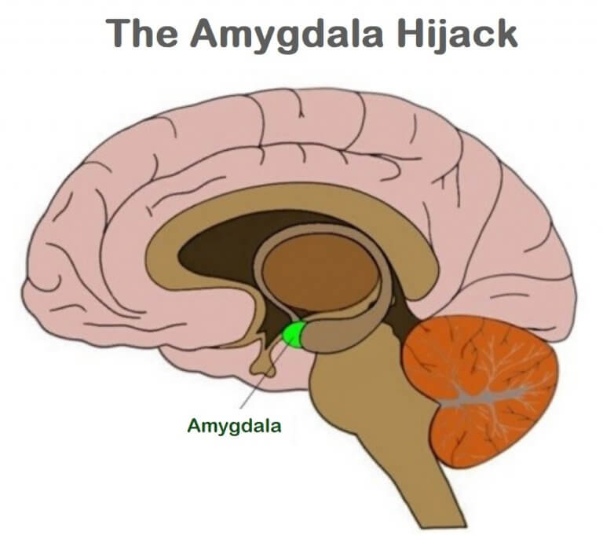
When does your amygdala hijack you?

Slide 33
What is my negative behaviour really all about?
As we grow up, things happen in our lives that can affect the way our brain reacts to future events. If lots of bad things happen, this can lead to problem behaviours at school.
Watch the video clips – can you think why the boy has so much anger inside?
A MONSTER CALLS Clip 2 - Break the Windows – YouTube
A MONSTER CALLS Clip 4 - Lunch Room - YouTube

Slide 34
Managing relationships / other people
People can say and do things that can cause us upset.
We still get to choose how we react.

Slide 35
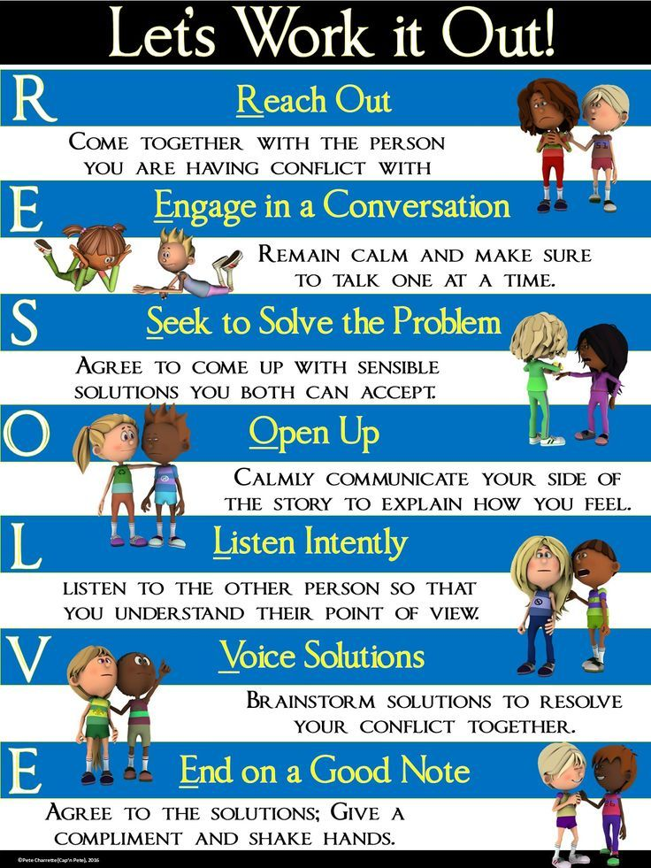
Managing relationships / other people – top tips

Slide 36
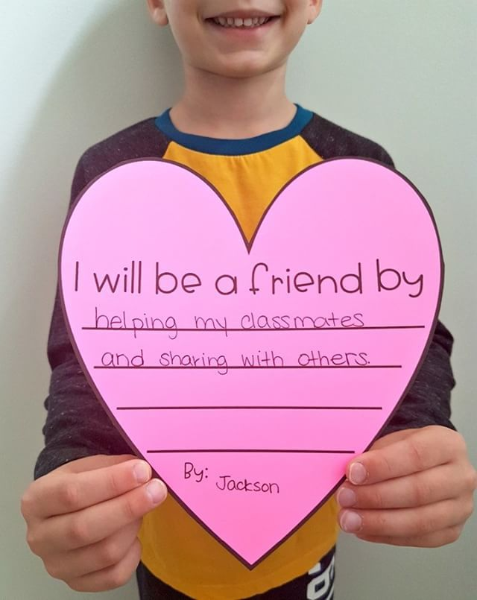
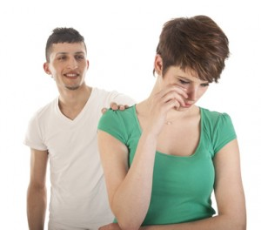
Managing relationships / other people – top tips
Never listen to rumours
Never believe someone who comes to tell you what someone else has said or done
Rather than fall out or row – go to a responsible adult and ask for a restorative meeting so that a problem can be solved

Slide 37
Violence is never the answer
By the time you are turning to violence as a solution – you have lost all sense of being reasonable and rational.
You will be in ‘crisis’ mode, in ‘fight’ mode and your amygdala has hijacked you!

Slide 38
Violence is never the answer
What are you going to do here to stop losing your cool?

Slide 39
Violence is never the answer
What are you going to do here to stop losing your cool?
STOP!
THINK
WALK AWAY

Slide 40
Violence is never the answer
What are you going to do here to stop losing your cool?
STOP!
Engage your pre-frontal cortex – your thinking, rational brain
THINK
WALK AWAY

Slide 41
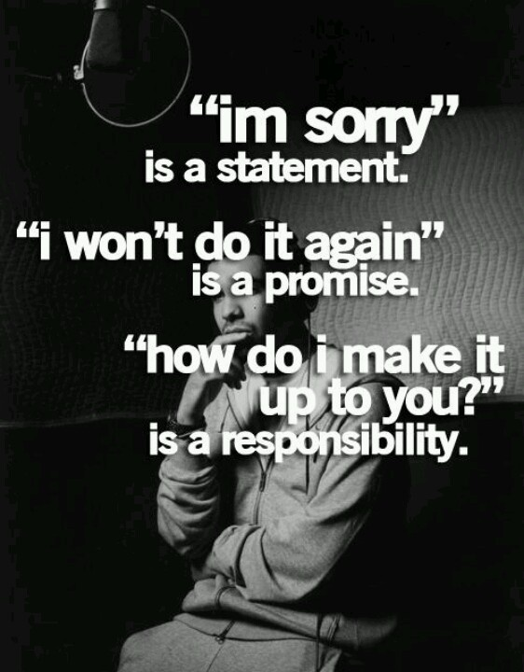
How are you going to make up for what you have done?
Look at the section of be Back-On-Track booklet that ask you how you will make things right – complete this and talk to your Key Worker about it.

Slide 42
Let’s storyboard what you will do next time – on paper
Stage 1 – it happens again
Stage 2 – my first response will be
Stage 3 – the problem doesn’t stop
Stage 4 – my second response will be

Slide 43
You can always ask an adult to call a restorative meeting when a problem comes up
These are formal meetings where everyone can sit down and talk things through together
They help stop an issue boiling over

Slide 44
Do you think you are ready to go back to your site now?
Find adults to talk to if you start to feel angry or upset again

