Slide 1

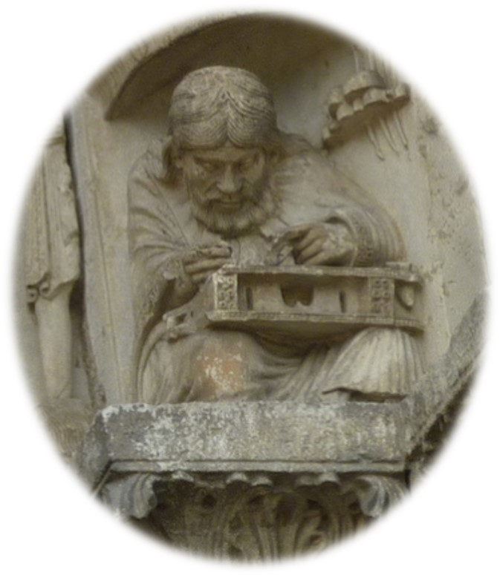
Trigonometry

Slide 2
My objectives
To
suggest some principles
share some examples
respond to your questions
to support and enhance your planning of a two-year ‘learning journey’ for your KS5 students.

Slide 3
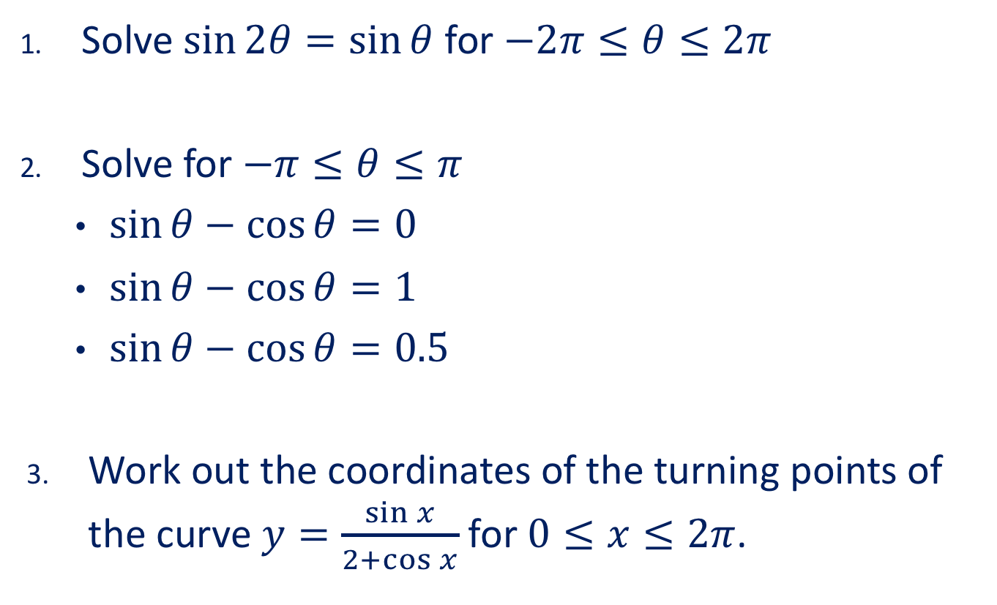
Trouble ahead!
Solve $\sin{2θ=\sin{θ}}$ for $−2π≤θ≤2π$
Solve for $−π≤θ≤π$
  $\sin{θ}−\cos{θ}=0$
  $\sin{θ}−\cos{θ}=1$
  $\sin{θ}−\cos{θ}=0.5$
Work out the coordinates of the turning points of the curve $y=\frac{\sin{x}}{2+\cos{x}}$ for $0≤x≤2π$.

Slide 4
ALL students must
REASON MATHEMATICALLY by following a line of enquiry, conjecturing relationships and generalisations, and developing an argument, justification or proof using mathematical language.

Slide 5
ALL students must
become FLUENT in the fundamentals of mathematics, including through varied and frequent practice with increasingly complex problems over time, so that pupils develop conceptual understanding and the ability to recall and apply knowledge rapidly and accurately.
REASON MATHEMATICALLY by following a line of enquiry, conjecturing relationships and generalisations, and developing an argument, justification or proof using mathematical language.

Slide 6
ALL students must
become FLUENT in the fundamentals of mathematics, including through varied and frequent practice with increasingly complex problems over time, so that pupils develop conceptual understanding and the ability to recall and apply knowledge rapidly and accurately.
SOLVE PROBLEMS by applying their mathematics to a variety of routine and non-routine problems with increasing sophistication, including breaking down problems into a series of simpler steps and persevering in seeking solutions.
REASON MATHEMATICALLY by following a line of enquiry, conjecturing relationships and generalisations, and developing an argument, justification or proof using mathematical language.

Slide 7
Trigonometry …
… in KS4 is
About shapes, angles, lengths
Geometric
… in KS5 is
About equations, inequalities, graphs
Algebraic
The bridge from KS4 to KS5 needs to be explicit and reinforced

Slide 8


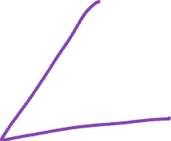








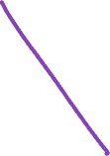

Trigonometry …
In the triangle ABC
angle ABC = 60°
angle BCA = 45°
AC is 1 cm longer than AB
Work out the exact length of AB.

Slide 9


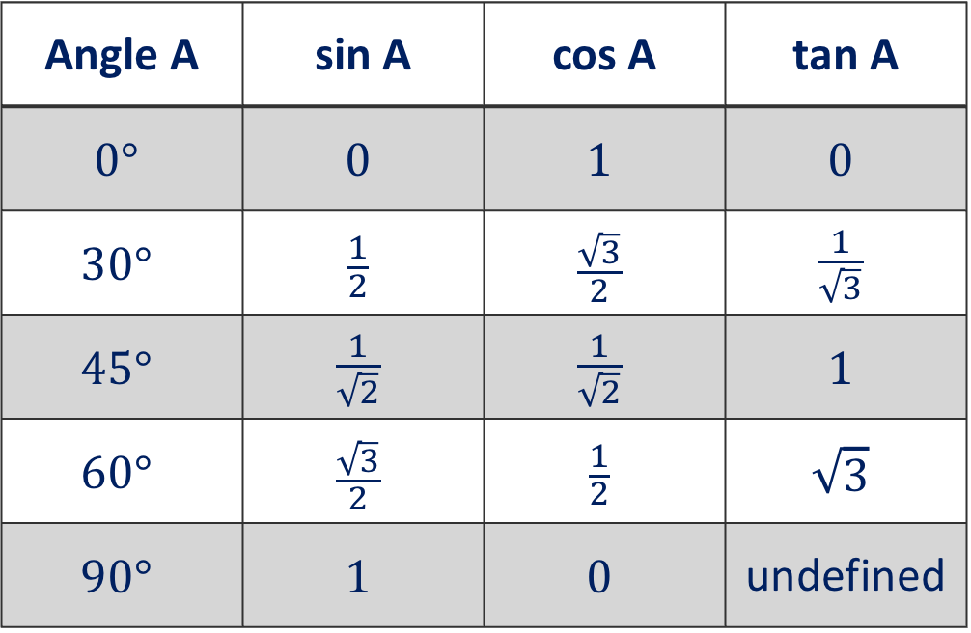



No to Desmos!
What is (and why is)
Angle A | sin A | cos A | tan A
$$0°$$ | $$0$$ | $$1$$ | $$0$$
$$30°$$ | $$\frac{1}{2}$$ | $$\frac{\sqrt{3}}{2}$$ | $$\frac{1}{\sqrt{3}}$$
$$45°$$ | $$\frac{1}{\sqrt{2}}$$ | $$\frac{1}{\sqrt{2}}$$ | $$1$$
$$60°$$ | $$\frac{\sqrt{3}}{2}$$ | $$\frac{1}{2}$$ | $$\sqrt{3}$$
$$90°$$ | $$1$$ | $$0$$ | undefined

Slide 10


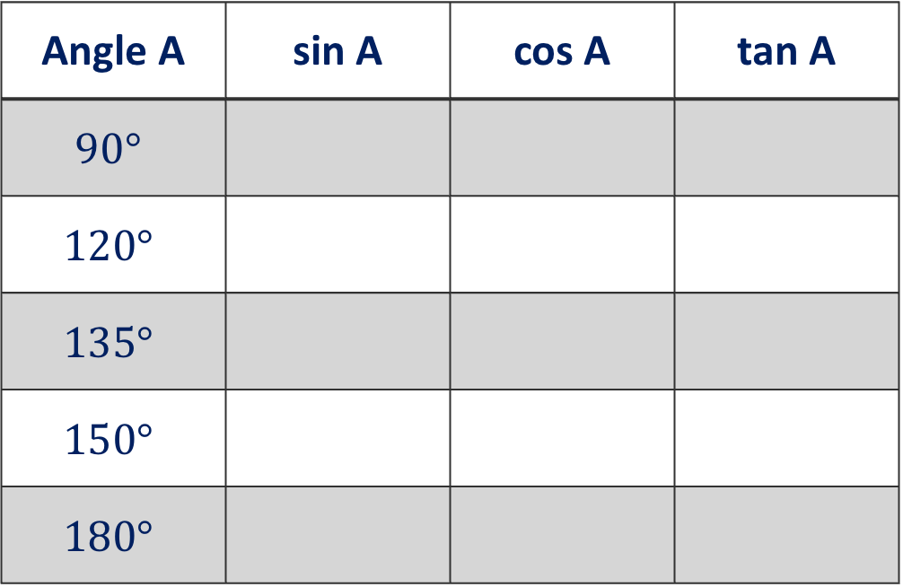



No to Desmos!
What is (and why should be)
Angle A | sin A | cos A | tan A
$$90°$$
$$120°$$
$$135°$$
$$150°$$
$$180°$$

Slide 11
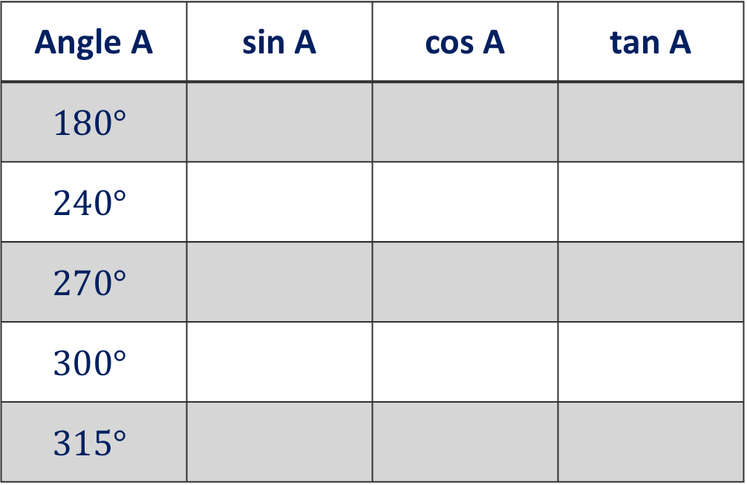



No to Desmos!
What is (and why should be)
Angle A | sin A | cos A | tan A
$$180°$$
$$240°$$
$$270°$$
$$300°$$
$$315°$$

Slide 12

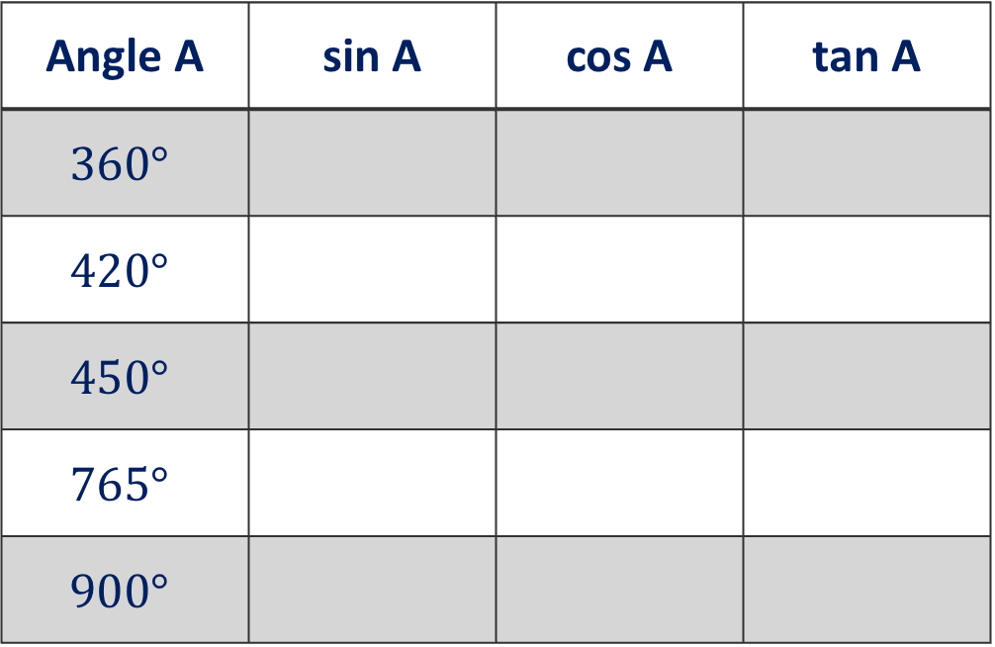



No to Desmos!
What is (and why should be)
Angle A | sin A | cos A | tan A
$$360°$$
$$420°$$
$$450°$$
$$765°$$
$$900°$$

Slide 13
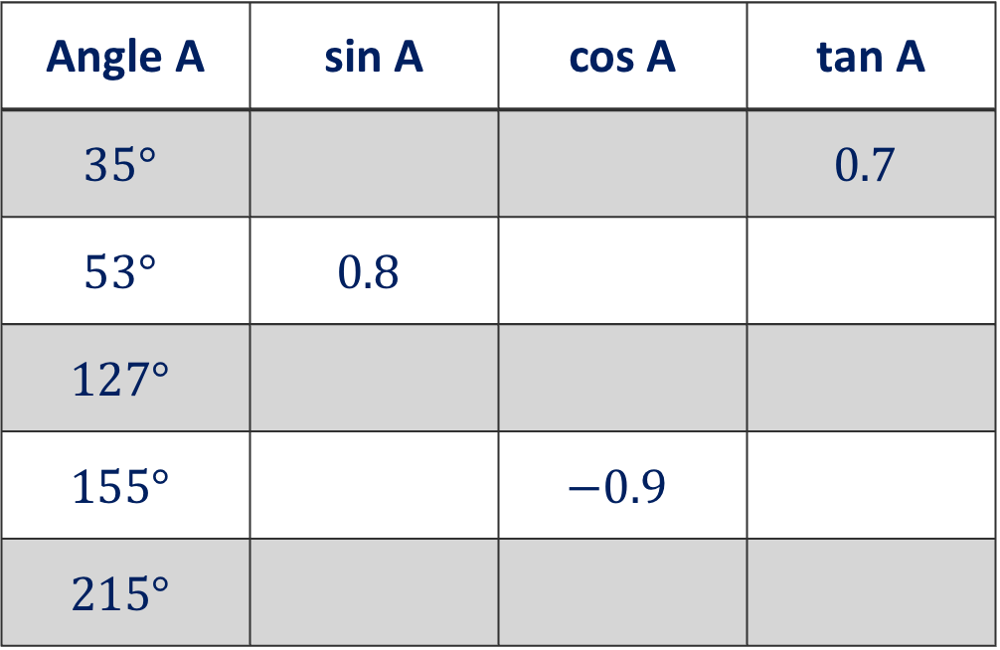


No to Desmos!
What is (and why should be)
Angle A | sin A | cos A | tan A
$$35°$$ |  |  | $$0.7$$
$$53°$$ | $$0.8$$
$$127°$$
$$155°$$ |  | $$−0.9$$
$$215°$$

Slide 14
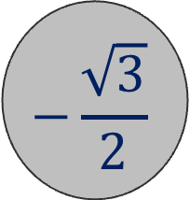
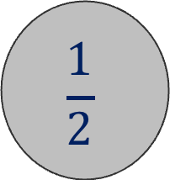
“Here’s the answer”
$$\frac{1}{2}$$
$$−\frac{\sqrt{3}}{2}$$

Slide 15

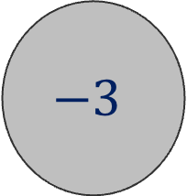


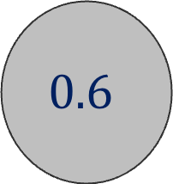
“Here’s the answer”
$$0.6$$
$$\sin{37°}$$
$$−3$$
$$\tan{108°}$$

Slide 16
















Valentine Trig
Match the perfect couples …
$$\sin{40}°$$
$$\sin{140}°$$
$$\sin{310}°$$
$$\cos{300}°$$
$$\cos{40}°$$
$$\sin{50}°$$
$$\sin{150}°$$
$$\cos{140}°$$

Slide 17














Yes to Desmos
$y=\sin{x}$
$y=2\sin{x}$
$y=\sin{2x}$

Slide 18





Yes to Desmos
$y=\sin{(x+90°})$
$y=\sin{(x−30°)}$

Slide 19



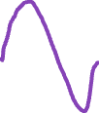










WTS, WD?
Solve for $0≤x≤360°$
$\sin{x}=0.3$
$\sin{x}=−0.3$
$\sin{3x}=0.3$
$3sin{3x}=0.3$

Slide 20




WTS, WD?
Solve for $−270°≤x≤90°$
$\sin{x}=0.3$
$\sin{x}=−0.3$
$\sin{3x}=0.3$
$3sin{3x}=0.3$

Slide 21











WTS, WD?
Solve for $0≤x≤360°$
$\tan{x}=0.75$
$4\sin{x}=3\cos{x}$
$4\sin{x}−3\cos{x=0}$
$3\cos{x}=4\sin{x}$

Slide 22


WTS, WD?
Solve for $450°≤x≤990°$
$\tan{x}=0.75$
$4\sin{x}=3\cos{x}$
$4\sin{x}−3\cos{x=0}$
$3\cos{x}=4\sin{x}$

Slide 23
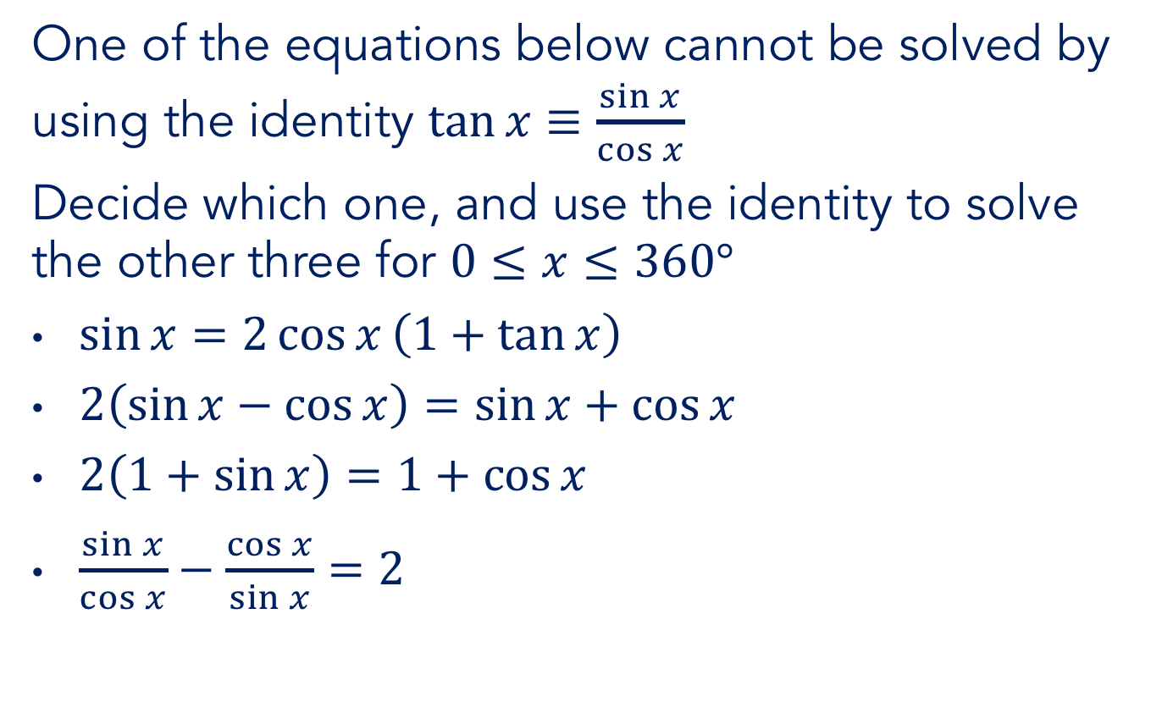
WTS, WD?
One of the equations below cannot be solved by using the identity $\tan{x}≡\frac{\sin{x}}{\cos{x}}$
Decide which one, and use the identity to solve the other three for $0≤x≤360°$
$\sin{x}=2\cos{x}\left(1+\tan{x}\right)$
$2\left(\sin{x}−\cos{x}\right)=\sin{x}+\cos{x}$
$2\left(1+\sin{x}\right)=1+\cos{x}$
$\frac{\sin{x}}{\cos{x}}−\frac{\cos{x}}{\sin{x}}=2$

Slide 24





Practice makes permanent
Simplify
$\frac{\sin{x}}{\cos{x}}+\frac{\cos{x}}{\sin{x}}$
$\frac{1}{1+\cos{x}}+\frac{1}{1−\cos{x}}$
$\frac{\sin{x}}{1+\sin{x}}−\frac{\sin{x}}{1−\sin{x}}$

Slide 25

















Practice makes permanent
Simplify
$\frac{\cos^{2}{x}−\sin^{2}{x}}{\cos{x}−\sin{x}}$
$\frac{\cos^{4}{x}−\sin^{4}{x}}{\cos^{2}{x}−\sin^{2}{x}}$
$\frac{\cos^{4}{x}−\cos^{2}{x}}{\sin^{4}{x}−\sin^{2}{x}}$

Slide 26
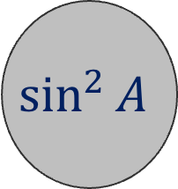




“Here’s the answer”
$$\sin^{2}{A}$$
$$1−\cos^{2}{A}$$

Slide 27

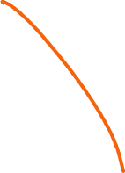








WTS, WD?
Solve for $0≤x≤360°$
$6\cos^{2}{x}=\cos{x}$
$6\cos^{2}{x}−\cos{x}=0$
$6\cos^{2}{x}−\cos{x}=1$

Slide 28


WTS, WD?
Solve for $0≤x≤360°$
$6\cos^{2}{x}=\sin{x}$
$6\sin^{2}{x}=\sin{x}$
$6\sin^{2}{x}=\cos{x}$

Slide 29

WTS, WD?
Solve for $0≤x≤360°$
$6\sin^{2}{x}=1+\cos{x}$
$6\sin^{2}{x}=1+\sin{x}$

Slide 30

WTS, WD?
Solve for $0≤x≤360°$
$6\cos{x}=\tan{x}$
$6\sin{x}\tan{x}=1$

Slide 31



WTS, WD?
Solve
$\begin{matrix}4a+2b=2+\sqrt{3} \\ 2a−4b=1−2\sqrt{3}\end{matrix}$
$\begin{matrix}4\sin{x}+2\cos{x}=2+\sqrt{3} \\ 2\sin{x}−4\cos{x}=1−2\sqrt{3}\end{matrix}$for $0≤x≤360°$

Slide 32



WTS, WD?
Solve
$\begin{matrix}4a+2b=2 \\ 2a−4b=−1½\end{matrix}$
$\begin{matrix}4\sin{x}+2\cos{x}=2 \\ 2\sin{x}−4\cos{x}=−1½\end{matrix}$for $0≤x≤360°$

Slide 33




Yes to Desmos
$y=\cos{x}$
$y=\cos^{2}{x}$
$y=6\cos^{2}{x}−\cos{x}−1$

Slide 34
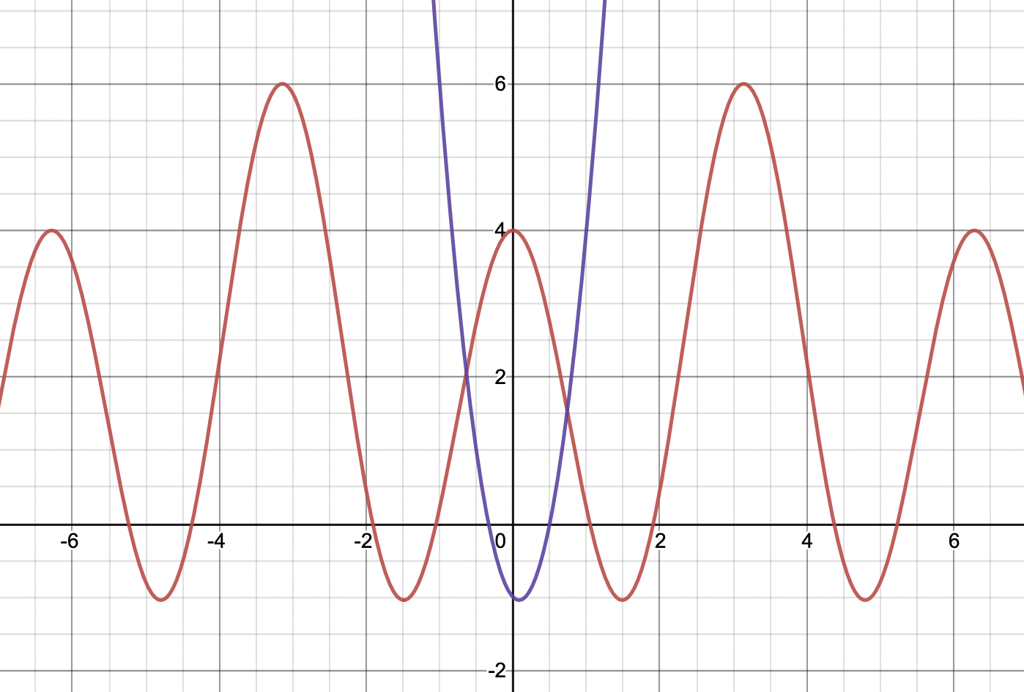

Yes to Desmos
$y=\cos{x}$
$y=\cos^{2}{x}$
$y=6\cos^{2}{x}−\cos{x}−1$

Slide 35
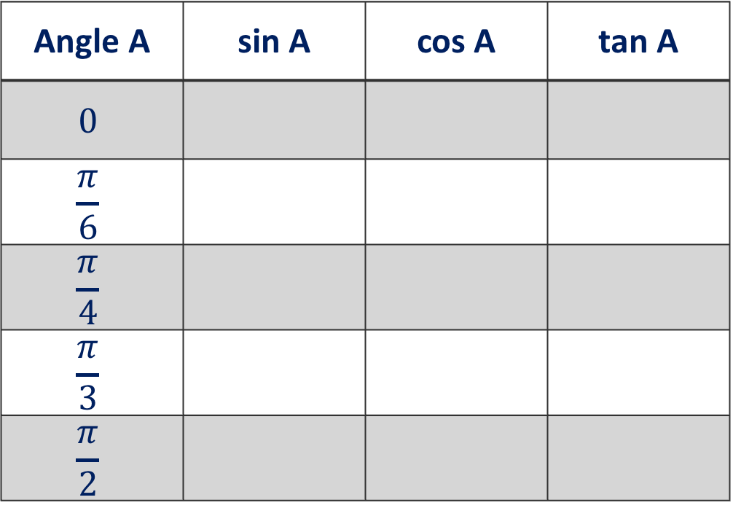
Déjà vu
What is (and why is)
Angle A | sin A | cos A | tan A
$$0$$
$$\frac{π}{6}$$
$$\frac{π}{4}$$
$$\frac{π}{3}$$
$$\frac{π}{2}$$

Slide 36
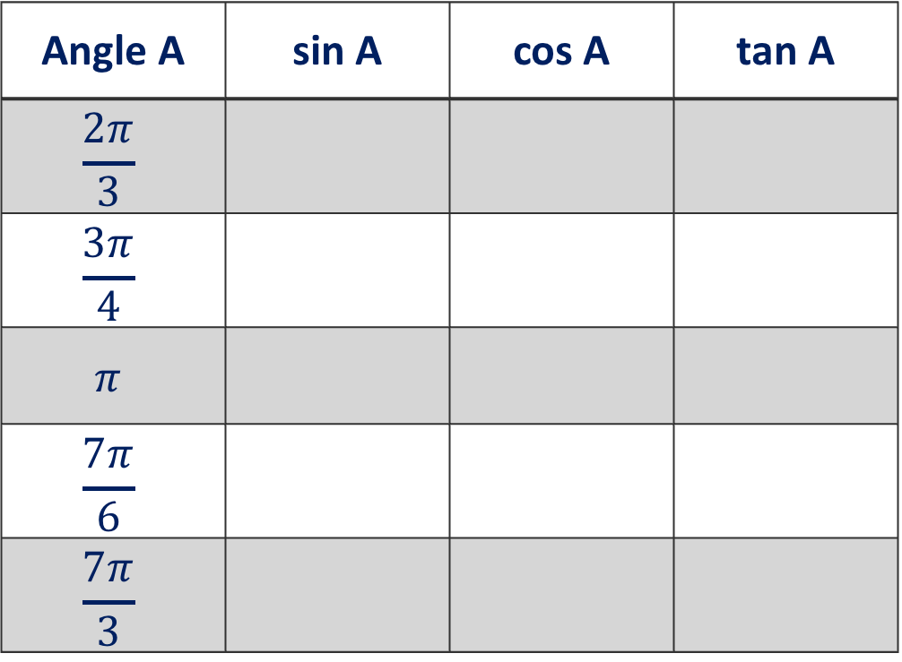
Déjà vu
What is (and why should be)
Angle A | sin A | cos A | tan A
$$\frac{2π}{3}$$
$$\frac{3π}{4}$$
$$π$$
$$\frac{7π}{6}$$
$$\frac{7π}{3}$$

Slide 37
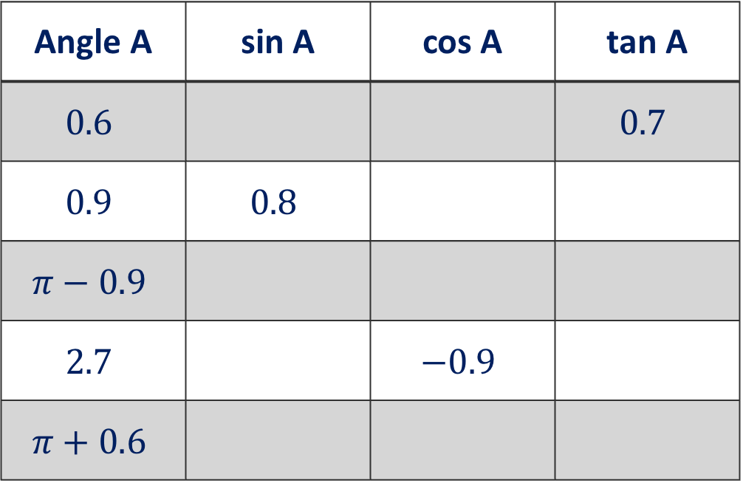

Déjà vu
What is (and why should be)
Angle A | sin A | cos A | tan A
$$0.6$$ |  |  | $$0.7$$
$$0.9$$ | $$0.8$$
$$π−0.9$$
$$2.7$$ |  | $$−0.9$$
$$π+0.6$$

Slide 38
How we learn
When a new concept is encountered, in order for learning to take place, one of two things must happen:
either
the new idea is connected to and incorporated into the learner’s existing framework of knowledge (assimilation)
or
existing knowledge structures must be extended / reorganised (accommodation).
Richard Skemp, 1976 & 1986
Notes:
Give TTs time to read

Slide 39
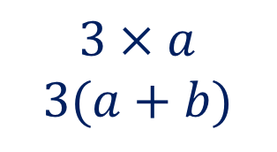




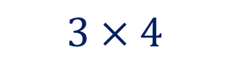

How we learn
$a$
$b$
$3$
$$3 × a$$
$$3(a+b)$$
$$3 × 4$$
Assimilation
Accommodation
Notes:
Give TTs time to read

Slide 40


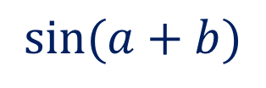
How we learn
$a$
$b$
$a$
$b$
$3$
$$3 × a$$
$$3(a+b)$$
$$3 × 4$$
$$\sin{(a+b)}$$
Assimilation
Accommodation
Notes:
Give TTs time to read

Slide 41





How we learn
So, for teaching to result in meaningful learning, we need to know students’ prior knowledge.
Vygotsky’s idea of zone of proximal development (ZPD) is helpful here. ZPD is “the distance between where the student is on their own, and where they can get to with the help of a more knowledgeable other … learning things that are just beyond where their current understanding is”.
Vygotsky, 1962
Notes:
Give TTs time to read

Slide 42

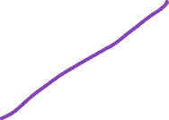


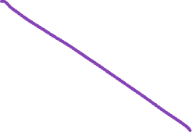

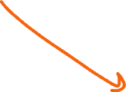
Double no Trouble
“Area” reasoning

Slide 43
“Here’s the answer”
$$\sin^{2}{A}$$
$$1−\cos^{2}{A}$$

Slide 44

WTS, WD?
Solve for $−180°≤x≤180°$
$\sin{2x}=\sin{x}$
$\cos{2x}=\cos{x}$

Slide 45








Harmonic Form
Express $3\sin{x}+4\cos{x}$ in harmonic form

Slide 46


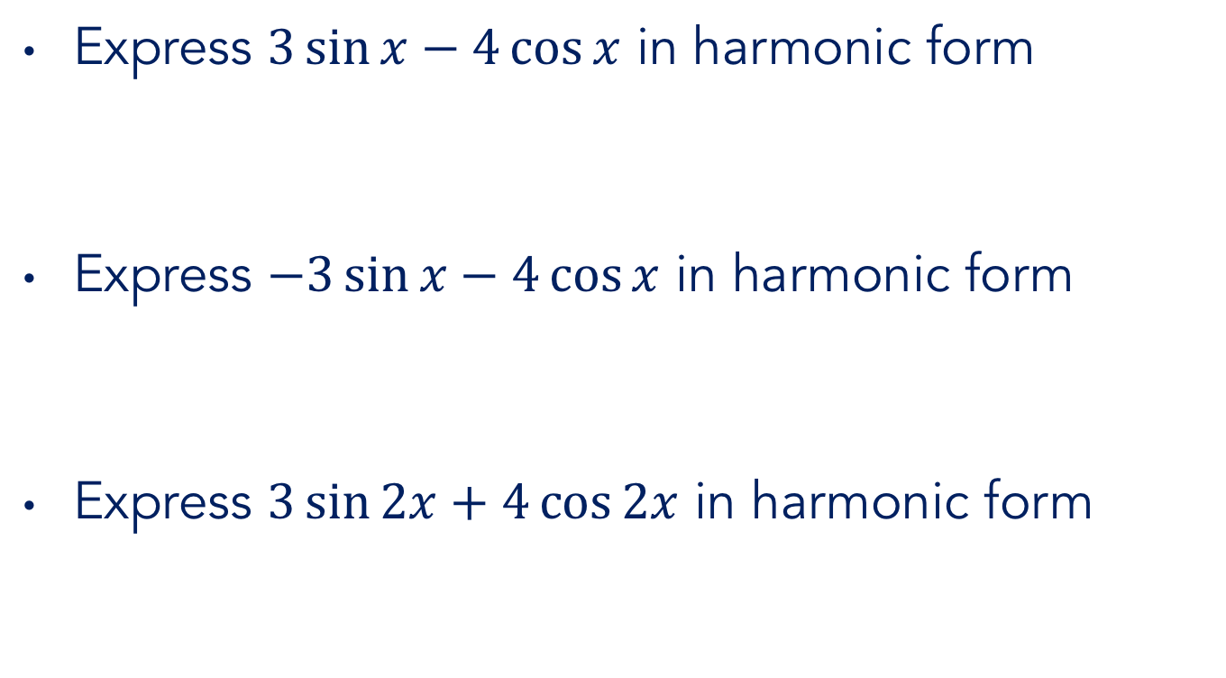
Harmonic Form
Express $3\sin{x}−4\cos{x}$ in harmonic form
Express $−3\sin{x}−4\cos{x}$ in harmonic form
Express $3\sin{2x}+4\cos{2x}$ in harmonic form

Slide 47

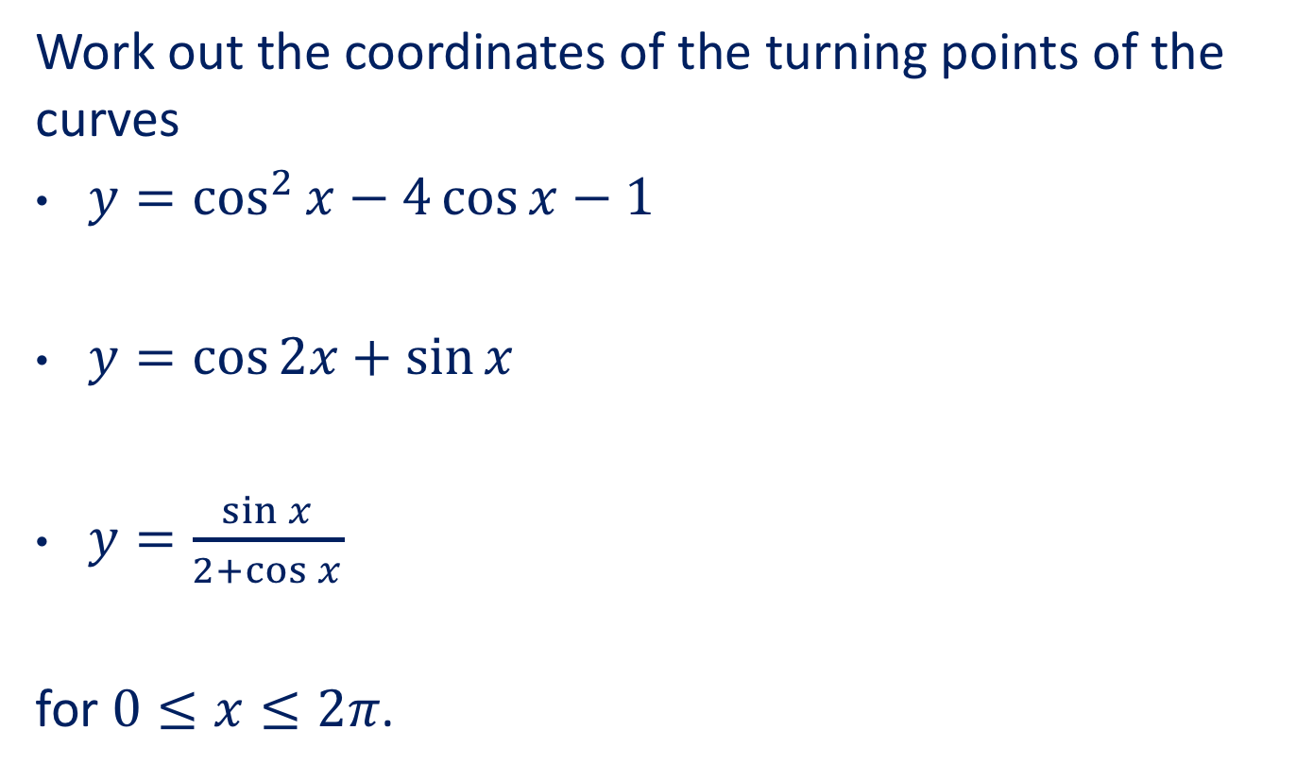

Calculus with Trig
Work out the coordinates of the turning points of the curves
$y=\cos^{2}{x}−4\cos{x}−1$
$y=\cos{2x}+\sin{x}$
$y=\frac{\sin{x}}{2+\cos{x}}$
for $0≤x≤2π$.

Slide 48
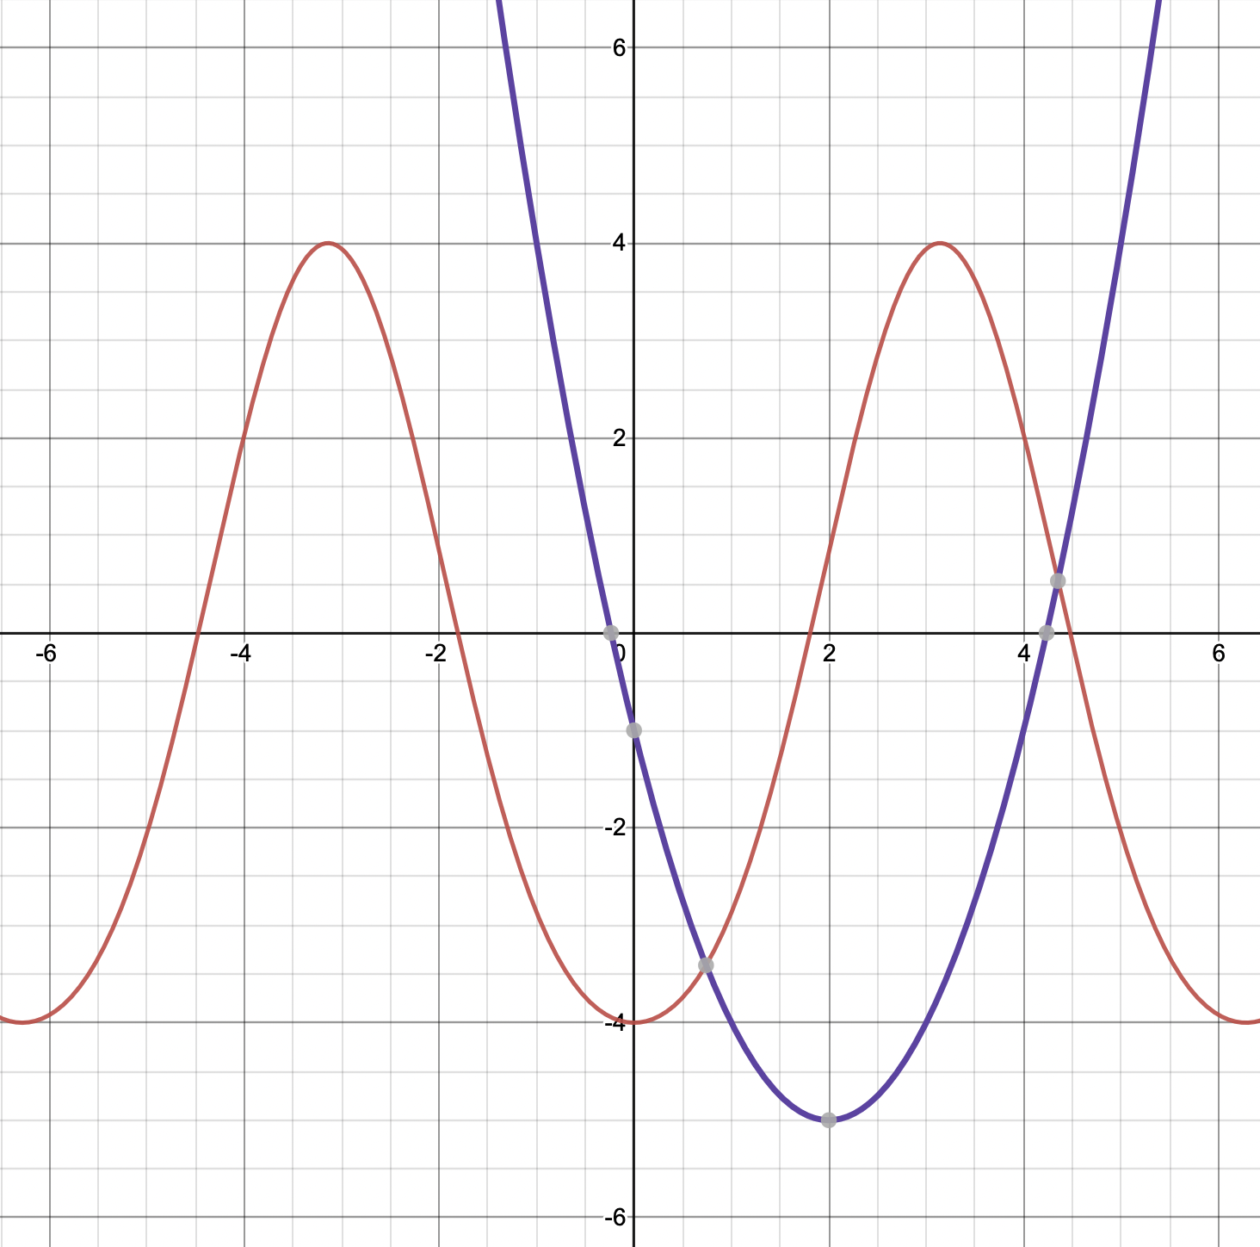




Calculus with Trig
Work out the coordinates of the turning points of the curves
$y=\cos^{2}{x}−4\cos{x}−1$
$y=\cos{2x}+\sin{x}$
$y=\frac{\sin{x}}{2+\cos{x}}$
for $0≤x≤2π$.

Slide 49





Calculus with Trig
Integrate with respect to $x$
$\frac{\sin{x}}{\cos{x}}+\frac{\cos{x}}{\sin{x}}$
$\frac{1}{1+\sin{x}}+\frac{1}{1−\sin{x}}$
$\frac{\sin{2x}}{1+\cos{2x}}$

Slide 50
In conclusion
“Unfinished business” leads to “trouble ahead”
General Tactics, Specific Strategies
Desirable difficulty, productive struggle
“Get the maths from them”
Accommodation is stronger than assimilation

Slide 51
(Suggested) Gap Task
Choose a specific question-form
Use it a lot! And take note …
When does it work? How do you know?
When doesn’t it work? How do you know?
Share your examples and reflections with
your colleagues
your students
us

Slide 52
Text
What might we do first? And then next?
Why did we … ?
Why didn’t we …?
Agree or challenge?
Here’s the answer …
Are you sure?
What do you notice?
What’s the same, what’s different
Can you use a graph?

Slide 53
Thank you
Robert Wilne
robert.wilne@kcl.ac.uk
#TeachersAlwaysLearning
#LearningTogether
@kingsmathschool

