Slide 1

Start as they need to go on
Developing algebra skills for A level success
Please
change your Zoom name to ”Full name, School”
keep your video on but microphone off
Have a paper and pencil, or something more modern!, to hand
Tell us in the Chat: “my favourite BBQ dish is …”

Slide 2
My objectives
To suggest
topics
examples
rationale
to support and inform your construction of a “Core skills in Algebra” development / consolidation programme for Y12 A-level mathematicians that will prepare them well for Y13 success.

Slide 3

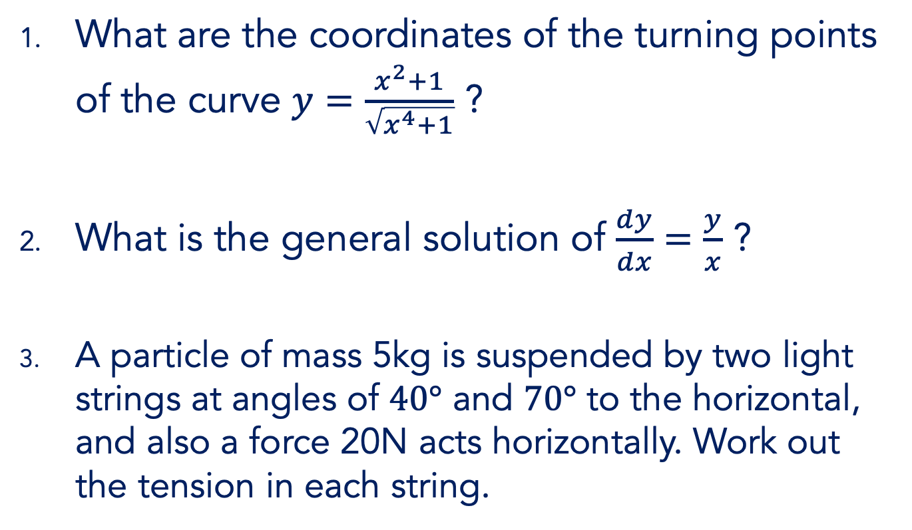
Trouble ahead!
What are the coordinates of the turning points of the curve $y=\frac{x^{2}+1}{\sqrt{x^{4}+1}}$ ?
What is the general solution of $\frac{dy}{dx}=\frac{y}{x}$ ?
A particle of mass 5kg is suspended by two light strings at angles of $40°$ and $70°$ to the horizontal, and also a force 20N acts horizontally. Work out the tension in each string.

Slide 4
ALL students must
REASON MATHEMATICALLY by following a line of enquiry, conjecturing relationships and generalisations, and developing an argument, justification or proof using mathematical language.

Slide 5
ALL students must
become FLUENT in the fundamentals of mathematics, including through varied and frequent practice with increasingly complex problems over time, so that pupils develop conceptual understanding and the ability to recall and apply knowledge rapidly and accurately.
REASON MATHEMATICALLY by following a line of enquiry, conjecturing relationships and generalisations, and developing an argument, justification or proof using mathematical language.

Slide 6
ALL students must
become FLUENT in the fundamentals of mathematics, including through varied and frequent practice with increasingly complex problems over time, so that pupils develop conceptual understanding and the ability to recall and apply knowledge rapidly and accurately.
SOLVE PROBLEMS by applying their mathematics to a variety of routine and non-routine problems with increasing sophistication, including breaking down problems into a series of simpler steps and persevering in seeking solutions.
REASON MATHEMATICALLY by following a line of enquiry, conjecturing relationships and generalisations, and developing an argument, justification or proof using mathematical language.

Slide 7
Routine and non-routine
Today
Factorising
Simultaneous equations
Indices & logarithms
Algebraic fractions
“Algebra-tisation”
Next week
Inequalities
Completing the square
Etc.

Slide 8
In conclusion
“Unfinished business” leads to “trouble ahead”
General tactics & Specific strategies
Desirable difficulty, productive struggle
Get the maths from them
Accommodate don’t assimilate

Slide 9












Factorising
“Factorise $x^{2}+5x−14$” at GCSE

Slide 10







Factorising
“Factorise $x^{3}+3x−14$” at A level

Slide 11






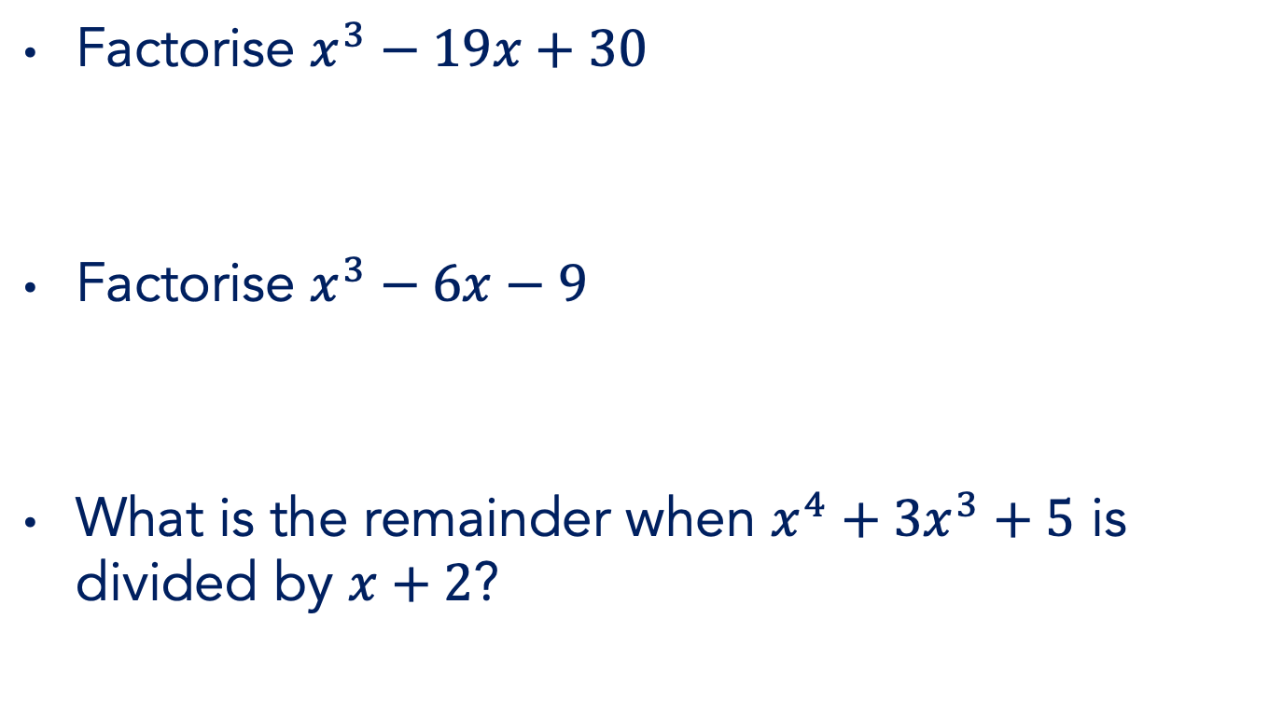






Factorising
Factorise $x^{3}−19x+30$
Factorise $x^{3}−6x−9$
What is the remainder when $x^{4}+3x^{3}+5$ is divided by $x+2$?

Slide 12









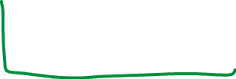

Factorising
What is the remainder when $x^{4}+3x^{3}+5$ is divided by $x+2$?

Slide 13
















Factorising
Simplify
$81{\left(x+y\right)}^{2}−16{\left(x−y\right)}^{2}$
$(x−3+\sqrt{2})(x−3−\sqrt{2})$

Slide 14







Factorising
Factorise
$4x^{−2}−x^{−3}$
$4x^{\frac{1}{2}}−{(4x)}^{−\frac{1}{2}}$

Slide 15



Factorising
Factorise
$4x^{−2}−x^{−1}−3$
${\left(2x\right)}^{−2}−{\left(4x\right)}^{−1}−3$

Slide 16

Simultaneous eqns
“Solve these simultaneous equations” at GCSE
$\begin{matrix}2x−3y=5 \\ 3x+4y=16\end{matrix}$
$\begin{matrix}x^{2}+y^{2}=40 \\ x−y=4\end{matrix}$

Slide 17



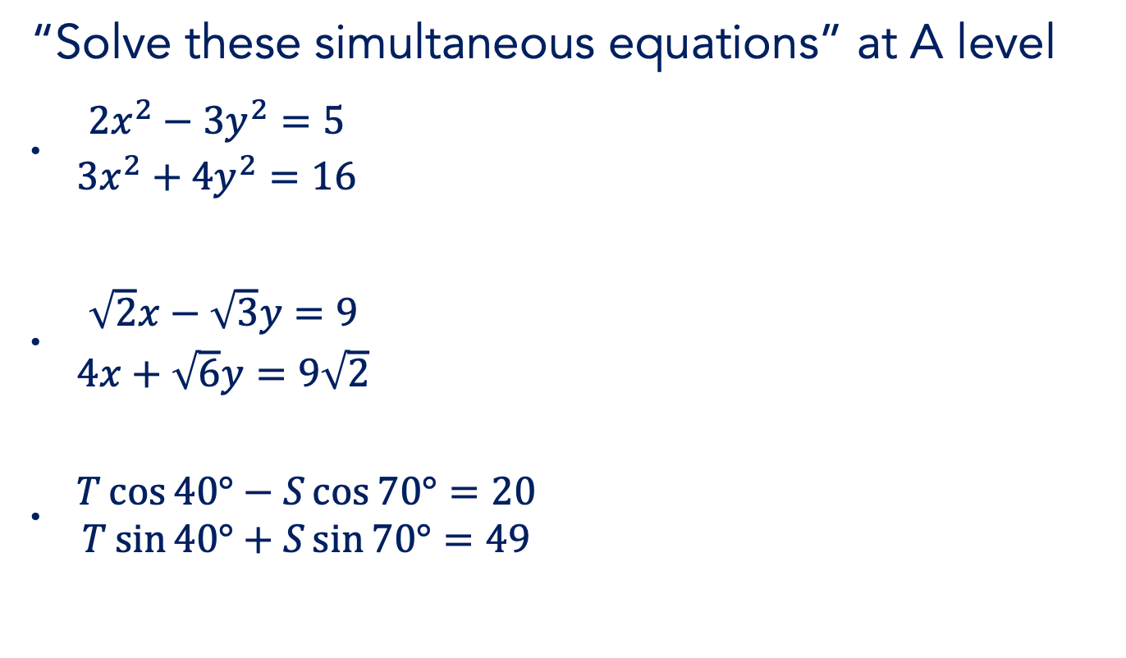

Simultaneous eqns
“Solve these simultaneous equations” at A level
$\begin{matrix}2x^{2}−3y^{2}=5 \\ 3x^{2}+4y^{2}=16\end{matrix}$
$\begin{matrix}\sqrt{2}x−\sqrt{3}y=9 \\ 4x+\sqrt{6}y=9\sqrt{2}\end{matrix}$
$\begin{matrix}T\cos{40°−S\cos{70°}=20} \\ T\sin{40°+S\sin{70°}=49}\end{matrix}$

Slide 18






Simultaneous eqns
Solve
$\begin{matrix}x^{2}+y^{2}=13 \\ 2x+y=4\end{matrix}$
$\begin{matrix}x^{2}+y^{2}=13 \\ 3x+2y=5\end{matrix}$
$\begin{matrix}{3x}^{2}+2y^{2}=35 \\ 2x−3y=12\end{matrix}$

Slide 19

Simultaneous eqns
Solve
$\begin{matrix}x^{2}+{xy+y}^{2}=7 \\ 3x+2y=5\end{matrix}$
$\begin{matrix}x^{2}+y^{2}=13 \\ x^{4}+y^{4}=97\end{matrix}$

Slide 20






Algebraic fractions
Simplify
${2x}^{−3}+{3x}^{−3}$
$2x^{−3}+{3x}^{−2}$
${\left(2x\right)}^{−3}+{\left(3x\right)}^{−2}$

Slide 21

















Algebraic fractions
Simplify
${\left(x+1\right)}^{\frac{1}{2}}−{\left(x+1\right)}^{−\frac{1}{2}}$
${\left(9x+9\right)}^{\frac{3}{2}}−x{\left(4x+4\right)}^{\frac{1}{2}}$

Slide 22







Algebraic fractions
Simplify
$2x{\left(x^{4}+1\right)}^{−0.5}−2x^{3}\left(x^{2}+1\right){\left(x^{4}+1\right)}^{−1.5}$

Slide 23




Algebraic fractions
Simplify
$\frac{{3x}^{2} − 4x^{5}}{x^{4}}$
$\frac{4x +5}{3x}$
$\frac{{2x}^{2}\sqrt{x} + 9x}{\sqrt{3x^{3}}}$

Slide 24





Algebraic fractions
Simplify
$\frac{{3x}^{2} − 4x^{5}}{x^{4}}$
$\frac{4x +5}{3x}$
$\frac{{2x}^{2}\sqrt{x} + 9x}{\sqrt{3x^{3}}}$

Slide 25






Algebraic fractions
Simplify
$\frac{x^{2}}{x+1}$
$\frac{x^{2} + 1}{x+1}$
$\frac{x^{2} + 3x}{x+1}$

Slide 26






Indices …
Simplify
$\sqrt{36x^{36}}$
$\sqrt[3]{216y^{216}}$
${\left(3x\right)}^{−2} × 2x^{−3}$
$3x^{−2}÷{\left(2x\right)}^{−3}$

Slide 27







Indices …
If $2^{a}=9$, evaluate
$2^{a+2}$
$2^{−a}$
$2^{\frac{a}{2}}$
$4^{a−1}$

Slide 28








… & logarithms
If $a=\log_{2}{9}$, simplify
$2^{a}$
$4^{−a}$
Express in terms of $a$
$\log_{2}{18}$
$\log_{2}{\frac{8}{9}}$
$\log_{4}{3}$

Slide 29

















… & logarithms
If $a=\frac{1}{2}\log_{2}{6}$, simplify
$12÷2^{a}$
$\frac{4a+1}{4a−1}$
$\frac{4^{a}+4^{−a}}{4^{a}−4^{−a}}$

Slide 30


… & logarithms
If $a=\sqrt{e}$ and $b=−\ln{4}$, simplify
$a\ln{a}$
$\ln\left(\frac{1}{a^{2}}\right)+\frac{1}{{\left(\ln{a}\right)}^{2}}$
$\frac{a^{2}}{1−\ln{a}}$
$b−\ln{2}$
$e^{\frac{1}{2}b}$

Slide 31
How we learn
When a new concept is encountered, in order for learning to take place, one of two things must happen:
either
the new idea is connected to and incorporated into the learner’s existing framework of knowledge (assimilation)
or
existing knowledge structures must be extended / reorganised (accommodation).
Richard Skemp, 1976 & 1986
Notes:
Give TTs time to read

Slide 32
How we learn
Area = 20cm²
Base = 5cm
Height = ?
Notes:
Give TTs time to read

Slide 33
How we learn
Area = 10cm²
Base = 5cm
Height = ?
Area = 20cm²
Base = 5cm
Height = ?
Assimilation
Notes:
Give TTs time to read

Slide 34
How we learn
Area = 10cm²
Base = 5cm
Height = ?
Area = 20cm²
Base = 5cm
Height = ?
Area = 25cm²
Height = ?
Assimilation
Accommodation
Notes:
Give TTs time to read

Slide 35


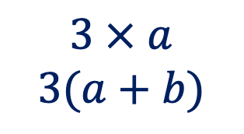



How we learn
$a$
$b$
$3$
$$3 × a$$
$$3(a+b)$$
$$3 × 4$$
Assimilation
Accommodation
Notes:
Give TTs time to read

Slide 36

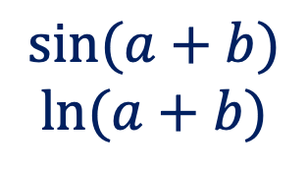


How we learn
$a$
$b$
$3$
$$3 × a$$
$$3(a+b)$$
$$\sin{(a+b)}$$
$$\ln{(a+b)}$$
$$3 × 4$$
Assimilation
Accommodation
Notes:
Give TTs time to read

Slide 37


How we learn
$a$
$b$
$3$
$b$
$a$
$$3 × a$$
$$3(a+b)$$
$$\sin{(a+b)}$$
$$\ln{(a+b)}$$
$$3 × 4$$
Assimilation
Accommodation
Notes:
Give TTs time to read

Slide 38
How we learn
So, for teaching to result in meaningful learning, we need to know students’ prior knowledge.
Vygotsky’s idea of zone of proximal development (ZPD) is helpful here. ZPD is “the distance between where the student is on their own, and where they can get to with the help of a more knowledgeable other … learning things that are just beyond where their current understanding is”.
Vygotsky, 1962
Notes:
Give TTs time to read

Slide 39
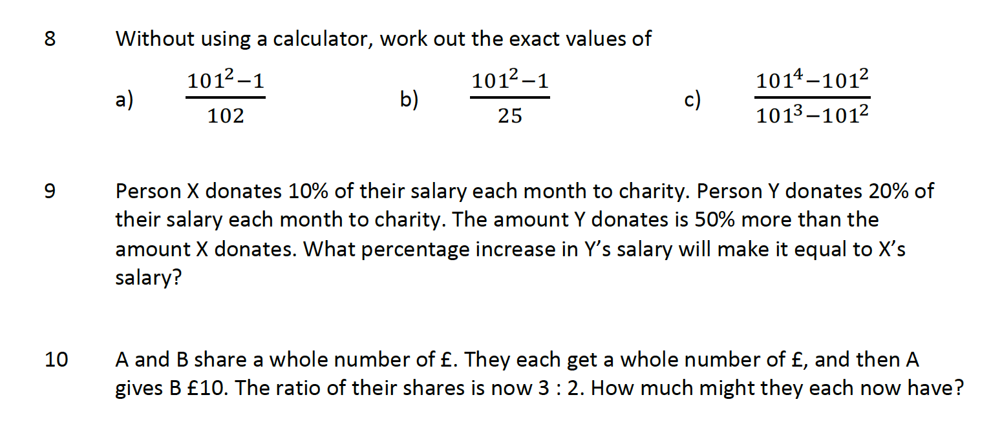
Algebra-tisation
Notes:
Give TTs time to read

Slide 40
In conclusion
“Unfinished business” leads to “trouble ahead”
General tactics & Specific strategies
Desirable difficulty, productive struggle
Get the maths from them
Accommodate don’t assimilate

Slide 41





Text
What might we do first?
What might we do next?
Agree or challenge?
Why did we … ?
Are you sure?
What do you notice?
What’s the same, what’s different
Why didn’t we … ?

Slide 42
Text
Your Q
Your Q
Your Q
Your Q
Your Q
Your Q
Your Q
Your Q

Slide 43
Thank you
Robert Wilne
robert.wilne@kcl.ac.uk
#TeachersAlwaysLearning
#LearningTogether
@kingsmathschool

