Slide 1

Start as they need to go on
Developing graph skills for A level success
Please
change your Zoom name to ”Full name, School”
keep your video on but microphone off
Have a paper and pencil, or something more modern!, to hand
Tell us in the Chat: “My favourite chocolate is …”

Slide 2
My objectives
To suggest
topics
examples
rationale
to support and inform your construction of a Y12 “Core Ideas in Graphs” curriculum thread that will prepare your students well for Y13 success.

Slide 3
ALL students must
REASON MATHEMATICALLY by following a line of enquiry, conjecturing relationships and generalisations, and developing an argument, justification or proof using mathematical language.

Slide 4
ALL students must
become FLUENT in the fundamentals of mathematics, including through varied and frequent practice with increasingly complex problems over time, so that pupils develop conceptual understanding and the ability to recall and apply knowledge rapidly and accurately.
REASON MATHEMATICALLY by following a line of enquiry, conjecturing relationships and generalisations, and developing an argument, justification or proof using mathematical language.

Slide 5
ALL students must
become FLUENT in the fundamentals of mathematics, including through varied and frequent practice with increasingly complex problems over time, so that pupils develop conceptual understanding and the ability to recall and apply knowledge rapidly and accurately.
SOLVE PROBLEMS by applying their mathematics to a variety of routine and non-routine problems with increasing sophistication, including breaking down problems into a series of simpler steps and persevering in seeking solutions.
REASON MATHEMATICALLY by following a line of enquiry, conjecturing relationships and generalisations, and developing an argument, justification or proof using mathematical language.

Slide 6
Routine and non-routine
Completing the Square
Sketching graphs
Intersecting graphs
Inequalities
Transforming graphs
(and some lovely circle stuff 🤞)

Slide 7
In conclusion
“Unfinished business” leads to “trouble ahead”
General tactics & Specific strategies
Desirable difficulty, productive struggle
Get the maths from them
Accommodate don’t assimilate

Slide 8
In conclusion
Graphs are representations of functions
“Unfinished business” leads to “trouble ahead”
General tactics & Specific strategies
Desirable difficulty, productive struggle
Get the maths from them
Accommodate don’t assimilate

Slide 9
In conclusion
Graphs are representations of functions
“Unfinished business” leads to “trouble ahead”
General tactics & Specific strategies
Desirable difficulty, productive struggle
Get the maths from them
Accommodate don’t assimilate

Slide 10












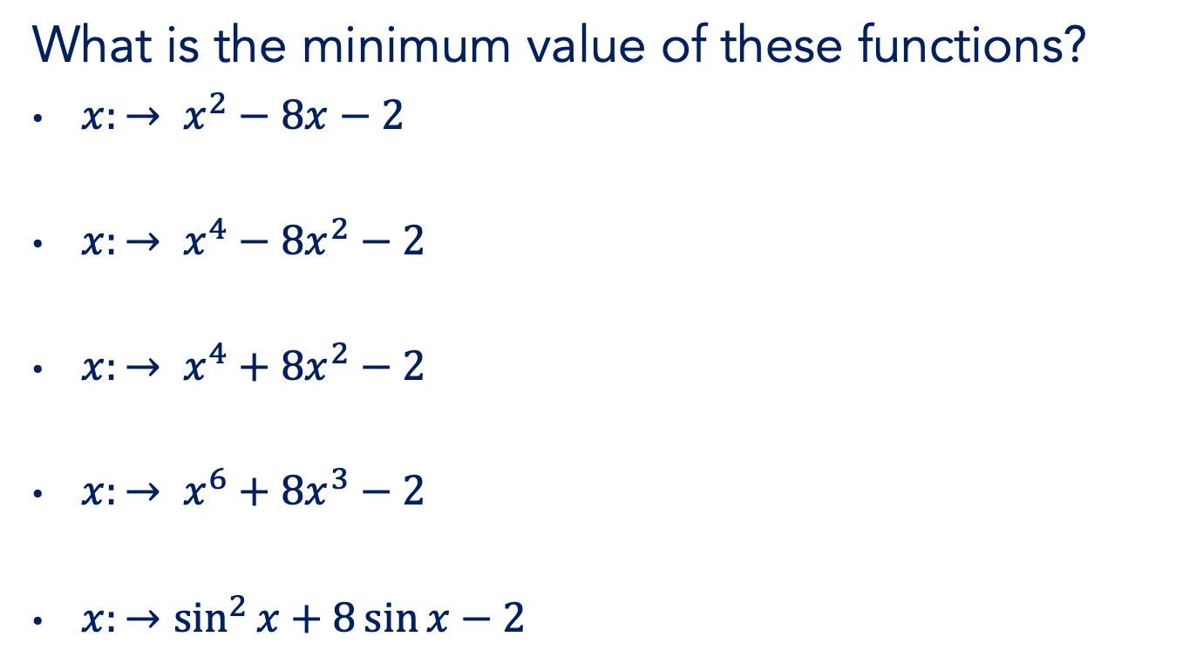
Completing the square
What is the minimum value of these functions?
$x:→ x^{2}−8x−2$
$x:→ x^{4}−8x^{2}−2$
$x:→ x^{4}+8x^{2}−2$
$x:→ x^{6}+8x^{3}−2$
${x:→sin}^{2}{x}+8\sin{x}−2$

Slide 11


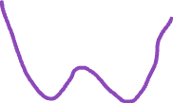



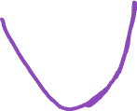

Completing the square
Hence sketch the graphs representing the functions
$x:→ x^{2}−8x−2$
$x:→ x^{4}−8x^{2}−2$
$x:→ x^{4}+8x^{2}−2$

Slide 12


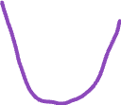

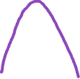

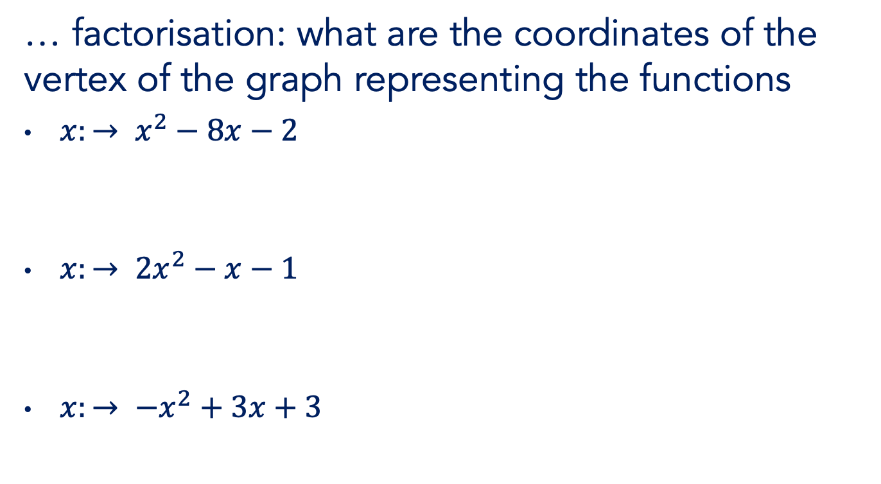
Not-completing the …
… factorisation: what are the coordinates of the vertex of the graph representing the functions
$x:→ x^{2}−8x−2$
$x:→ {2x}^{2}−x−1$
$x:→ {−x}^{2}+3x+3$

Slide 13
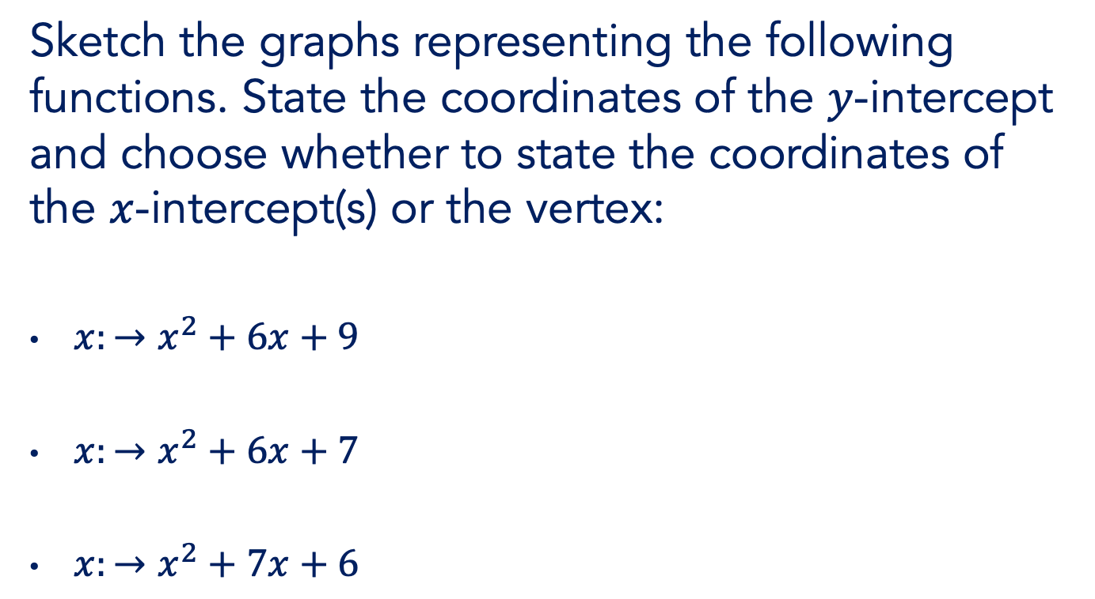

“Choose wisely”
Sketch the graphs representing the following functions. State the coordinates of the $y$-intercept and choose whether to state the coordinates of the $x$-intercept(s) or the vertex:
$x:→x^{2}+6x+9$
$x:→x^{2}+6x+7$
$x:→x^{2}+7x+6$

Slide 14

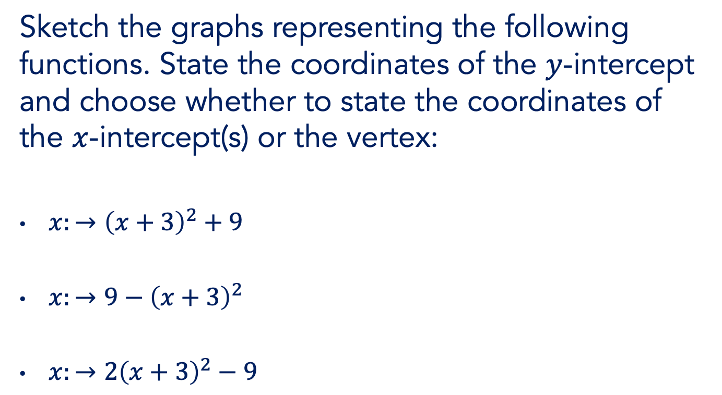
“Choose wisely”
Sketch the graphs representing the following functions. State the coordinates of the $y$-intercept and choose whether to state the coordinates of the $x$-intercept(s) or the vertex:
$x:→{\left(x+3\right)}^{2}+9$
$x:→9−{\left(x+3\right)}^{2}$
$x:→2{\left(x+3\right)}^{2}−9$

Slide 15
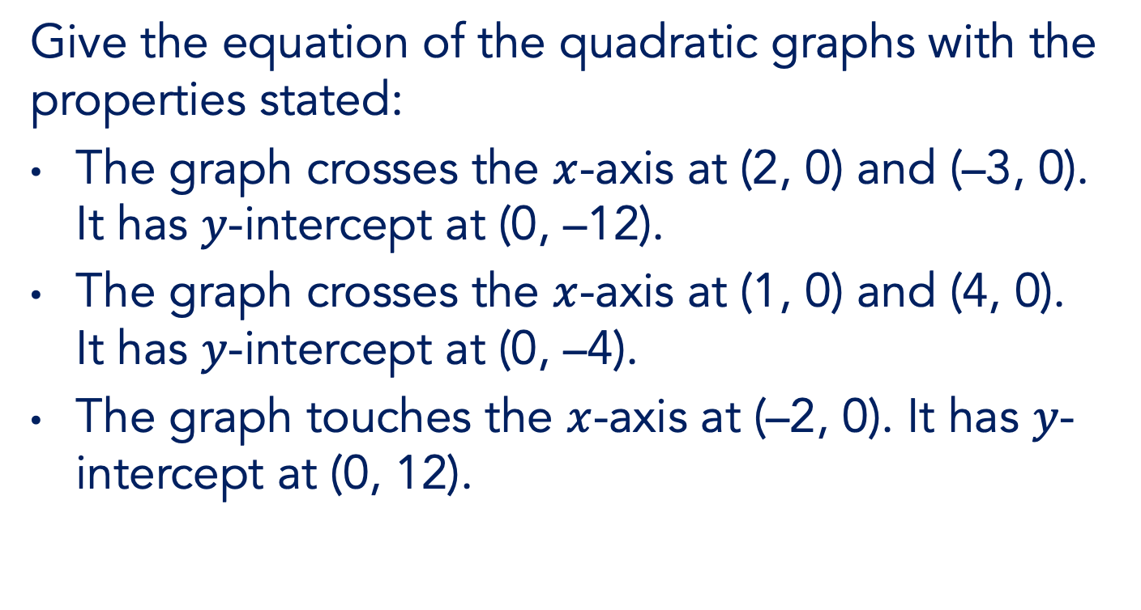
“Thinking backwards”
Give the equation of the quadratic graphs with the properties stated:
The graph crosses the $x$-axis at (2, 0) and (–3, 0). It has $y$-intercept at (0, –12).
The graph crosses the $x$-axis at (1, 0) and (4, 0). It has $y$-intercept at (0, –4).
The graph touches the $x$-axis at (–2, 0). It has $y$-intercept at (0, 12).

Slide 16

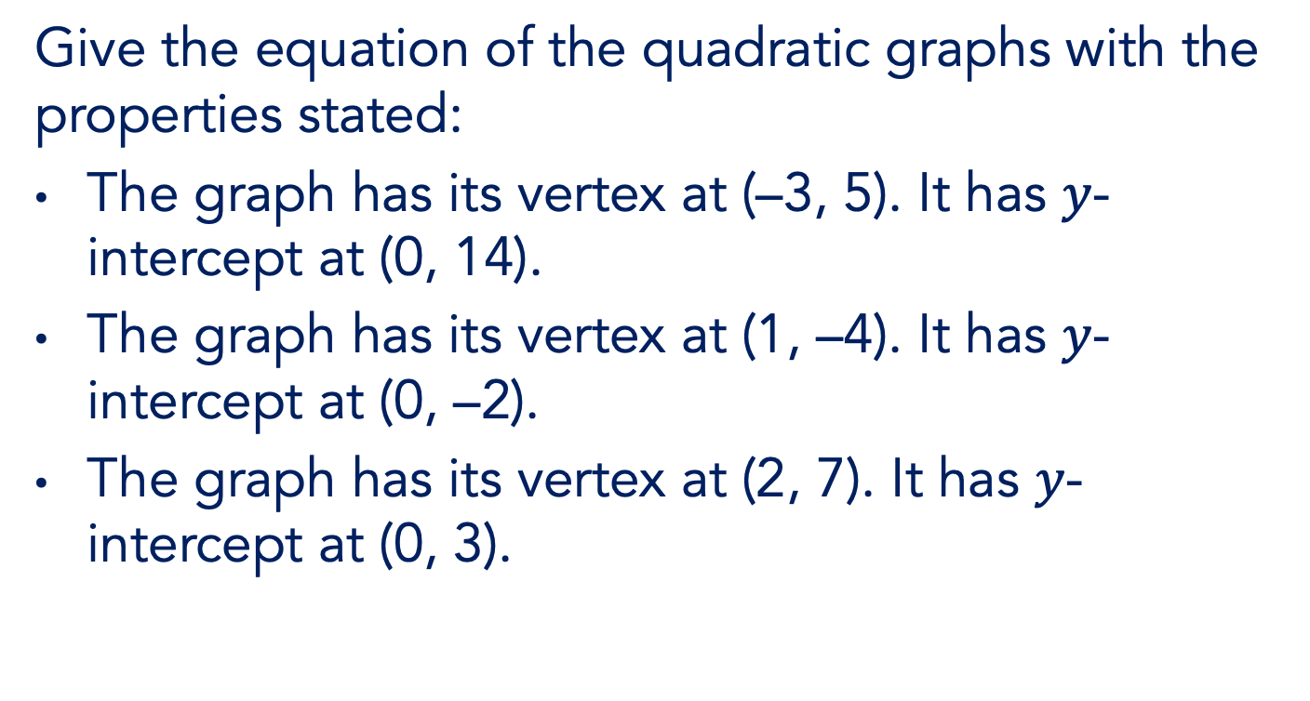
“Thinking backwards”
Give the equation of the quadratic graphs with the properties stated:
The graph has its vertex at (–3, 5). It has $y$-intercept at (0, 14).
The graph has its vertex at (1, –4). It has $y$-intercept at (0, –2).
The graph has its vertex at (2, 7). It has $y$-intercept at (0, 3).

Slide 17
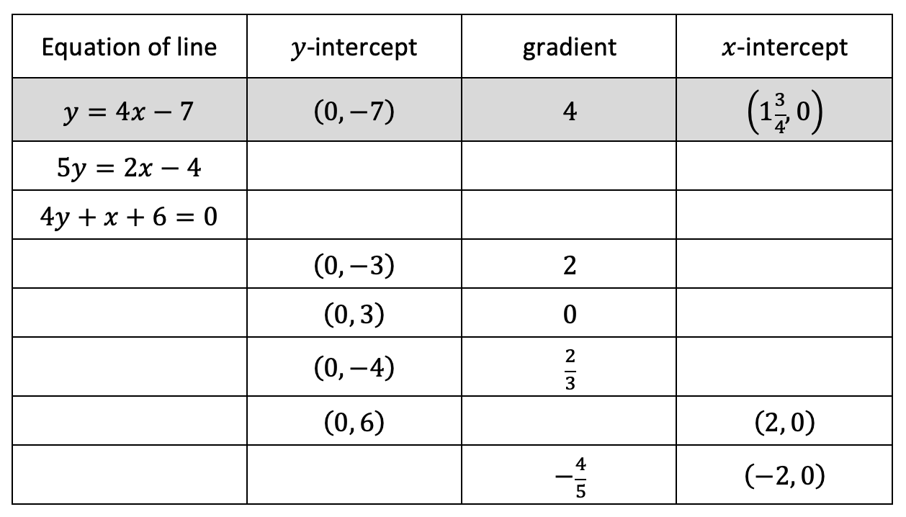
“Thinking backwards”

Slide 18
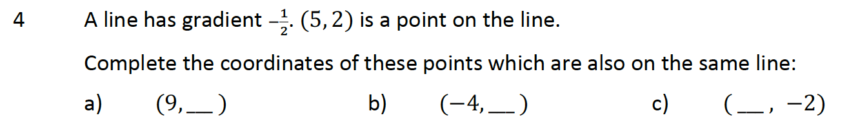

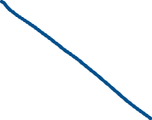



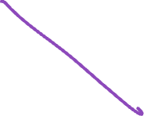



“Thinking backwards”

Slide 19















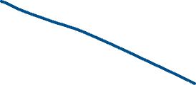

“Thinking sideways”
Work out the area of the triangle with vertices at
(−2, 0), (3, 5) and (4, −2).

Slide 20
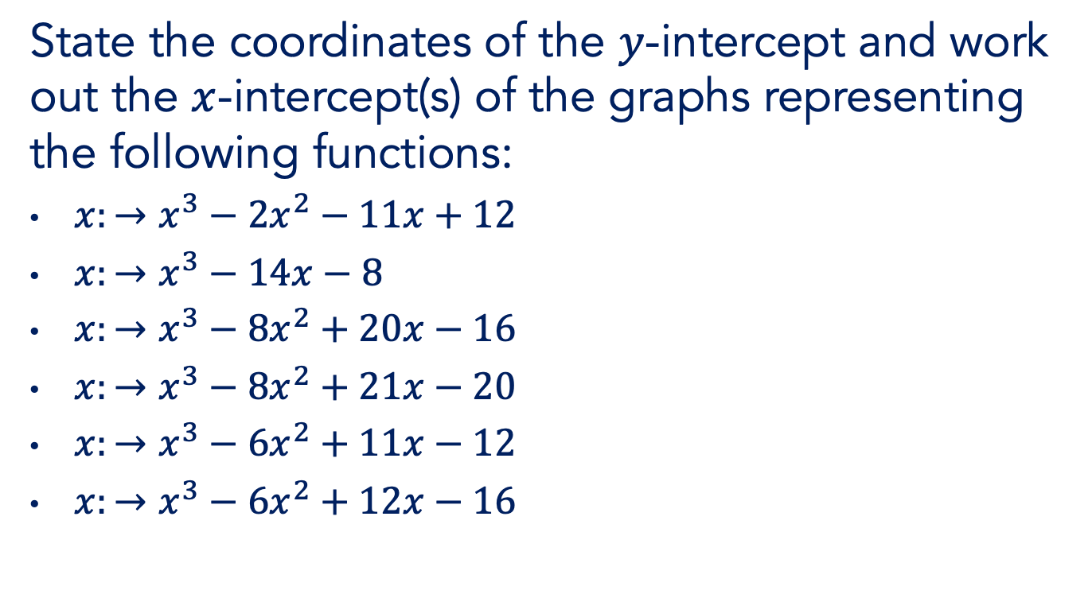

Cubic graphs
State the coordinates of the $y$-intercept and work out the $x$-intercept(s) of the graphs representing the following functions:
$x:→x^{3}−2x^{2}−11x+12$
$x:→x^{3}−14x−8$
$x:→x^{3}−8x^{2}+20x−16$
$x:→x^{3}−8x^{2}+21x−20$
$x:→x^{3}−6x^{2}+11x−12$
$x:→x^{3}−6x^{2}+12x−16$

Slide 21


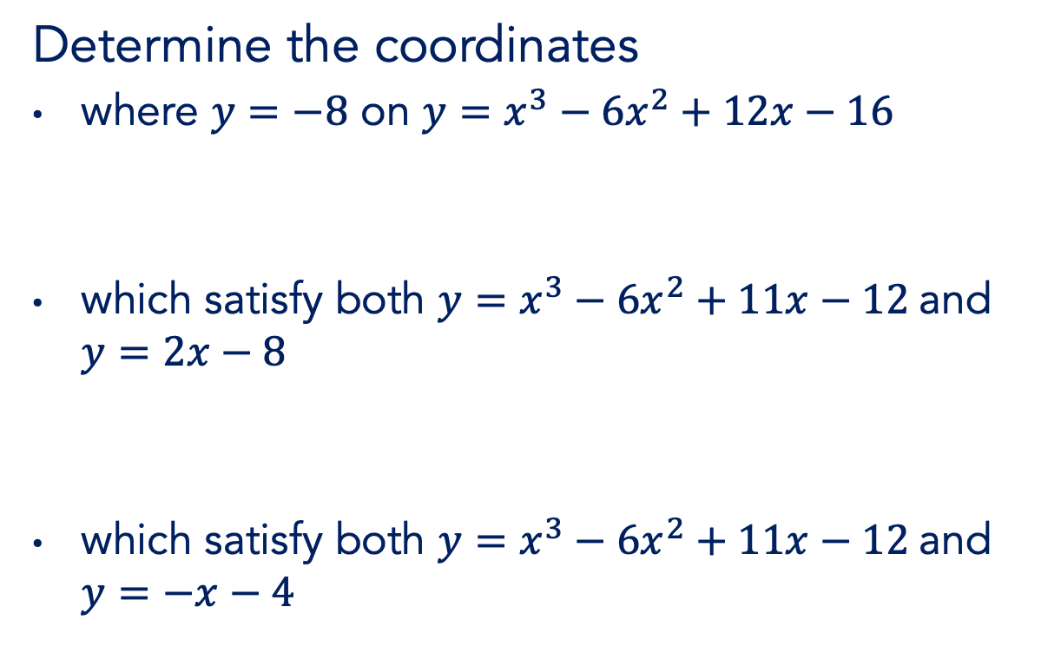


Cubic graphs
Determine the coordinates
where $y=−8$ on $y=x^{3}−6x^{2}+12x−16$
which satisfy both $y=x^{3}−6x^{2}+11x−12$ and $y=2x−8$
which satisfy both $y=x^{3}−6x^{2}+11x−12$ and $y=−x−4$

Slide 22


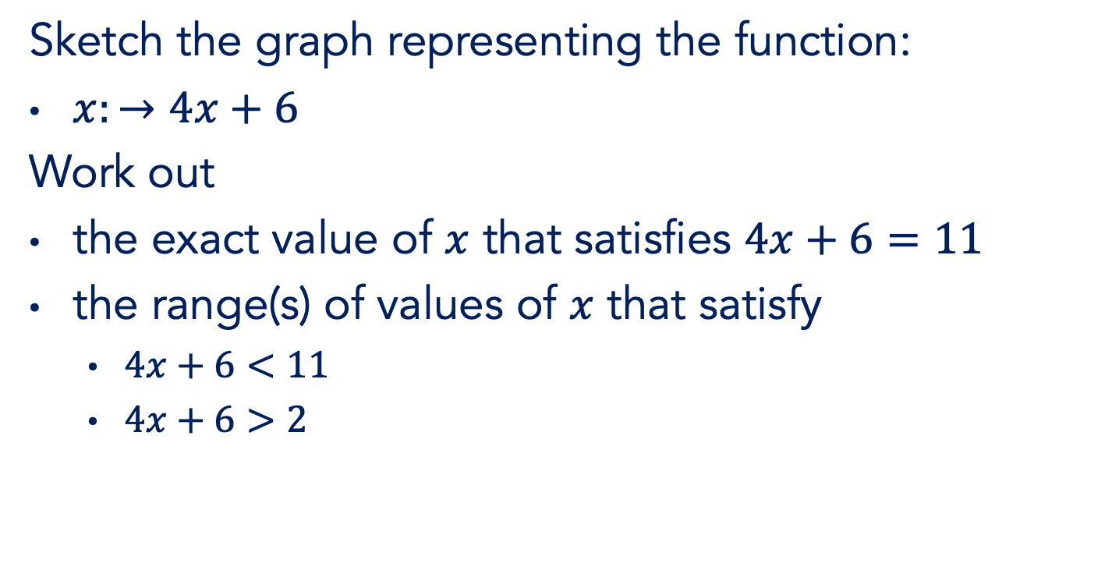
Inequalities
Sketch the graph representing the function:
$x:→4x+6$
Work out
the exact value of $x$ that satisfies $4x+6=11$
the range(s) of values of $x$ that satisfy
  $4x+6<11$
  $4x+6>2$

Slide 23
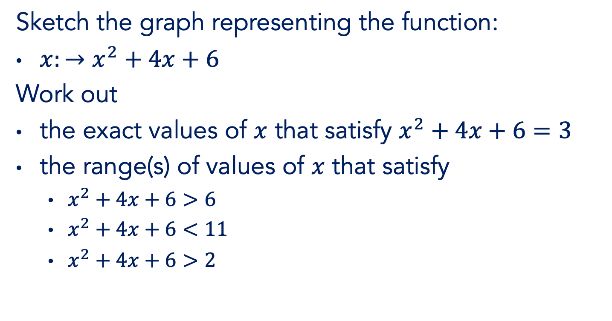
Inequalities
Sketch the graph representing the function:
$x:→x^{2}+4x+6$
Work out
the exact values of $x$ that satisfy $x^{2}+4x+6=3$
the range(s) of values of $x$ that satisfy
  $x^{2}+4x+6>6$
  $x^{2}+4x+6<11$
  $x^{2}+4x+6>2$

Slide 24

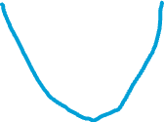

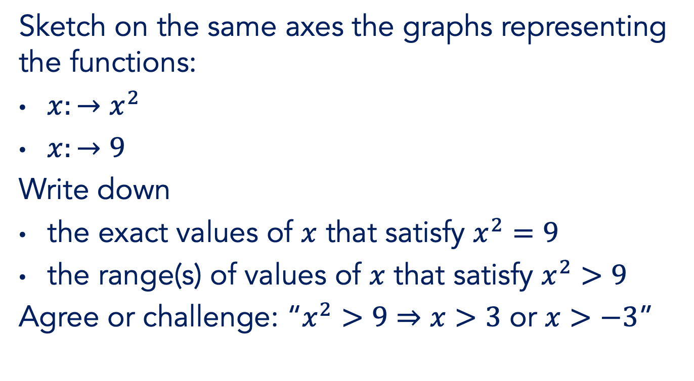

Inequalities
Sketch on the same axes the graphs representing the functions:
$x:→x^{2}$
$x:→9$
Write down
the exact values of $x$ that satisfy $x^{2}=9$
the range(s) of values of $x$ that satisfy $x^{2}>9$
Agree or challenge: “$x^{2}>9⇒x>3$ or $x>−3$”

Slide 25

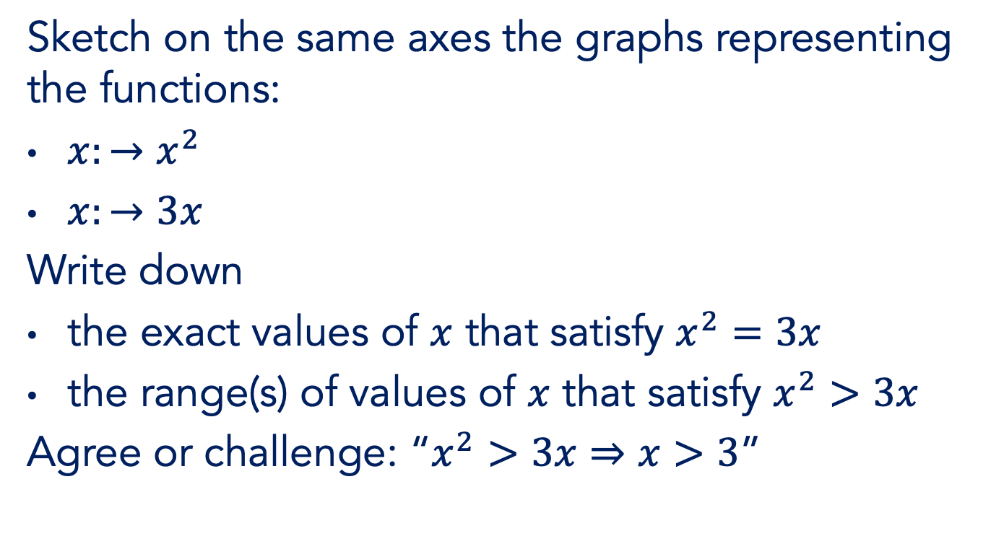


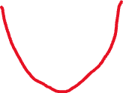



Inequalities
Sketch on the same axes the graphs representing the functions:
$x:→x^{2}$
$x:→3x$
Write down
the exact values of $x$ that satisfy $x^{2}=3x$
the range(s) of values of $x$ that satisfy $x^{2}>3x$
Agree or challenge: “$x^{2}>3x⇒x>3$”

Slide 26
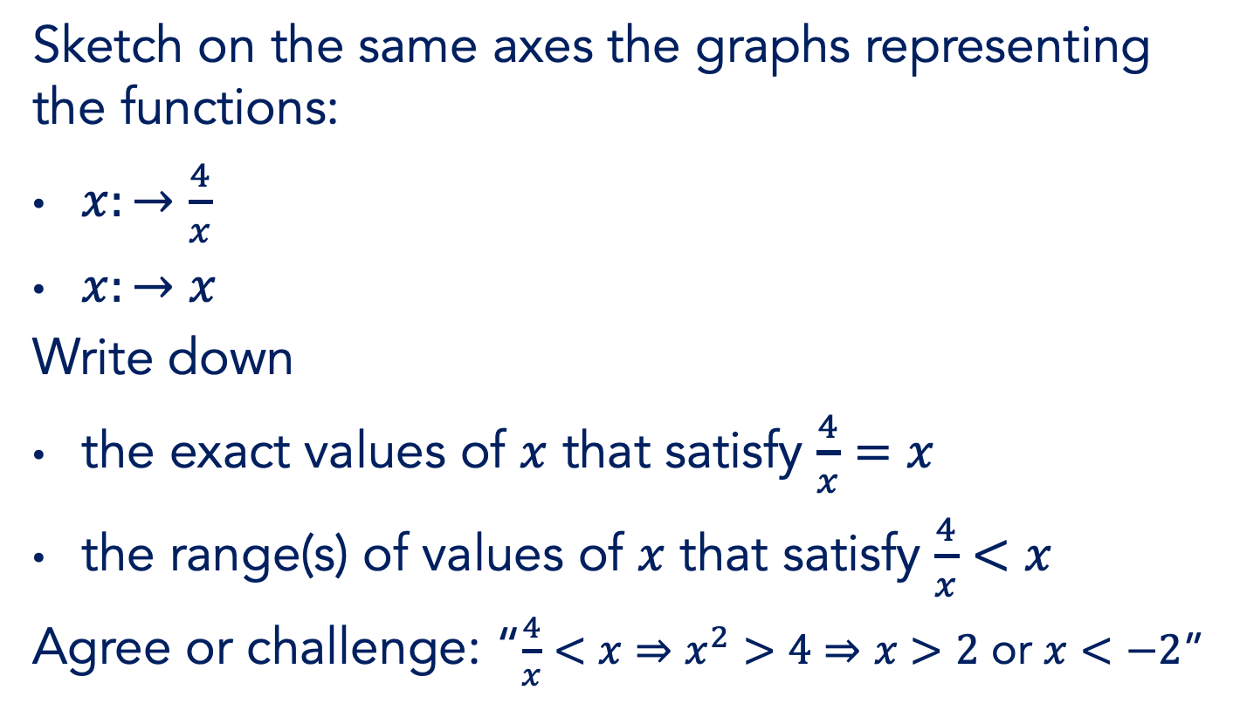
Inequalities
Sketch on the same axes the graphs representing the functions:
$x:→\frac{4}{x}$
$x:→x$
Write down
the exact values of $x$ that satisfy $\frac{4}{x}=x$
the range(s) of values of $x$ that satisfy $\frac{4}{x}<x$
Agree or challenge: “$\frac{4}{x}<x⇒x^{2}>4⇒x>2$ or $x<−2$”

Slide 27
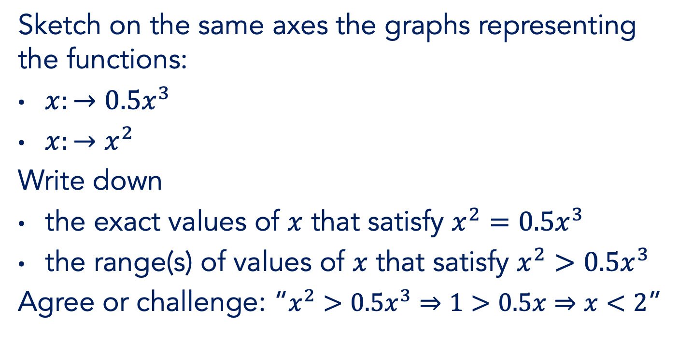
Inequalities
Sketch on the same axes the graphs representing the functions:
$x:→0.5x^{3}$
$x:→x^{2}$
Write down
the exact values of $x$ that satisfy $x^{2}=0.5x^{3}$
the range(s) of values of $x$ that satisfy $x^{2}>0.5x^{3}$
Agree or challenge: “$x^{2}>0.5x^{3}⇒1>0.5x⇒x<2$”

Slide 28




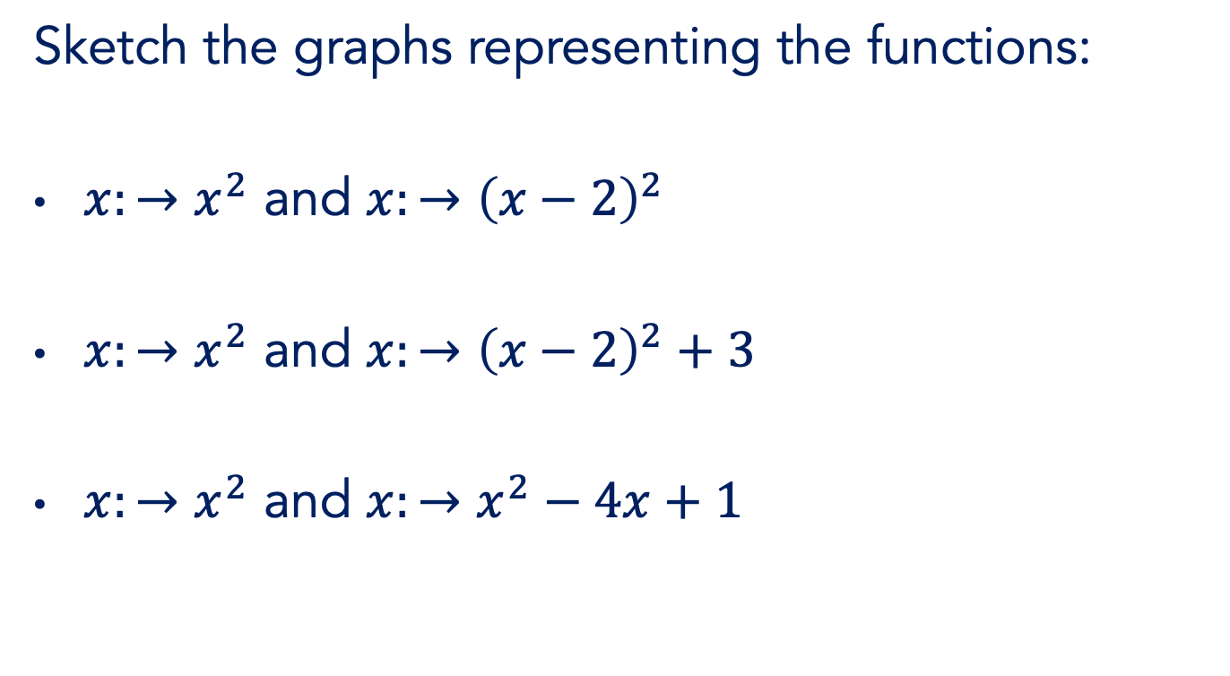


Transforming graphs
Sketch the graphs representing the functions:
$x:→x^{2}$ and $x:→{\left(x−2\right)}^{2}$
$x:→x^{2}$ and $x:→{\left(x−2\right)}^{2}+3$
$x:→x^{2}$ and $x:→x^{2}−4x+1$

Slide 29











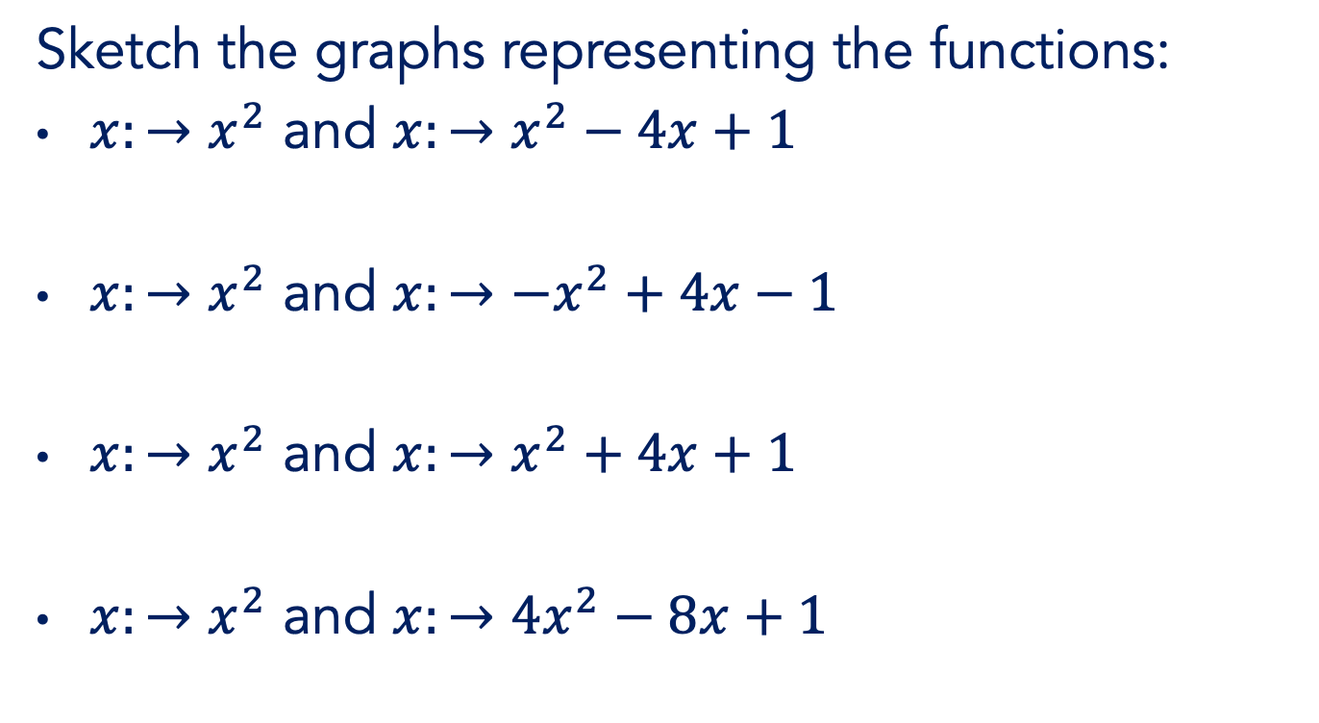
Transforming graphs
Sketch the graphs representing the functions:
$x:→x^{2}$ and $x:→x^{2}−4x+1$
$x:→x^{2}$ and $x:→{−x}^{2}+4x−1$
$x:→x^{2}$ and $x:→x^{2}+4x+1$
$x:→x^{2}$ and $x:→{4x}^{2}−8x+1$

Slide 30
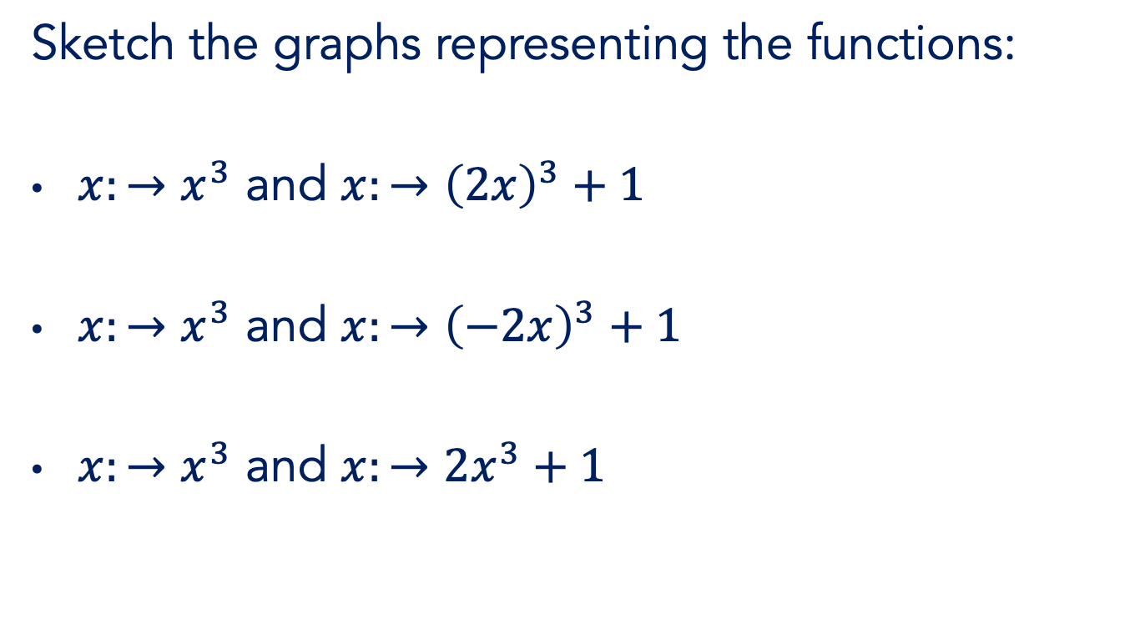



Transforming graphs
Sketch the graphs representing the functions:
$x:→x^{3}$ and $x:→{\left(2x\right)}^{3}+1$
$x:→x^{3}$ and $x:→{\left(−2x\right)}^{3}+1$
$x:→x^{3}$ and $x:→{2x}^{3}+1$

Slide 31










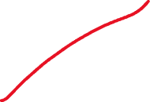




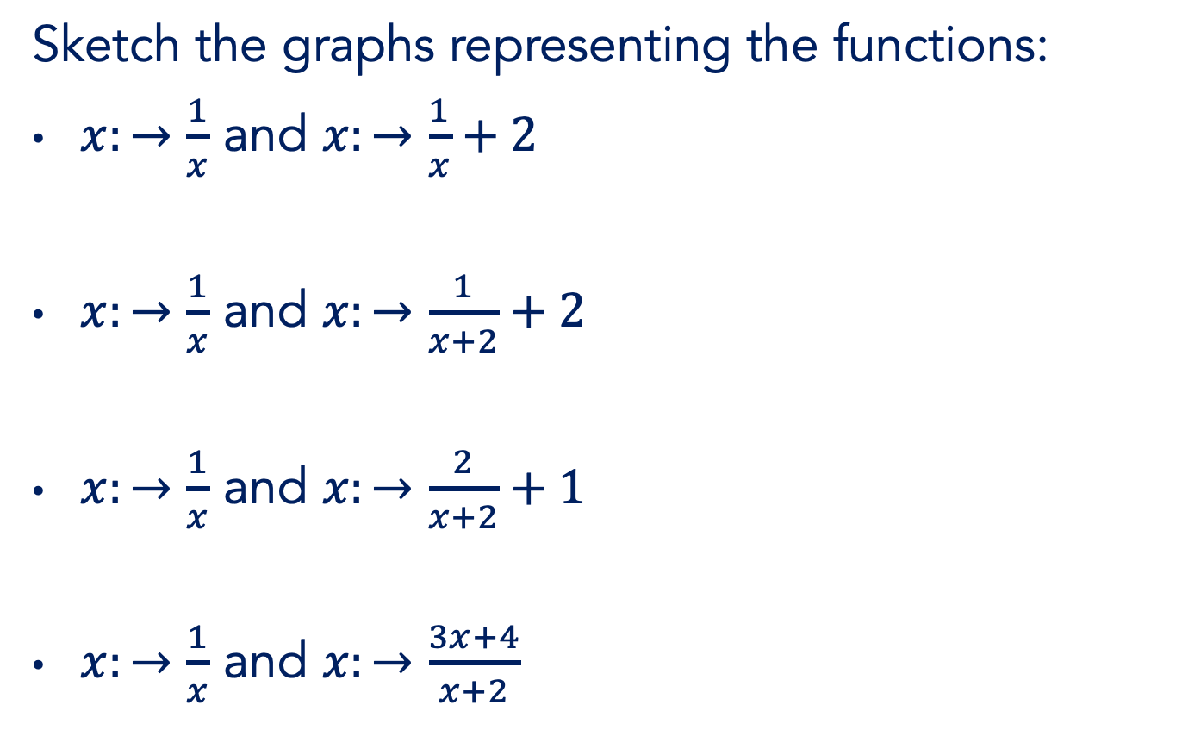

Transforming graphs
Sketch the graphs representing the functions:
$x:→\frac{1}{x}$ and $x:→\frac{1}{x}+2$
$x:→\frac{1}{x}$ and $x:→\frac{1}{x+2}+2$
$x:→\frac{1}{x}$ and $x:→\frac{2}{x+2}+1$
$x:→\frac{1}{x}$ and $x:→\frac{3x+4}{x+2}$

Slide 32

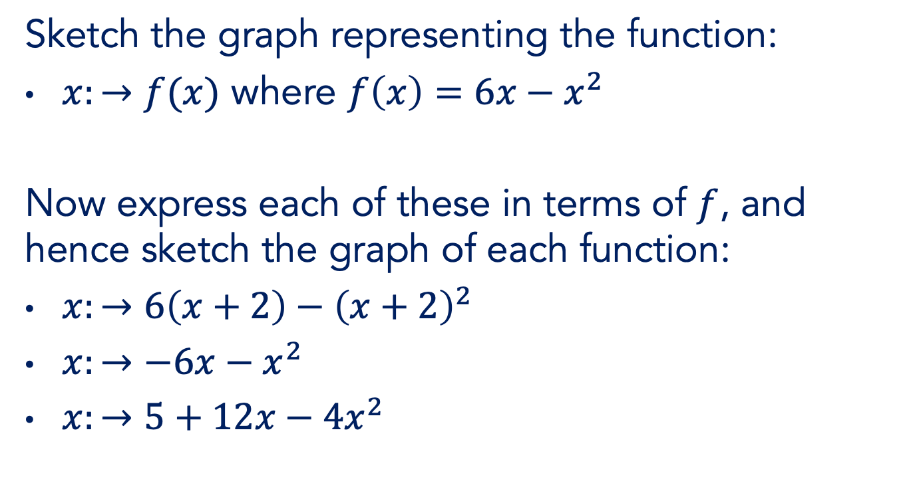
Transforming graphs
Sketch the graph representing the function:
$x:→f(x)$ where $f\left(x\right)=6x−x^{2}$
Now express each of these in terms of $f$, and hence sketch the graph of each function:
$x:→6\left(x+2\right)−{\left(x+2\right)}^{2}$
$x:→−6x−x^{2}$
$x:→5+12x−4x^{2}$

Slide 33


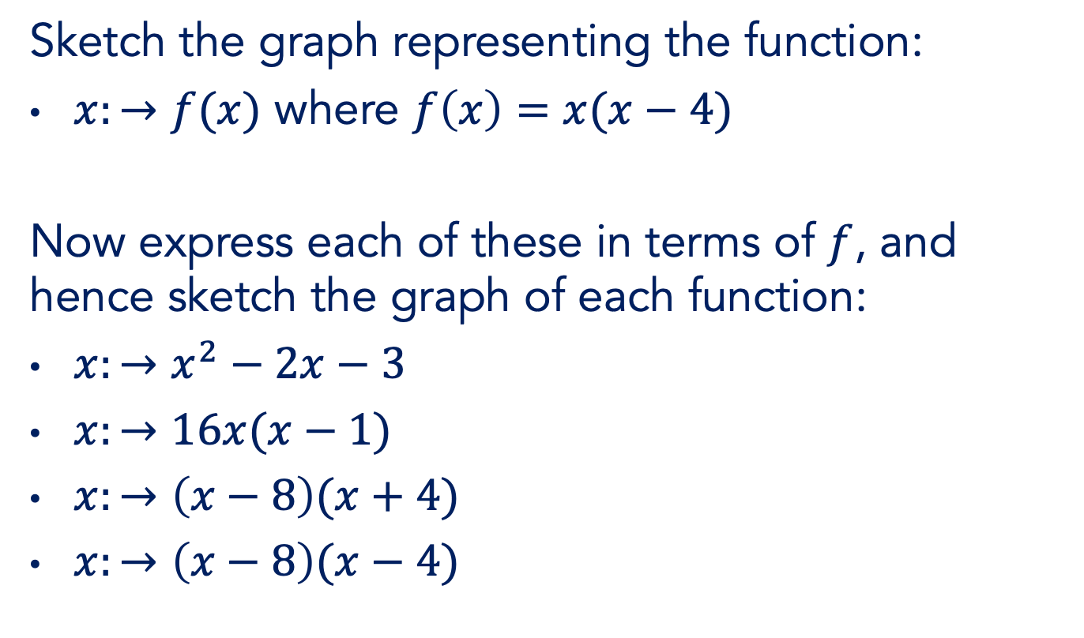

Transforming graphs
Sketch the graph representing the function:
$x:→f(x)$ where $f\left(x\right)=x(x−4)$
Now express each of these in terms of $f$, and hence sketch the graph of each function:
$x:→x^{2}−2x−3$
$x:→16x(x−1)$
$x:→\left(x−8\right)(x+4)$
$x:→\left(x−8\right)(x−4)$

Slide 34
Text
Your Q
Your Q
Your Q
Your Q
Your Q
Your Q
Your Q
Your Q

Slide 35








Text

Slide 36












Text

Slide 37
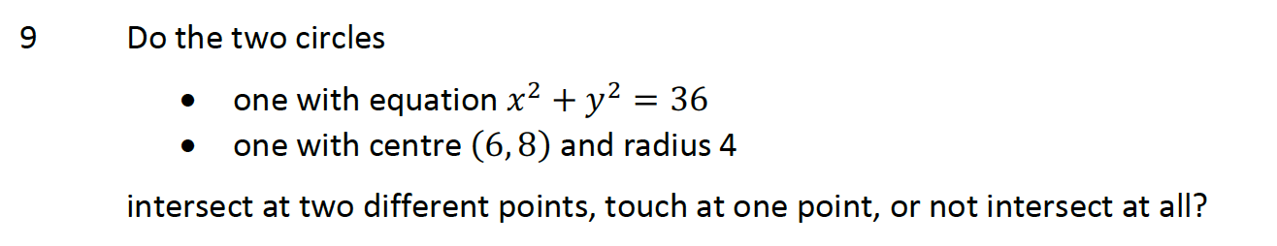

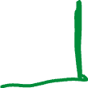






Intersecting circles
Notes:
Give TTs time to read

Slide 38



Intersecting circles
Find the intersection(s) of
$x^{2}+y^{2}−2x−8=0$
$x^{2}+y^{2}−12x+20=0$
Notes:
Give TTs time to read

Slide 39
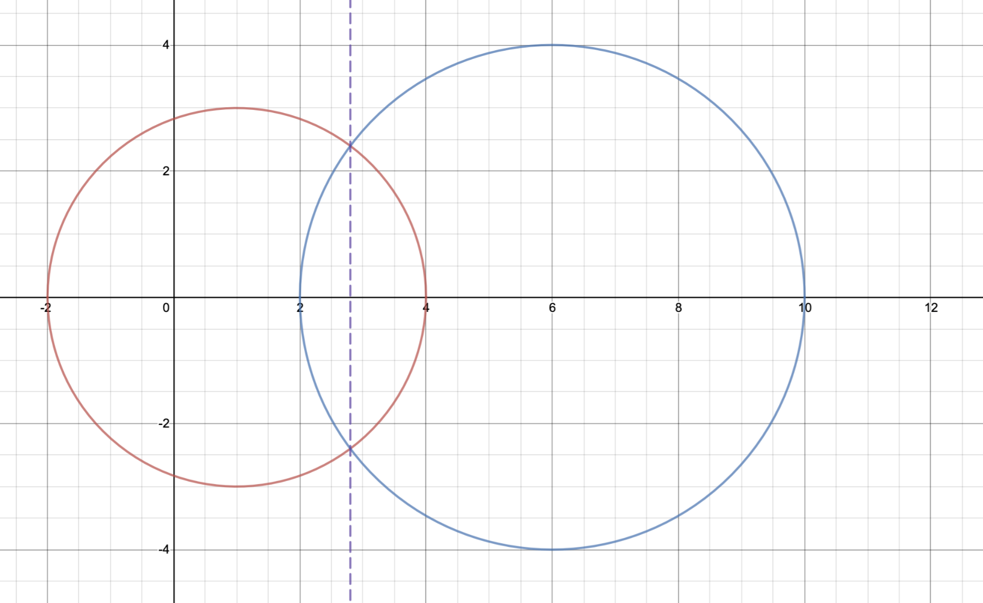




Intersecting circles
Find the intersection(s) of
$x^{2}+y^{2}−2x−8=0$
$x^{2}+y^{2}−12x+20=0$
Notes:
Give TTs time to read

Slide 40




Intersecting circles
Find the intersection(s) of
$x^{2}+y^{2}−2x−8=0$
$x^{2}+y^{2}−16x+48=0$
Notes:
Give TTs time to read

Slide 41
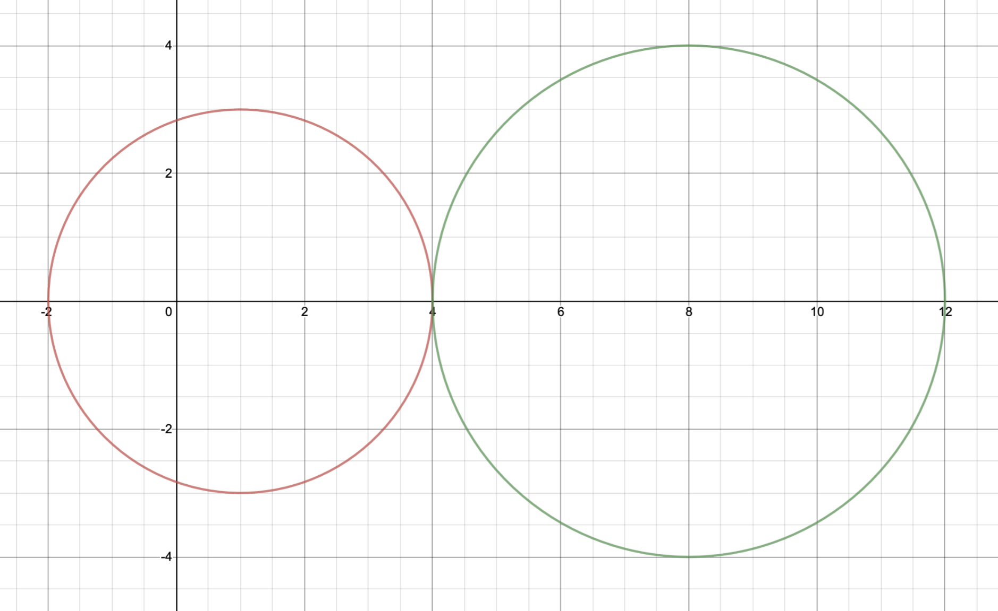

Intersecting circles
Find the intersection(s) of
$x^{2}+y^{2}−2x−8=0$
$x^{2}+y^{2}−16x+48=0$
Notes:
Give TTs time to read

Slide 42




Intersecting circles
Find the intersection(s) of
$x^{2}+y^{2}−2x−8=0$
$x^{2}+y^{2}−20x+84=0$
Notes:
Give TTs time to read

Slide 43
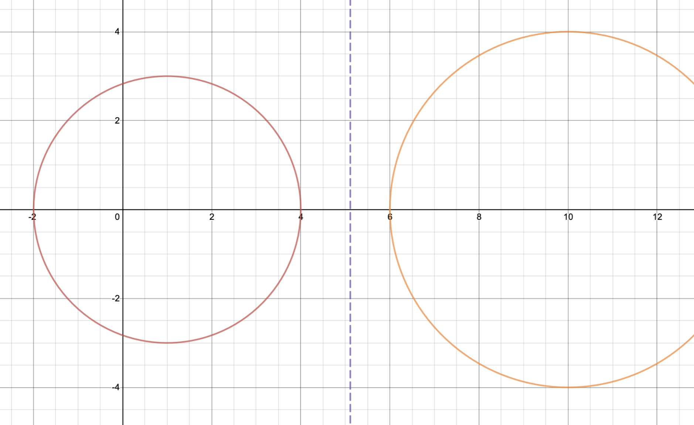






Intersecting circles
Find the intersection(s) of
$x^{2}+y^{2}−2x−8=0$
$x^{2}+y^{2}−20x+84=0$
Notes:
Give TTs time to read

Slide 44





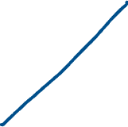
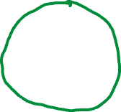



The altitudes of a triangle
A triangle has vertices at (-1, -6), (5, 6) and (11, -2)
Verify that the three altitudes are concurrent (at the orthocentre).

Slide 45
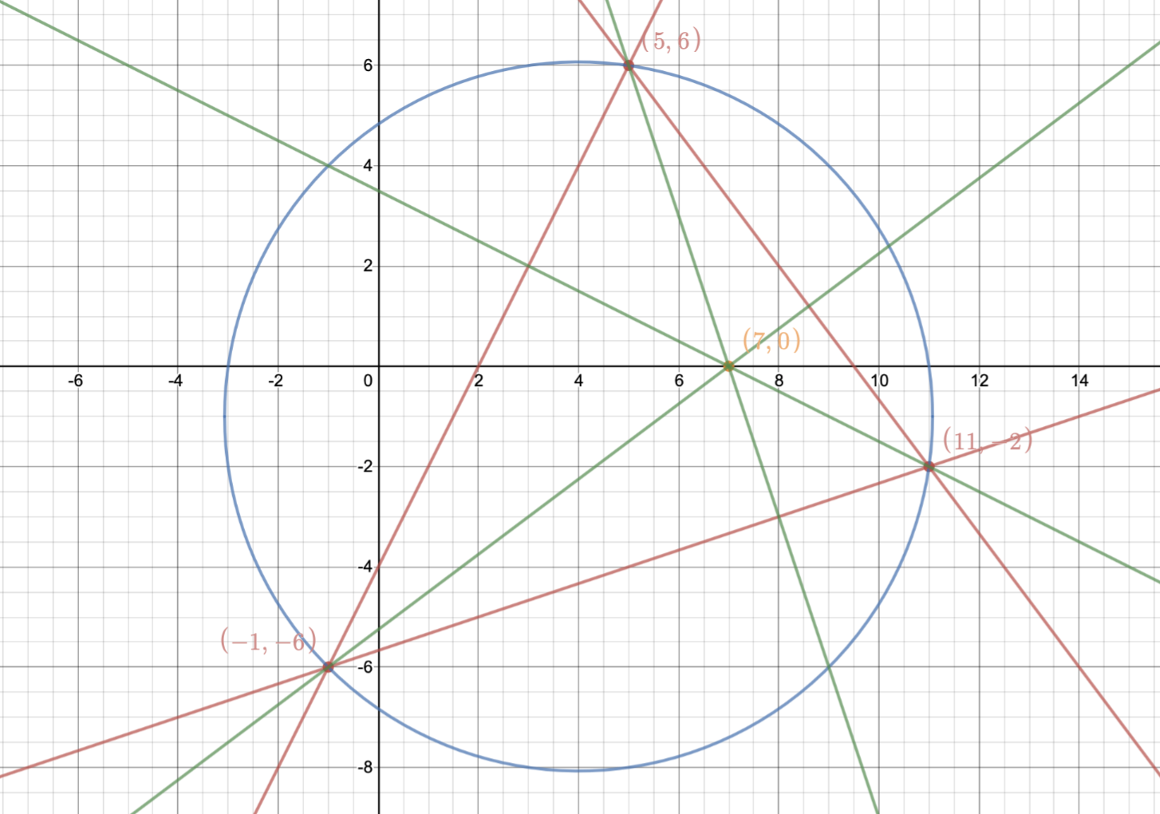




The altitudes

Slide 46
In conclusion
“Unfinished business” leads to “trouble ahead”
General tactics & Specific strategies
Desirable difficulty, productive struggle
Get the maths from them
Accommodate don’t assimilate

Slide 47
Text
What might we do first?
What might we do next?
Agree or challenge?
Why did we … ?
Are you sure?
What do you notice?
What’s the same, what’s different
Why didn’t we … ?

Slide 48
Text
What might we do first?
What might we do next?
Graphs are representations of functions
Agree or challenge?
Why did we … ?
Are you sure?
What do you notice?
What’s the same, what’s different
Why didn’t we … ?

Slide 49
Thank you
Robert Wilne
robert.wilne@kcl.ac.uk
#TeachersAlwaysLearning
#LearningTogether
@kingsmathschool

