Slide 1
Design and Technology LWA -HEP primary subject network meeting 10th November 2022 16:00-17:30
Lead: Sue Miles-Pearson

Slide 2
Agenda:
Breakout rooms- mixed schools /age phases
Discussion about what D&T has been taught recently in the primary schools considering the following:
What were the key:
Learning objectives (LO) / Skills needed / learnt / How was this assessed / What health and safety was in place?
Return to main room- feedback
How an we increase the amount of D&T that is being taught in school?
Product Analysis – activity.
Introduction to H&S in the primary classroom.
Tools and equipment
Teaching children to use the tools ‘appropriately’.
Levers and cardboard engineering
Subject knowledge
Examples: Different age phases, books, construction and toys.
Exploring and investigating – with card strips and split pins
Share examples
Breakout room
share ideas and suggestions
Q&A
Evaluation
Task for next session

Slide 3
Breakout rooms- mixed schools /age phases
Discussion about what D&T has been taught recently in the primary schools considering the following:
What were the key:
Learning objectives (LO)
Skills needed / learnt
How was this assessed
What health and safety was in place

Slide 4
Return to main room- feedback
How an we increase the amount of design and technology that is being taught in school?
Any ideas?

Slide 5
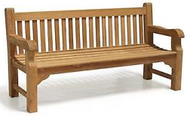
Product Analysis Looking at design
User
Function
Material
Aesthetics
Environment
(Sustainable wood or
where it is positioned.)
Improvements

Slide 6
Model of a whole class example. Getting the children to work in groups.
An everyday item
Examples could be…
Kettle
Brush
Phone
Cup
Hairdryer
Fork
etc…
A piece of street furniture
Examples could be…
Bench
Street lamp
Bus shelter
Railing
Bollard
Litter bin
etc…

Slide 7
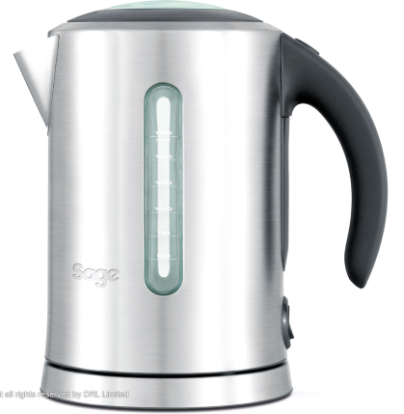
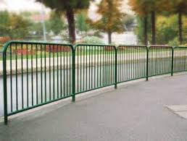
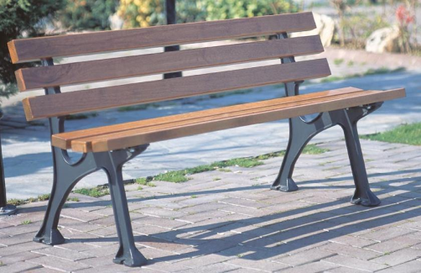
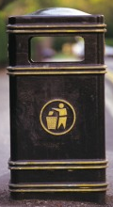
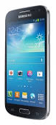
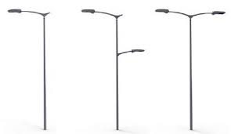
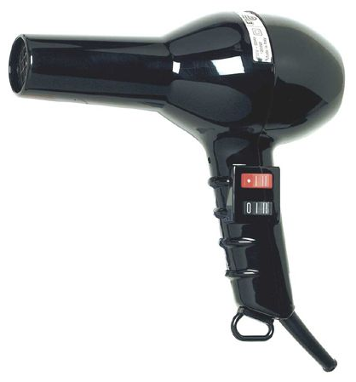
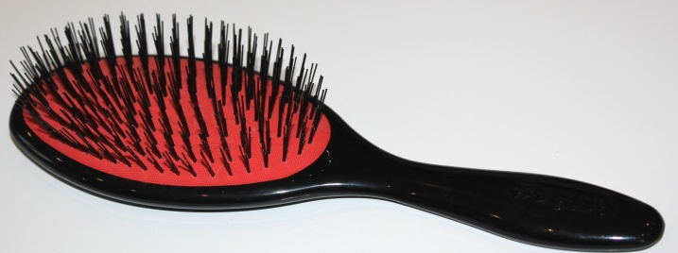
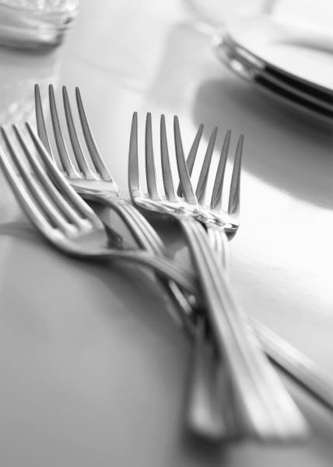
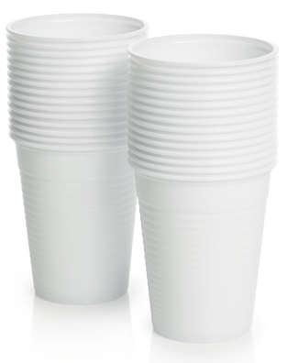
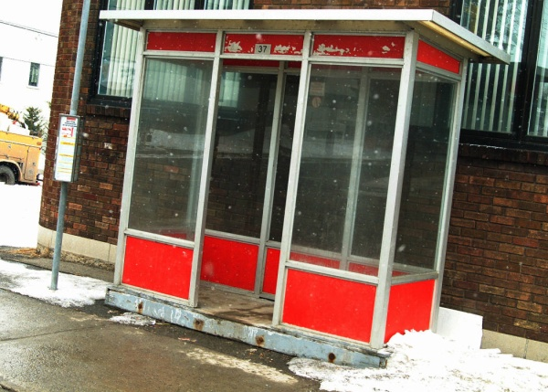
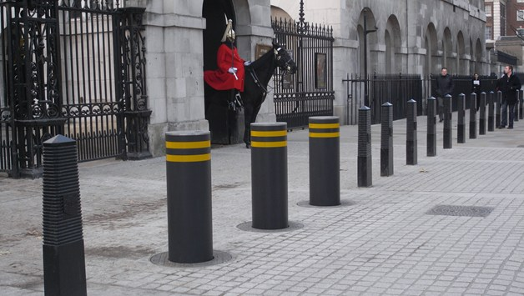
Group discussions It is really important to have a visual example if you cannot give the children the actual article.

Slide 8
Introduction to health & safety in the primary classroom.
Tools and equipment
Teaching children to use the tools ‘appropriately’.

Slide 9
Health and safety when using tools in design and technology
Self healing cutting board – like a dart board.
Craft knifes – now only in years 5 and 6 (One to one with adults).
Plastic ruler – do not use with craft knives.
Safety metal ruler – finger groove for safety.
Junior hack saw – carry safely like scissors (foundation years).
Bench hooks – attach to bench or tables.
Square battening, Round dowels, Balsa wood.

Slide 10
Red and yellow lynx joints, for getting the perfect right angle (but using the corner of a piece of paper will also work).
Card triangles - to make strong joints.
Scissors – crafts snip or tin snip cut through card, fabric even leather.
4 finger hole scissors – adult support for pore fine motor.
Sellotape – not used a great deal. Masking tape instead of clear adhesive tape, stronger and can withstand movement and decoration.

Slide 11
Levers and cardboard engineering
Subject knowledge
Examples: Different age phases, books, construction and toys.
Exploring and investigating – with card strips and split pins
Examples

Slide 12
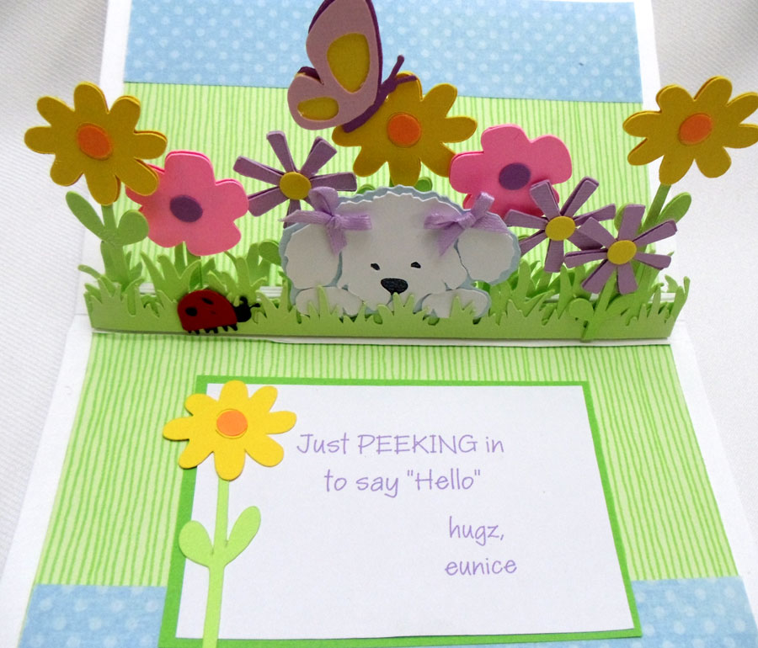
Introduction to Mechanisms Levers and cardboard engineering
This Photo by Unknown Author is licensed under CC BY-NC-ND

Slide 13
Description of a lever –
A lever is a rigid rod or bar that pivots about a point known as the fulcrum or pivot.
It is used to move or lift a load at one end by applying force to the other end.
You can ask the children “What would be a good example that you can see around you?”.

Slide 14
There are three main component parts to a lever:
Pivot / Fulcrum
Effort ( applied force / input)
Load (output)

Slide 15
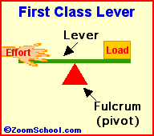
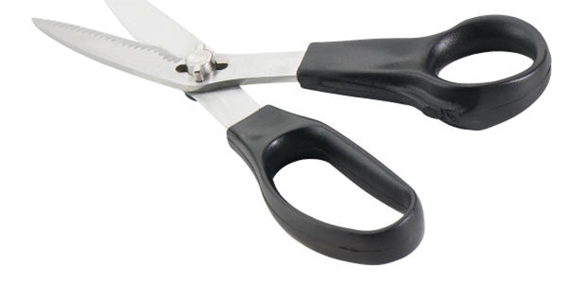
There are three classifications of a lever:
1st class lever
Effort Pivot Load

Slide 16
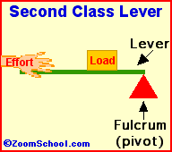

2nd class lever
Effort Load Pivot

Slide 17
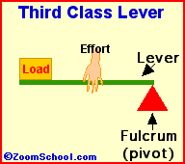
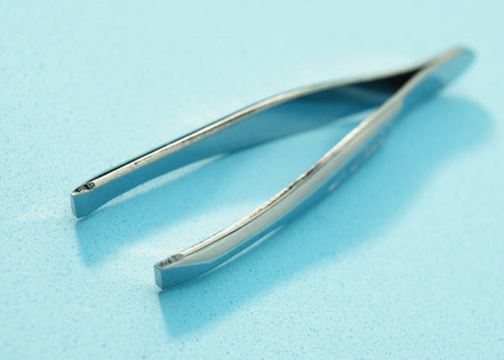
3rd class lever
Pivot Effort Load

Slide 18
Lever identification grid
Classifications
1st | E | P | L
2nd | P | L | E
3rd | P | E | L

Slide 19
Investigation and exploration
are essential
Examples: Different age phases, books, construction and toys.
Exploring and investigating – with card strips and split pins
Examples

Slide 20
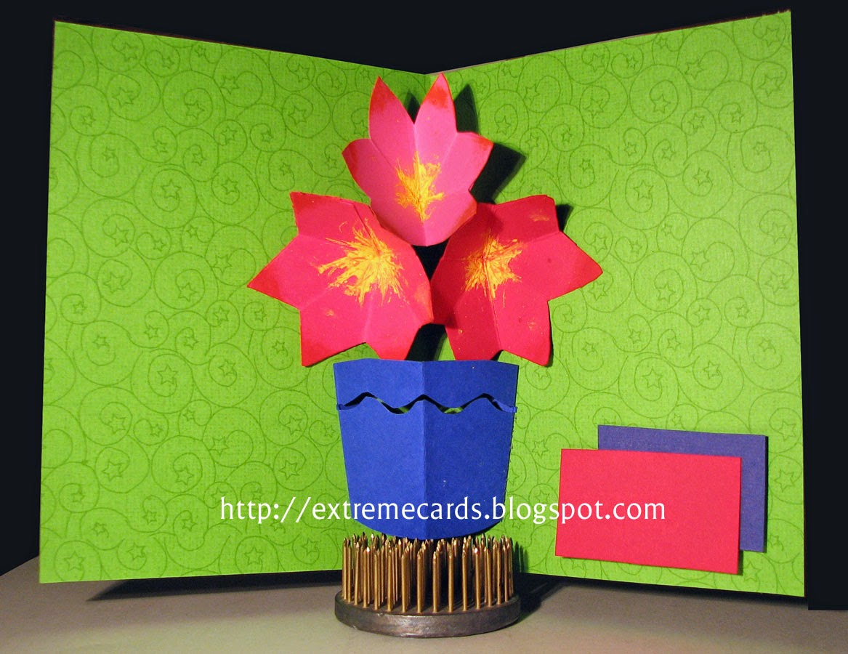
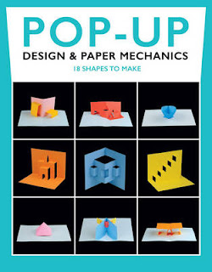
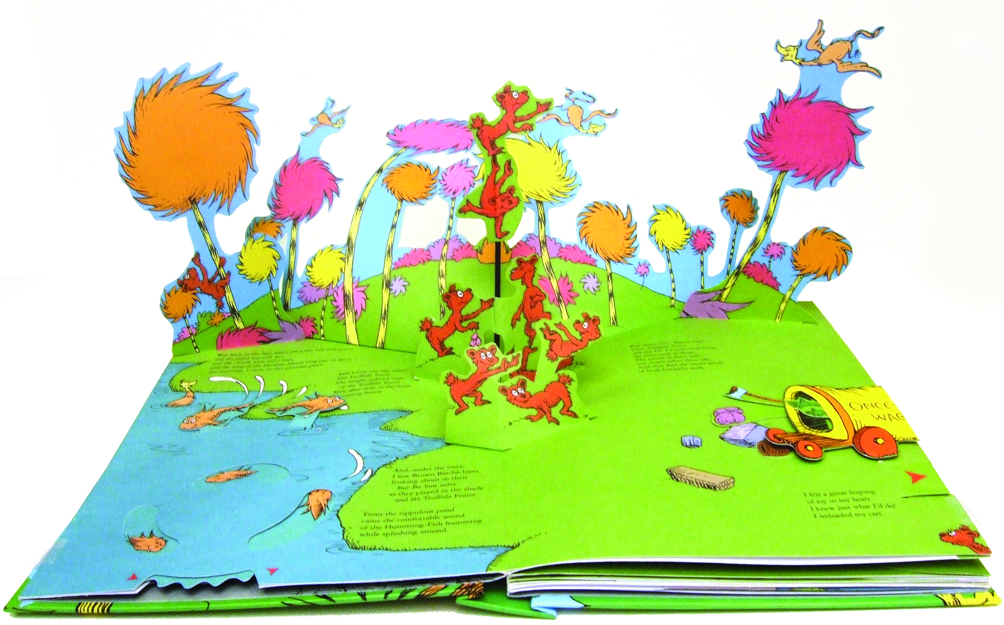
Childrens pop-up books and flap books are good examples of a basic lever for young children.

Slide 21
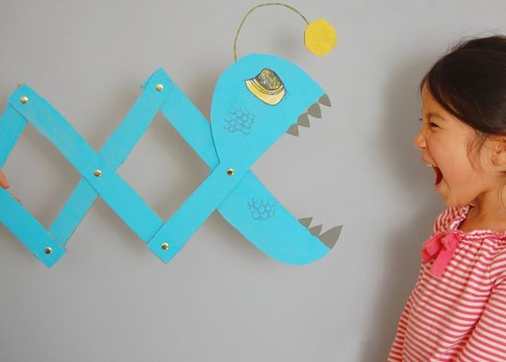
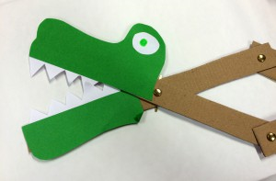
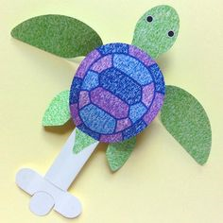
Cardboard engineering

Slide 22
Breakout rooms
Share ideas and suggestions

Slide 23
Any questions
Please?

Slide 24
Task for next session: Please bring along an example of a moving picture that you / or the children have made.
Please complete the online evaluation.
https://www.hounsloweducationpartnership.co.uk/survey/primary-subject-network-evaluation-november-2022/
Thank you, hope to see you next time. Sue

