Slide 1
Primary School Delivery

Slide 2
The Harlequins Foundation
The Harlequins Foundation is the embodiment of the Club’s belief to put our communities at the heart of everything we do.
Our Vision – A world where the power of sport is used to drive positive change.
2074 Participants - across our school programmes
£1: £4.73 - ratio £s spent : Social Value generated
£2,979,000 - Social Value created during 2021/22 season

Slide 3
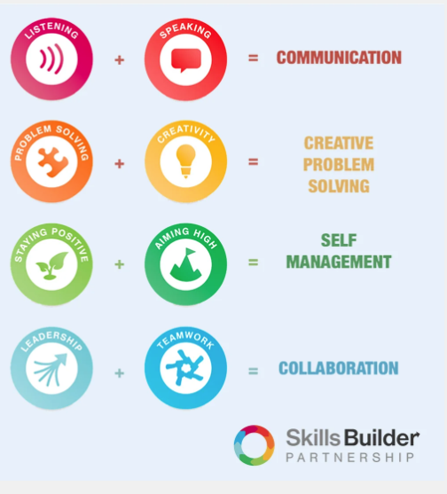
Essential Skills
At the Harlequins Foundation we pride ourselves on developing and delivering programmes that not only provide fun ways of getting our participants active, but also help them develop the essential skills required to succeed in life.
The Skills Builder Universal Framework provides the national standard for teaching the Essential Skills. It breaks each skill into steps, supporting progress for students of all ages and abilities – including those with Special Educational Needs.
We are able to map each of our sessions against this skills framework.

Slide 4
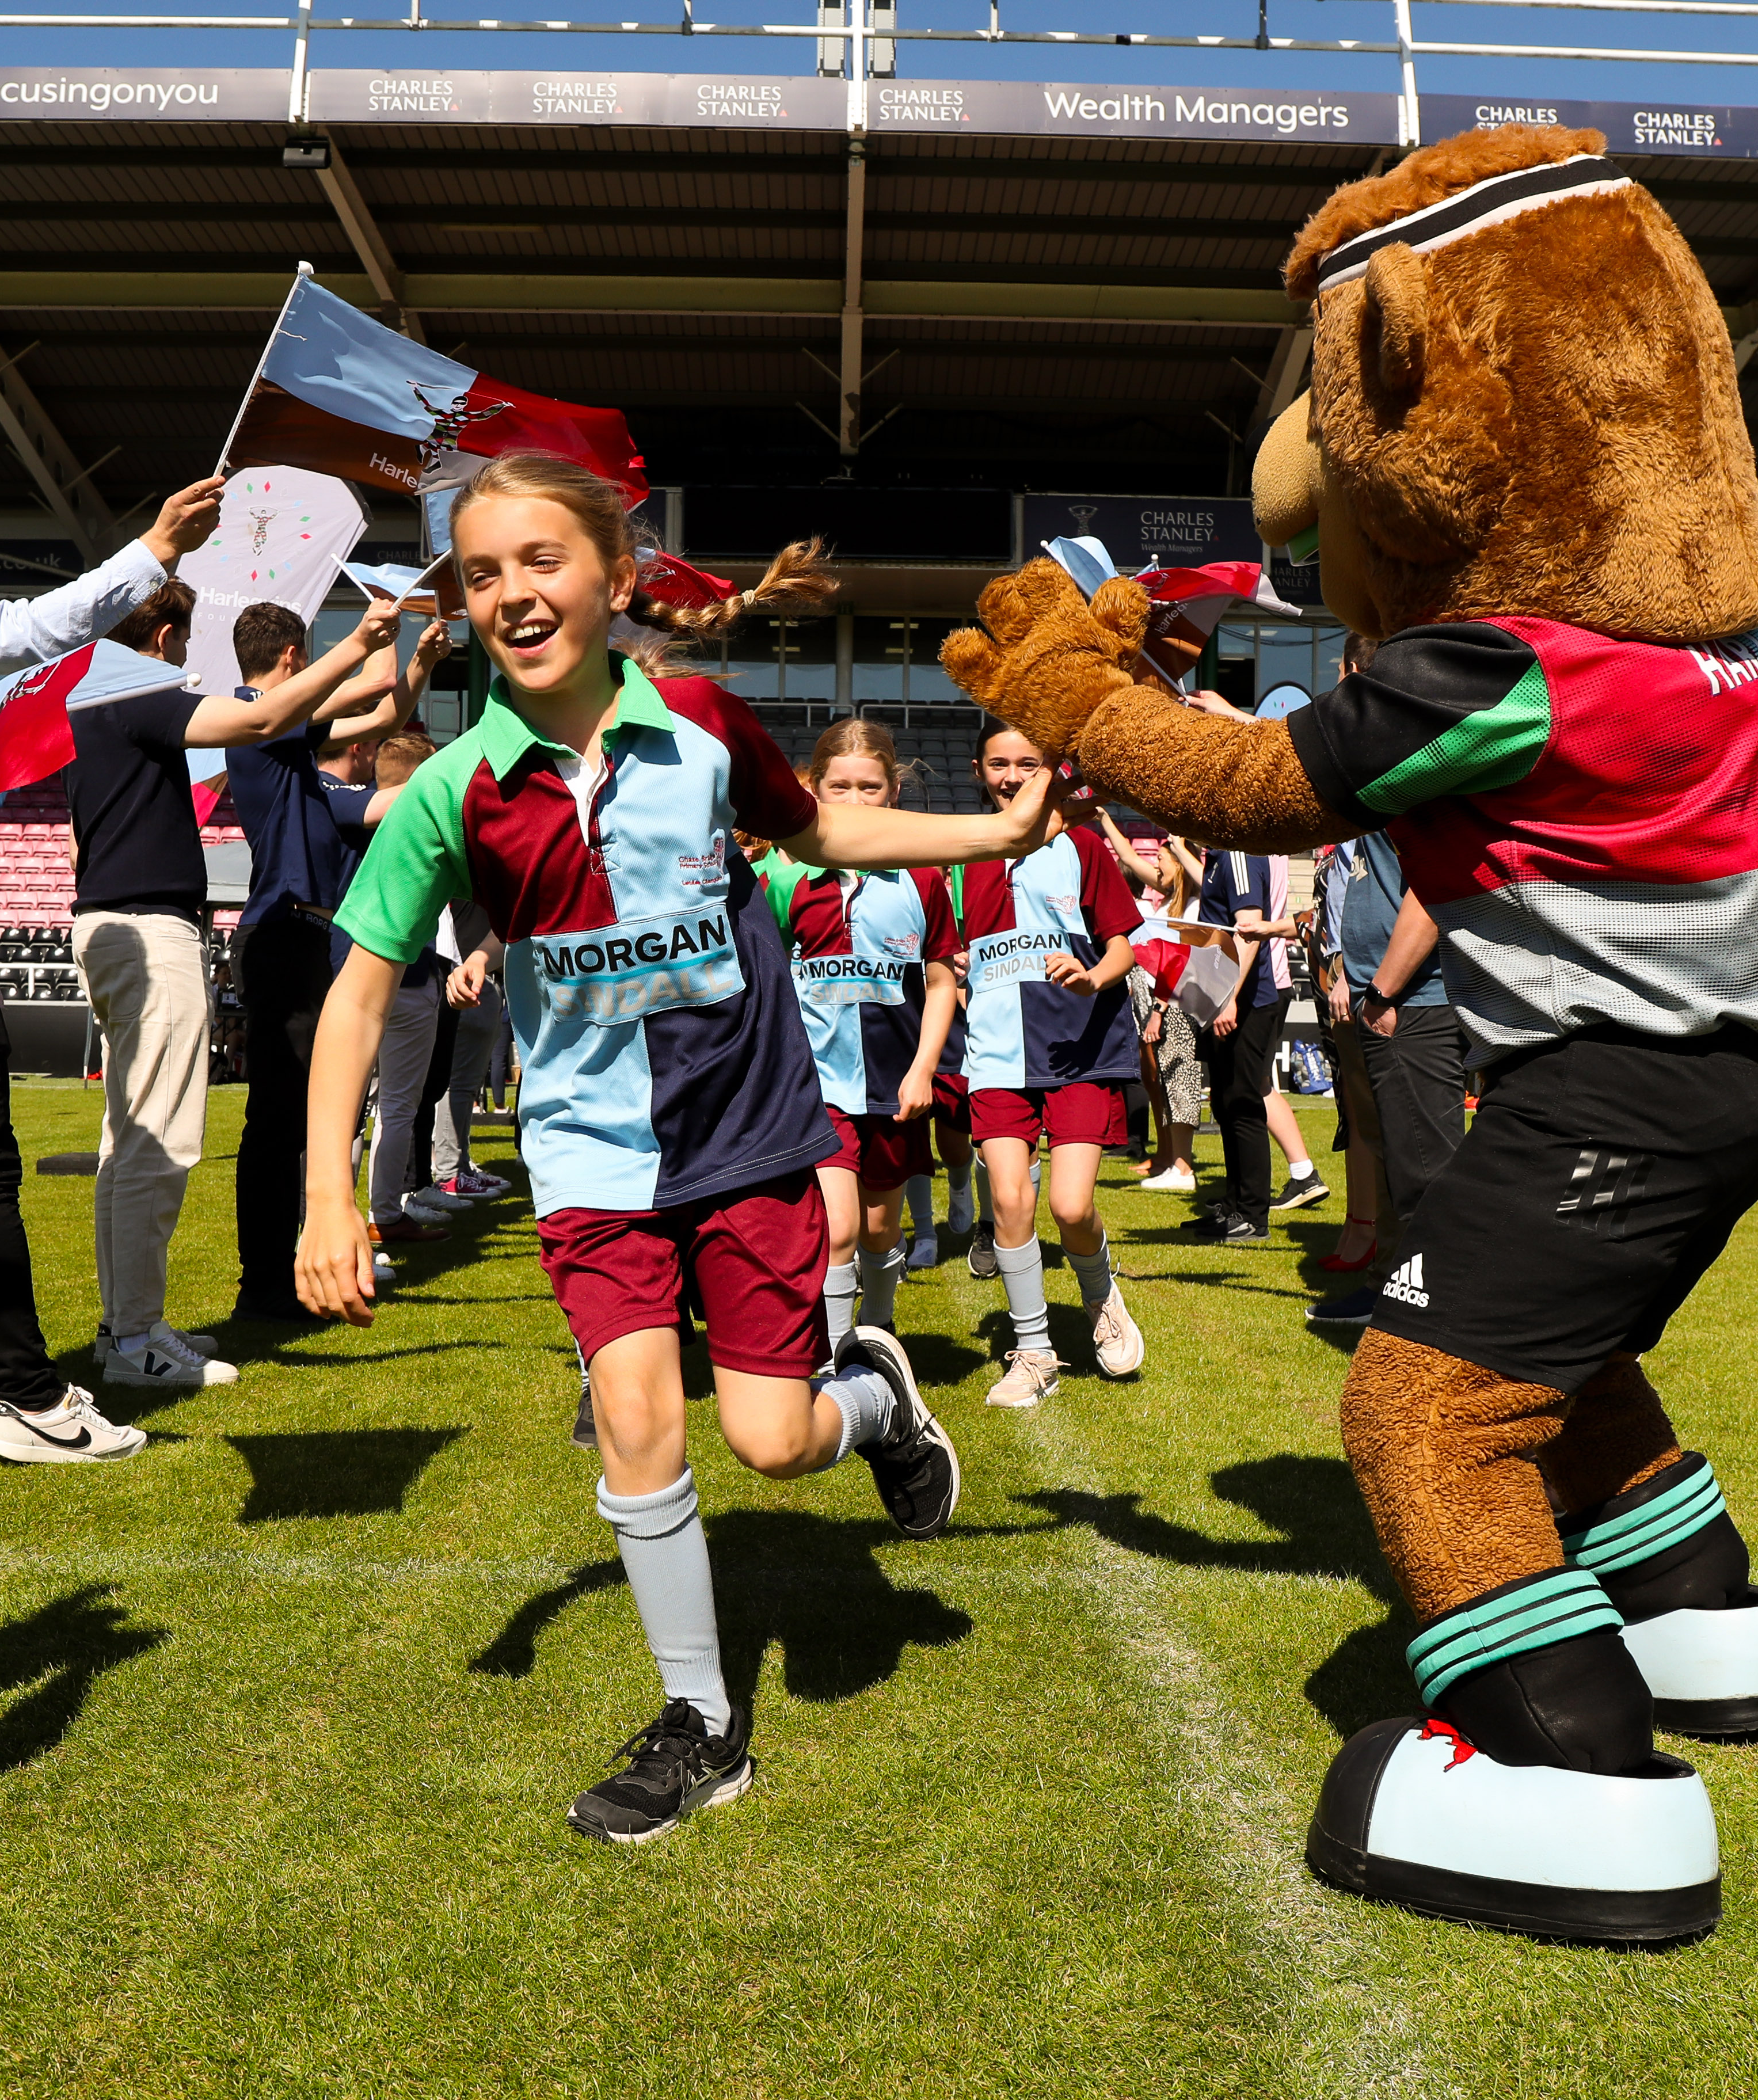
MOVE – LEARN – GROW
Why?
Only 44.6% children are completing an average of 60 minutes sport and physical activity a day (Active Lives- Children and Young People Survey)
Children’s activity levels have fallen by 13% compared to pre-pandemic levels
(International journal of Behavioural Nutrition and physical activity)
54% of children would like to do more exercise or sport (Youth Sports Trust – Foresight Factory)
Evidence indicates Primary PE and Sport premium spending is having a positive impact… how are you spending yours?

Slide 5
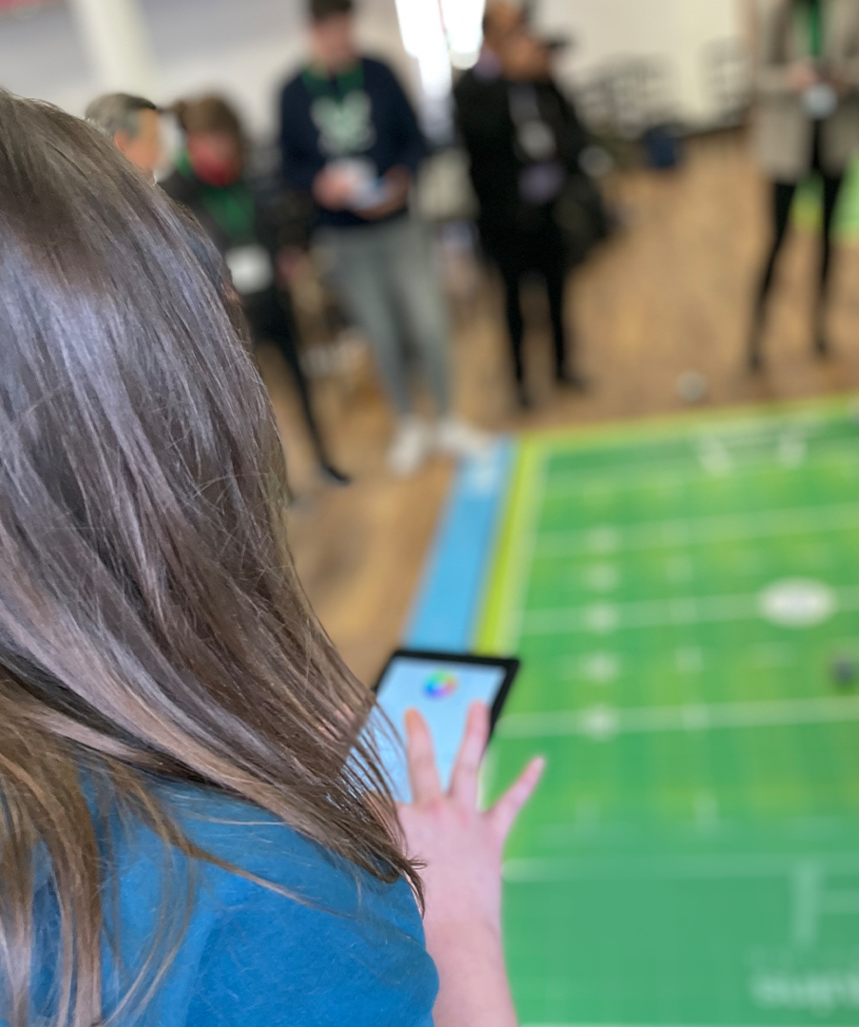
Robot Rugby
The Harlequins Foundation are proud to deliver 'Robot Rugby', a world-first coding experience for schools. ​
​Robot Rugby enables pupils to collaborate with their peers and explore the world of STEM while gaining a unique and exciting insight into careers in high performance sport.
“It was really amazing, such a well designed and expertly led piece of Stem learning. The children cant wait for the next session!”
Mr Lee, Headteacher at Deer Park Primary School

Slide 6
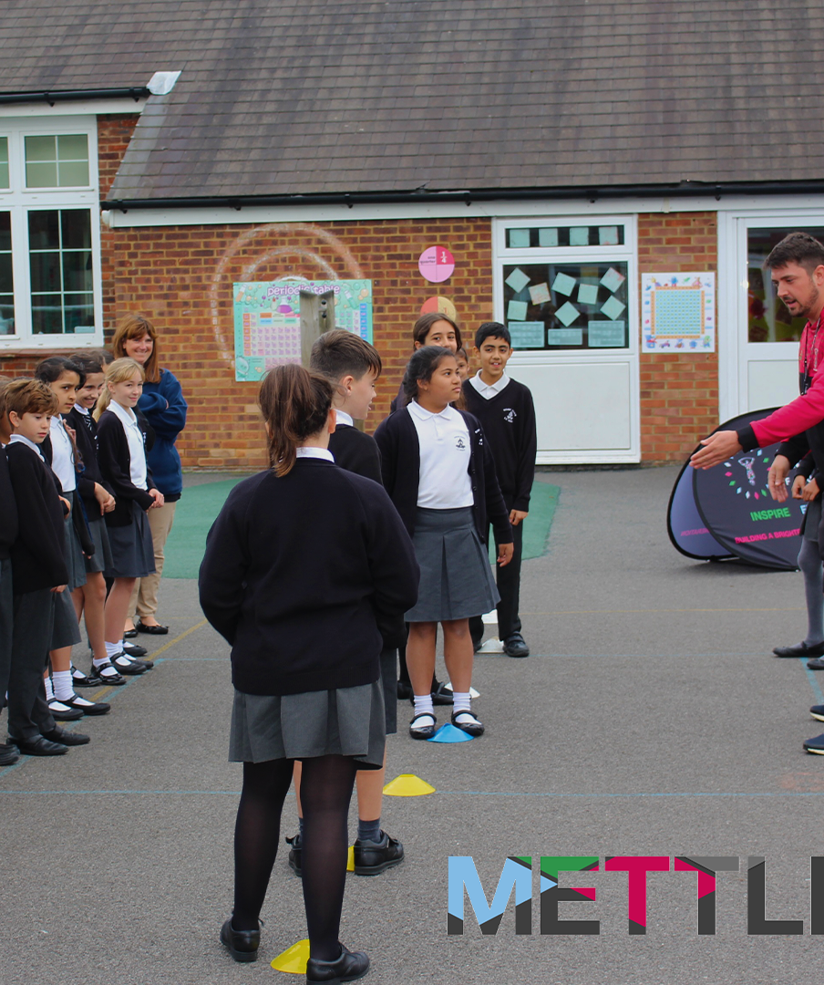
METTLE
Relationships – Emotions - Self-care – Physical Activity
Over a third (36%) of parents believe that their child’s physical wellbeing has been negatively impacted by the Covid-19 pandemic, while 43% believe that their child’s mental wellbeing has been negatively impacted and 53% believe social wellbeing has suffered. (Save the Children)
Why METTLE?
31.3% Participants were more active through sport after attending METTLE
19.8% of participants worried less and 18.3% felt unhappy/sad/tearful less often.
20.1% of participants were less nervous in new situations.

Slide 7
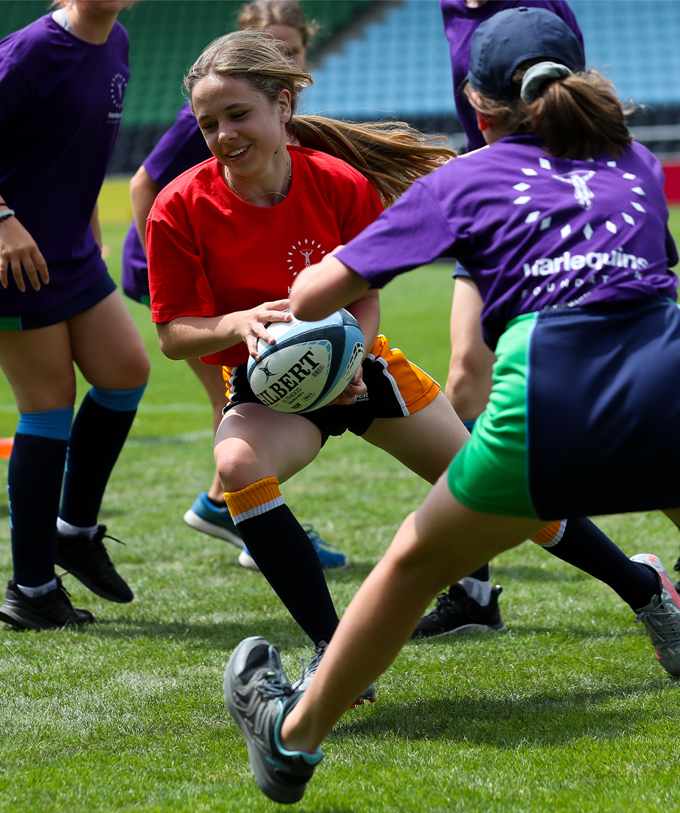
SWITCH
The Challenge:
Only 37% of young girls take part in PE at school and only 49% of those enjoy it.
90% of girls not doing enough physical activity by the age of 14.
SWITCH is a multi-tiered programme aimed at encouraging girls to get involved in rugby.​
​
Increasing accessibility and participation
Inspiring and excelling – using our coaches to nurture and develop girls’ progression within the game.​
Developing and sustaining – educating staff, supporting schools, and providing an onward pathway.​

Slide 8
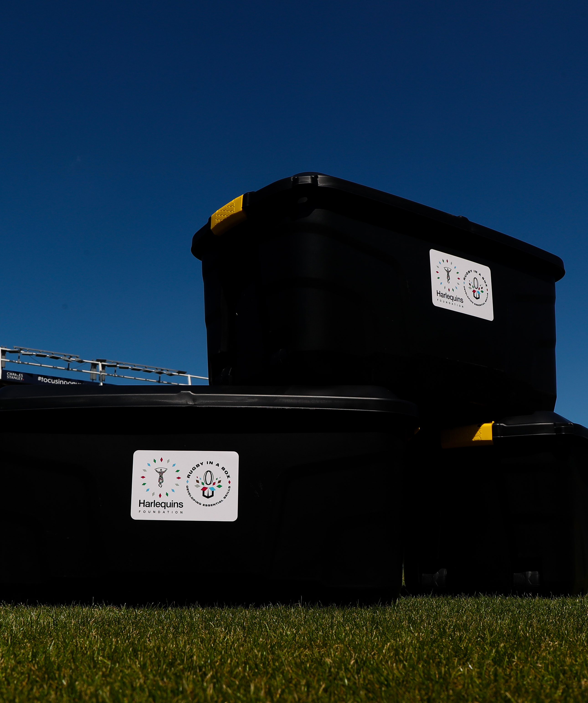
Rugby in a Box
Everything you need to run a tag rugby session, from tag belts and balls to a scheme
of work and session plans aligned with the national curriculum. Rugby in a Box is not only designed to introduce young people to rugby, but also to use sport to teach them the essential skills.
Rugby in a Box also provides opportunities for staff development, the Harlequins Foundation is providing training opportunities for coaches, teachers and support staff to help them maximise their ability to embed the essential skills throughout their sessions.

