Slide 1
Future
BUILDING

Slide 2
SESSION ONE
By the end of today’s session you will
KNOW: Reasons why good school attendance matters
UNDERSTAND: Your own personal ambitions and wishes
BE ABLE TO: Use foresight and personal planning skills to map out your future life goals
KEY WORDS
:

Slide 3
Why is good school attendance important?
https://www.youtube.com/watch?v=xnZYEojRx3o
https://www.youtube.com/watch?v=sv32MBxNfFk

Slide 4
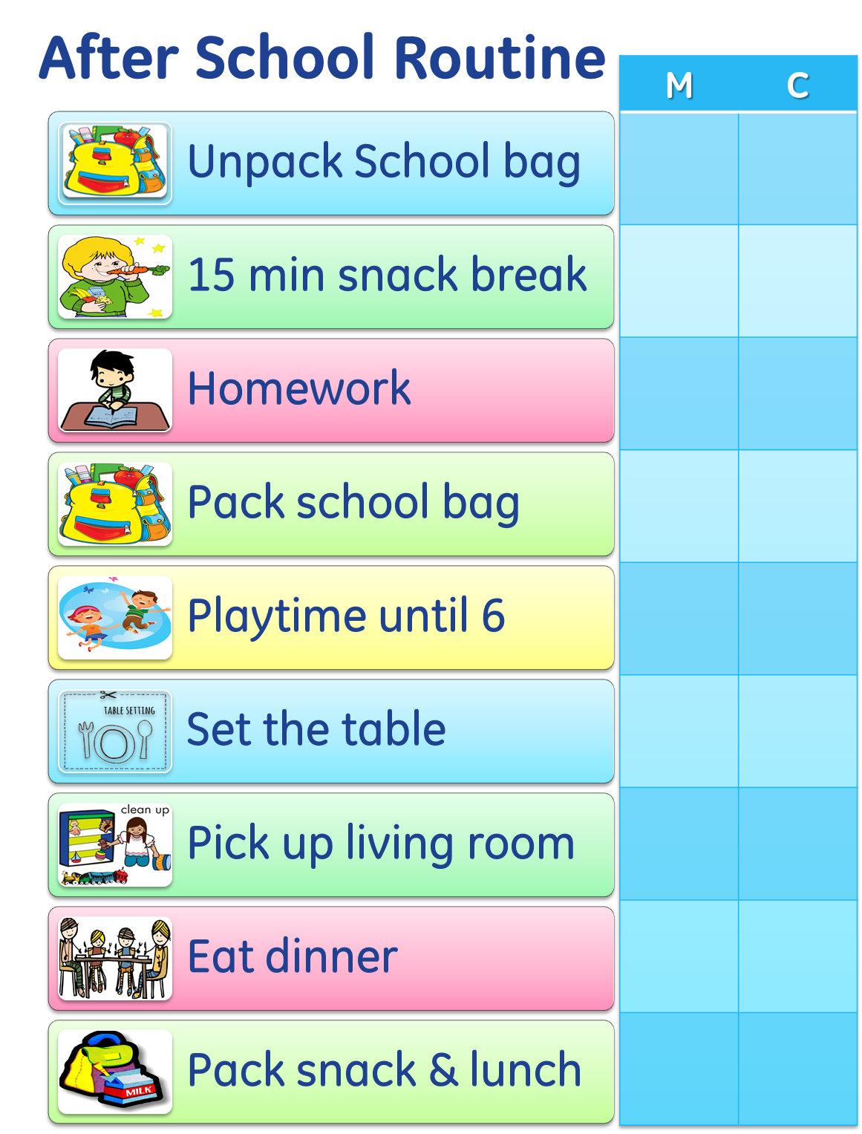
What can help get into a good routine for school?
How to Have a Good Daily Routine for School Days: 12 Steps (wikihow.com)

Slide 5
What are your plans for the future?

Slide 6
Future
BUILDING

Slide 7
SESSION TWO
By the end of today’s session you will
KNOW: Your exact current attendance
UNDERSTAND: How to read an attendance certificate
BE ABLE TO: Identify the problem causing your low attendance
KEY WORDS:

Slide 8
What is the real problem?
Unmet learning need
I don’t have any friends here
I can’t read properly
I’m being paid to move drugs
My parents need me at home
I can’t sleep at night
I’m worried about the journey to school
I can get paid work during school hours
My best mate is out of school
The lessons are just so boring
The subjects don’t interest me
I’m messed it all up so what’s the point!
Teenage Girl Tries to Drop Out of School | Educating | Our Stories - YouTube

Slide 9
Future
BUILDING

Slide 10
SESSION THREE
By the end of today’s session you will
KNOW: What action is needed to achieve personal goals
UNDERSTAND: That you cannot achieve something without planning and without effort
BE ABLE TO: Action plan to achieve personal goals
KEY WORDS:

Slide 11
What is the real problem?
Unmet learning need
I don’t have any friends here
I can’t read properly
I’m being paid to move drugs
My parents need me at home
I can’t sleep at night
I’m worried about the journey to school
I can get paid work during school hours
My best mate is out of school
The lessons are just so boring
The subjects don’t interest me
I’m messed it all up so what’s the point!
Teenage Girl Tries to Drop Out of School | Educating | Our Stories - YouTube

Slide 12
What are the solutions to my problems?
Get counselling
Set an alarm 15 mins earlier
Take a different bus
Get support with my reading
Have a restorative meeting to sort out a friendship issue

Slide 13
What action do I need to take to achieve my dreams?
Improve my attendance
Pay more attention in Maths
Start applying to colleges
Spend less time online
Join an evening sports club to get fit

Slide 14
Future
BUILDING

Slide 15
SESSION FOUR
By the end of today’s session you will
KNOW: The types of support and help available
UNDERSTAND: What support I personally need
BE ABLE TO: State clearly what I personally need
KEY WORDS:

Slide 16
Why is good school attendance important?
https://www.youtube.com/watch?v=xnZYEojRx3o
https://www.youtube.com/watch?v=sv32MBxNfFk

Slide 17
Why is good school attendance important?
The higher your attendance,
the more you’ll get paid
You’ll have far more
choice later in life
You will get
a better job
You’ll have better health
in your adult life
You could earn £3m
or more over your life time

Slide 18
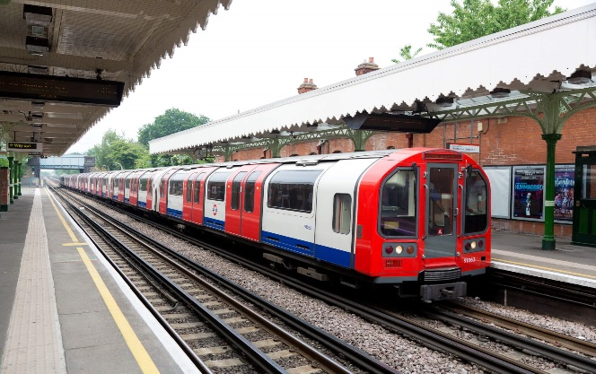
What support do you need to be successful?

Slide 19
Future
BUILDING

Slide 20
SESSION FIVE
By the end of today’s session you will
KNOW: My personal attendance targets
UNDERSTAND: How to work out an attendance target
BE ABLE TO: Set personal attendance targets
KEY WORDS:

Slide 21
Target setting for improvement

