Slide 1
Maths Subject Leadership meeting
H.E.P.
14.03.2022

Slide 2
Agenda
Welcome and introductions
Subject resources
Break out rooms to share resources
Planning and teaching for mastery - S Planning
Break out rooms. What is working well in your school?
Manipulatives
Break out rooms. Manipulatives in your school
Close – focus for future meetings
Evaluation

Slide 3
Welcome and Introductions
Name
School
Role and year group that you are working in

Slide 4
Etiquette for virtual meetings
Please ensure you are muted when the speaker/another participant is speaking.
Please keep cameras on.
Please use the chat function for questions or un-mute yourself to ask questions.
Please be as active as possible to make this worthwhile.

Slide 5
Subject Resources update
Cambridge Espressos Teaching logical reasoning
Early Years Foundation stage activities
Checkpoints Diagnostic maths activities to help teachers develop their assessment of students’ prior learning
Mindset boosting videos
Mastering Number Learning to think mathematically with the rekenrek

Slide 6
Break out rooms
An opportunity to share subject resources and what has been working well in your setting.

Slide 7
Essence of teaching for mastery

Slide 8
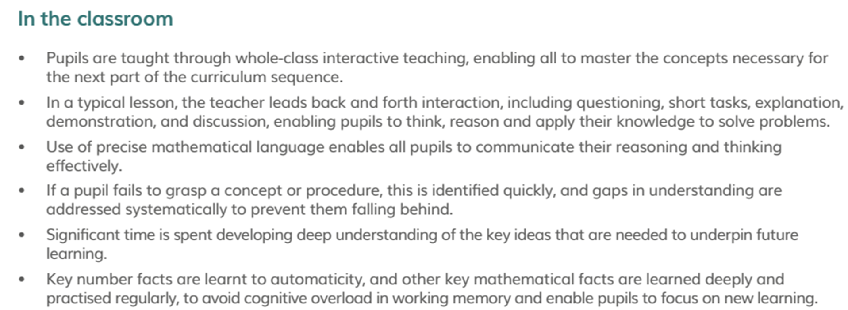
Essence of teaching for mastery

Slide 9
What do teaching for mastery lessons include?
•Discussion – the answer is only the beginning
•Ping-Pong style – providing sufficient scaffold for all pupils to access
•Precision in the use of mathematical language.
•Stem sentences
•Carefully chosen examples and representations to draw out the essence of the concept (conceptual variation)
•Guided practice
•Intelligent practice (procedural variation)
•Dong Nao Tin – opportunities to go deeper

Slide 10
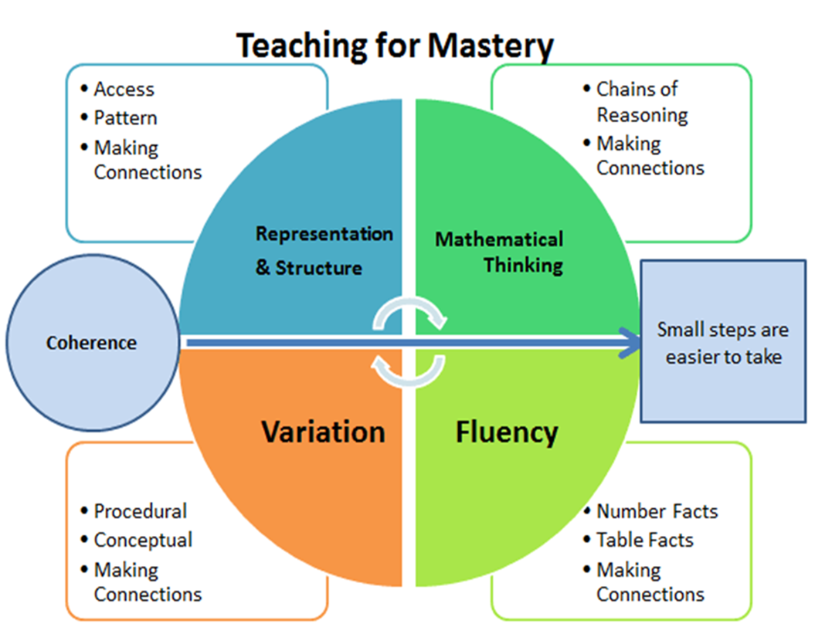
NCETM - Five Big Ideas

Slide 11
Coherence and small steps
A structured approach to planning a coherent journey of sequenced mathematical concepts.

Slide 12
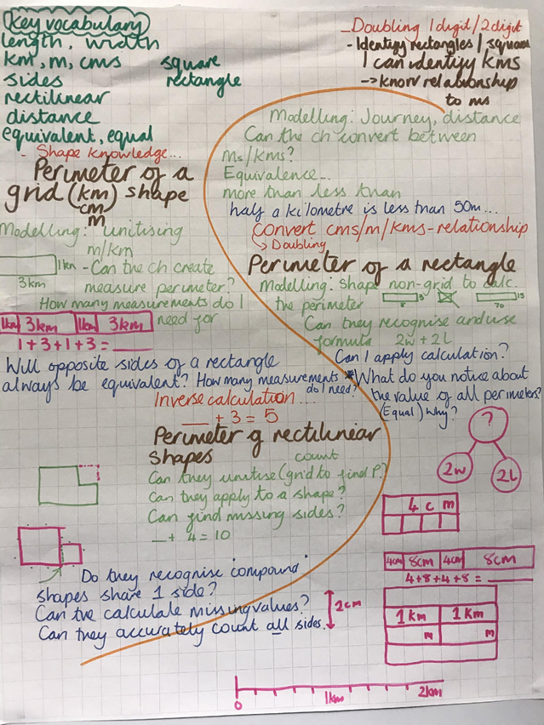
Planning a sequence of work
The S plan

Slide 13
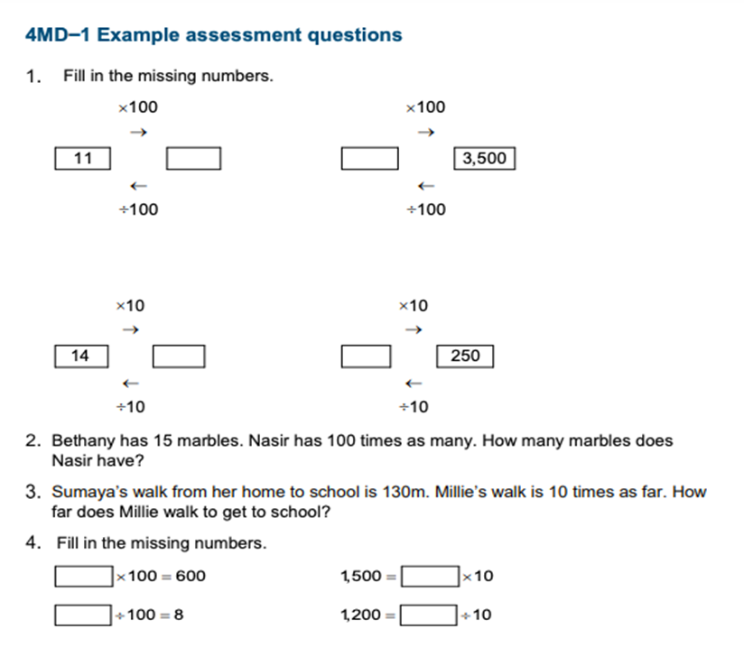
Prior learning
What prior knowledge is needed before starting this unit?
Where should they be now?
Are there any gaps?
Mathematics guidance: key stages 1 and 2 (covers years 1 to 6) (publishing.service.gov.uk)

Slide 14
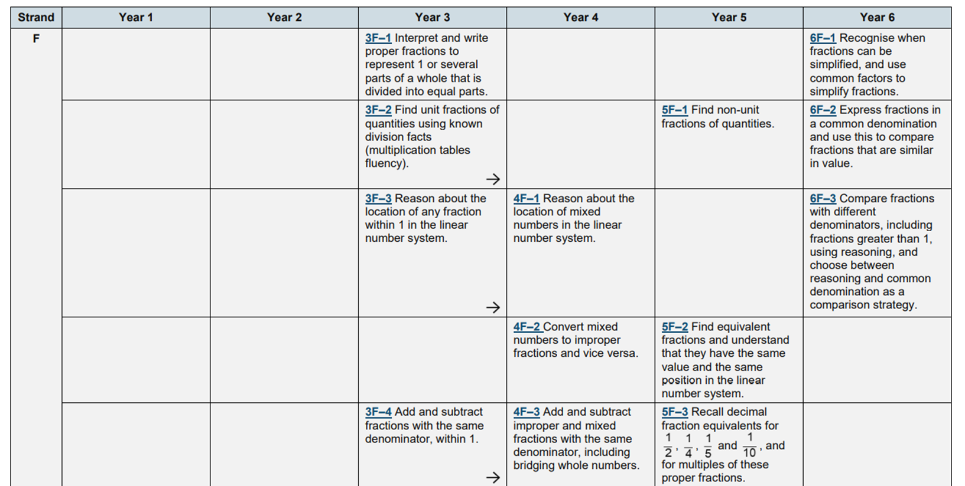
Prior learning

Slide 15
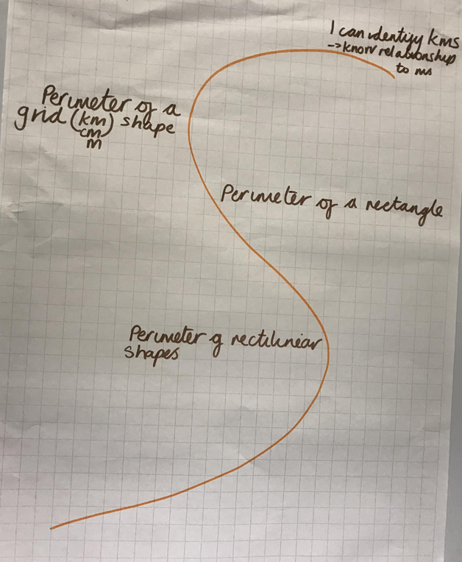
Step 1 - the journey
•Map out the coherent journey of learning
•Refer to the NCETM spine materials for teaching points
•For White Rose – look at the small steps
•NCETM CP materials – key learning points

Slide 16
Step 2 - Prior learning
•What do I assume/know the children can do from last year?
•What do they need to know or remember to be successful?
•Could this be a checklist for a pre-teach?
•Could this be added to morning work week before, if a “drip, drip” approach needed?

Slide 17
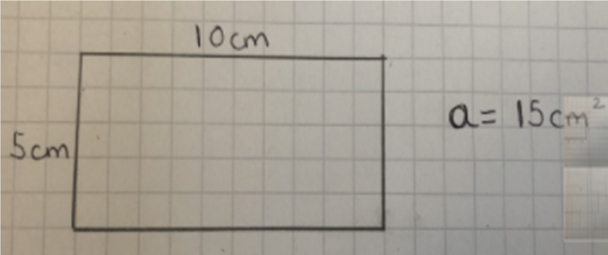
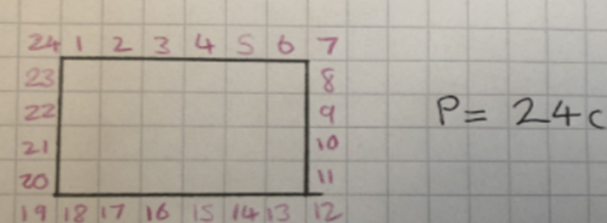
Step 3 - plan for misconceptions
From your previous experience of teaching this topic, what are the misconceptions you know will come up?

Slide 18
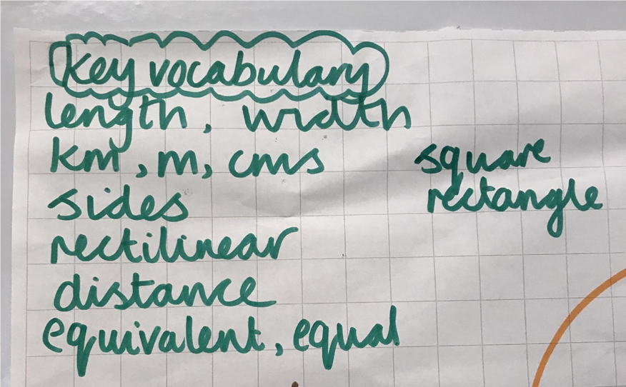
Step 4 - Key vocabulary and sentence stems
Where can you include this?
How do you expect the children to use/refer to it?
Key vocab available in the planning – must be consistent use across the school.

Slide 19
Sentence stems
Language focus “If I subtract 2 from an even number I get the previous even number, so 6 minus 2 is equal to 4.”

Slide 20
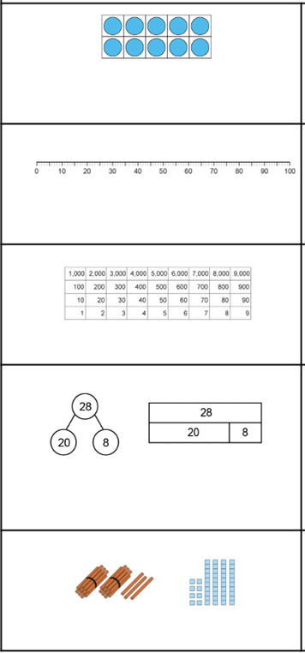
Step 5 - Representations, models, concrete resources
What models and images will you use?
How will they help the children to understand the structure of the mathematics?
How can they make connections?
What do you want them to notice?

Slide 21
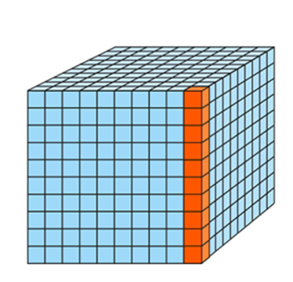
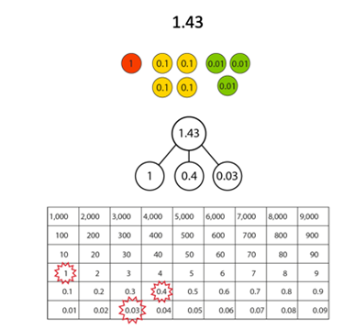
Step 5 - Representations, models, concrete resources
•Refer to the NCETM materials
•What do White Rose use as models?
•Ask yourself why they have used this? What structure does it underpin?

Slide 22
Break out rooms
How do you plan your units?
How confident are you that each aspect identified is planned for?
Is this consistent across the school?
Are there any actions that you need to take?

Slide 23
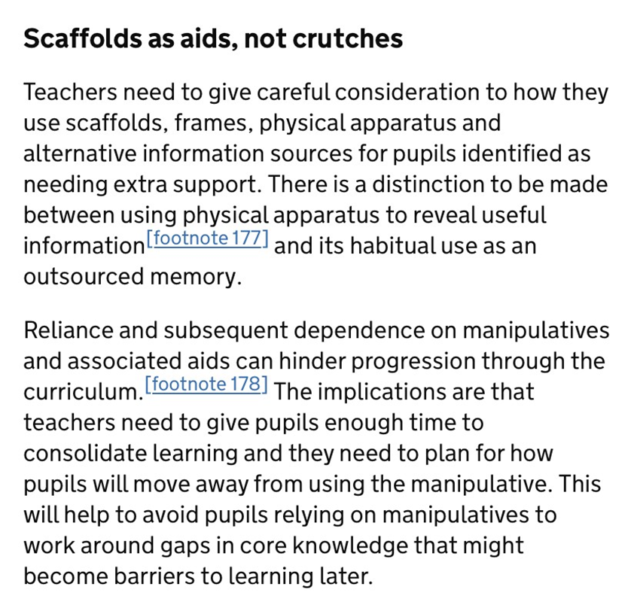
Ofsted: Research Review series: mathematics
Manipulatives
https://www.gov.uk/government/publications/research-review-series-mathematics/research-review-series-m
athematics

Slide 24
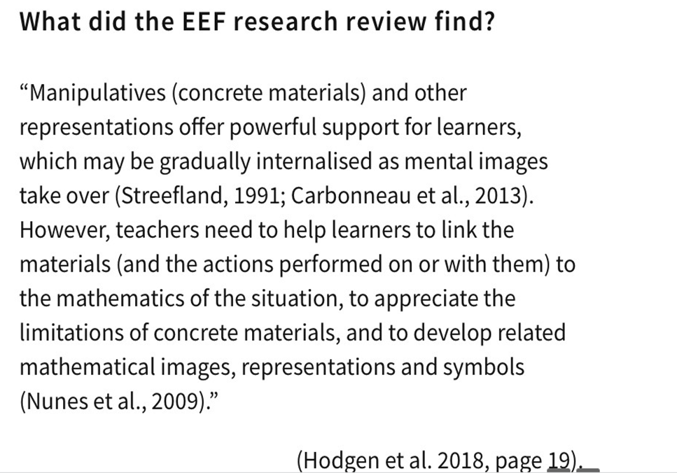
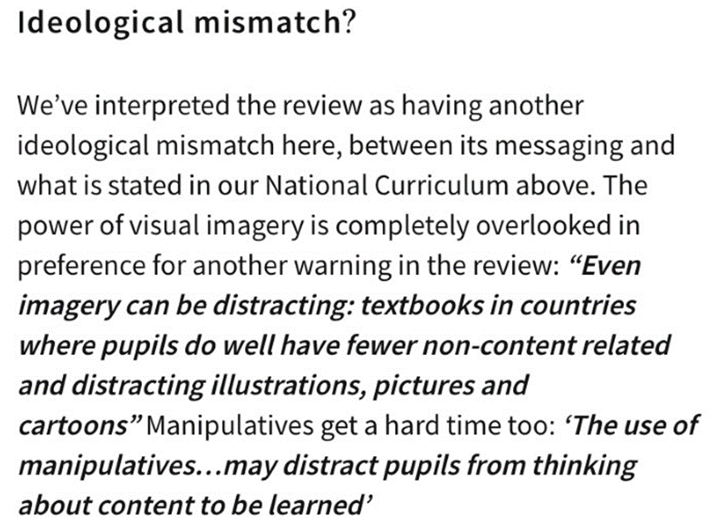
https://www.arkcurriculumplus.org.uk/news-events/2-ofsteds-research-review-standing-on-the-shoulders-of-maths-giants
This article highlights the research
challenge to the recent Ofsted review
into mathematics.

Slide 26
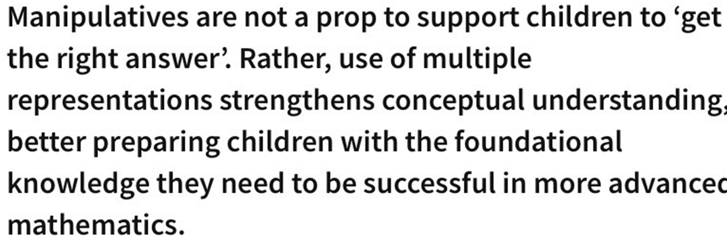

Slide 27
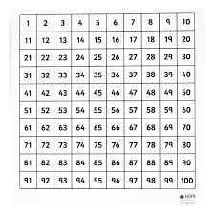
Manipulatives
How do you currently use a 100 square in your school?

Slide 28
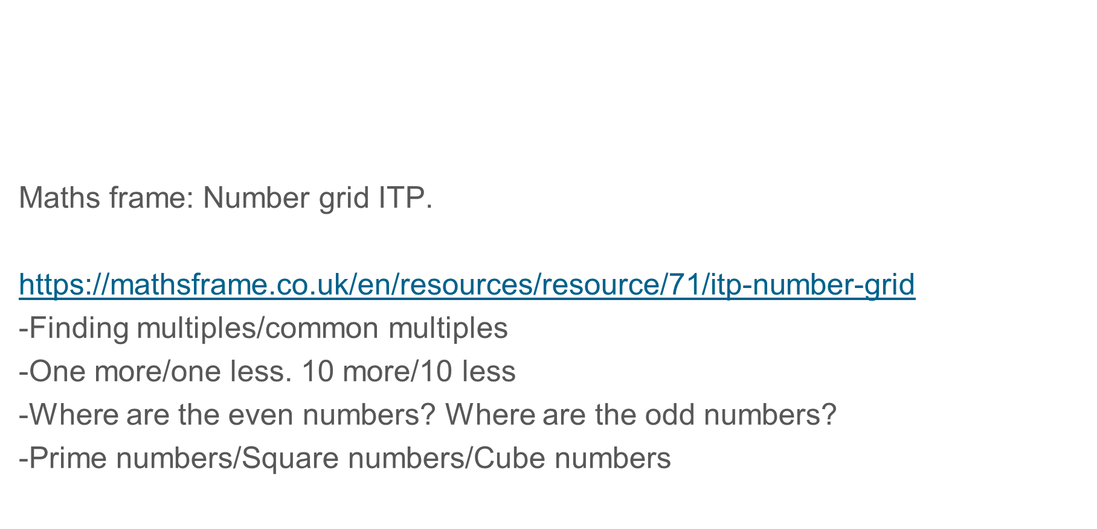
Activities
We can use the 100 square in the following ways:

Slide 29
Activities
We can use the 100 square in the following ways:
-Guess my number
-Follow the rabbit. ’The rabbit starts on 17 + 12 x 3. Where is the rabbit now?
-Find pairs of numbers that sum 100. How many can you find?
-Draw a square around 4 numbers. What do you notice? Is this always the same?
-Hundred Square Jigsaw – cut out and stick together
-Cut it out and make a number line?

Slide 30
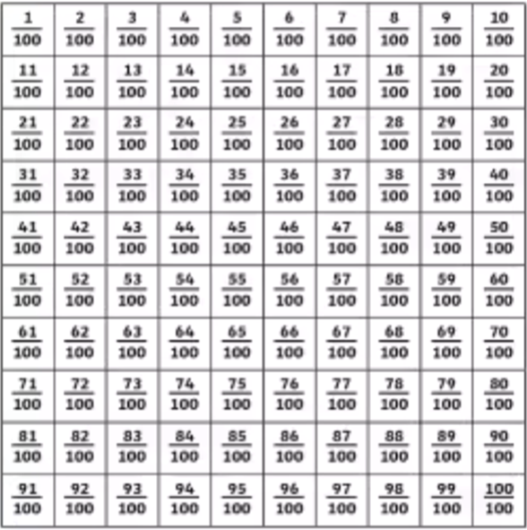
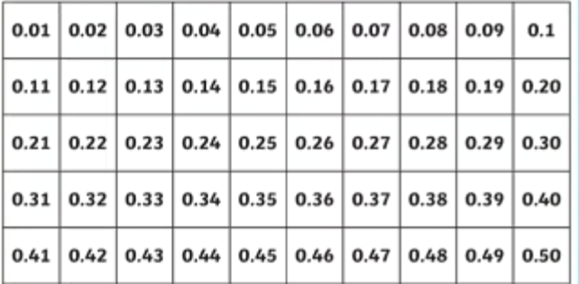
Activities
We can use 100 square in the following ways:
-Change to decimals/fractions/percentages
-This could show FDP equivalence

Slide 31
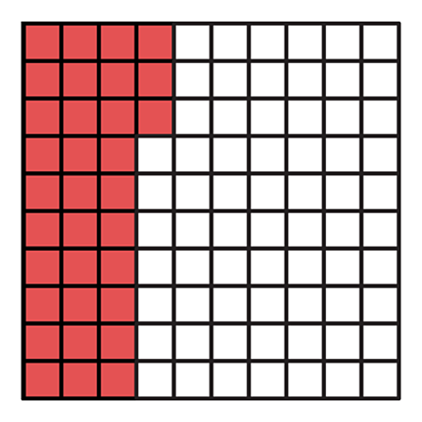
Activities
-Change to decimals/fractions/percentages
-This could show FDP equivalence
equivalence
What percentage is shaded?
What fraction is shaded?

Slide 32
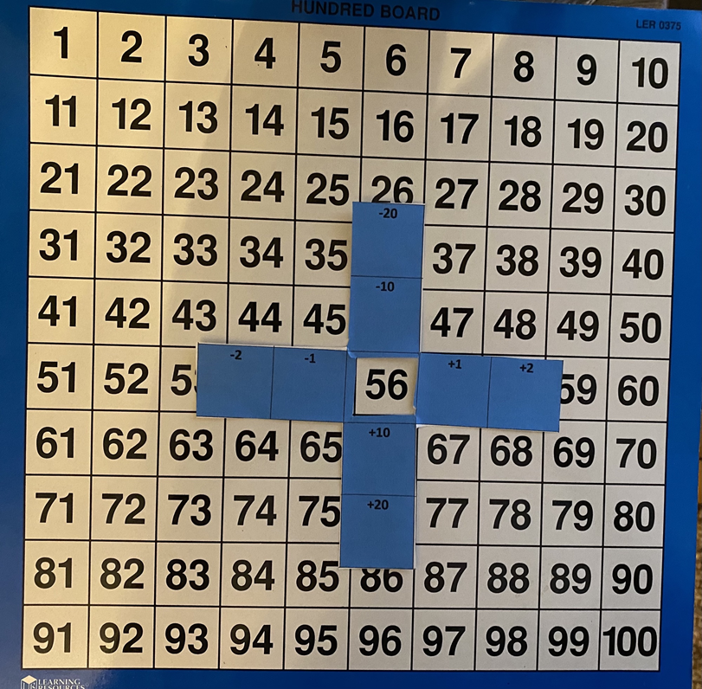
This can support seeing the position of numbers (10 more/10 less, etc) and this can be moved around the board. For older children it can be changed into the exposed number being x and x +1, x - 1 to explore algebra.

Slide 33
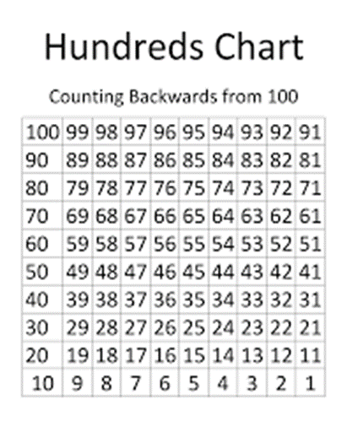
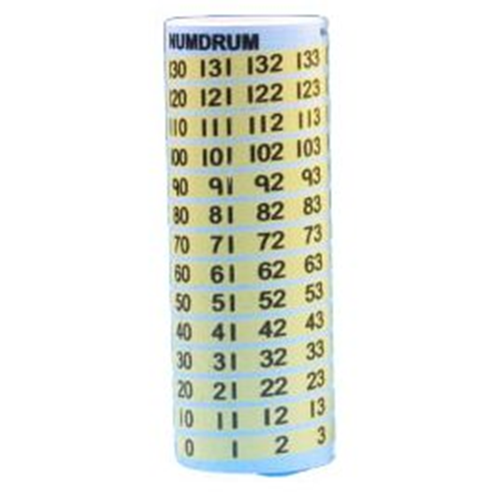
Manipulatives
Important to consider limitations of each manipulative.
Some children may get confused by orientation.
E.g. A hundred square starts at the ‘top’ and the numbers get bigger as you go ‘down’. Could this confuse children?
How are these representations different?
Could they support some children more effectively?

Slide 34
Manipulatives
Manipulatives are an important bridge to children being able to visualise models and structures to support their mathematics.
We can do activities which enable children to practice this.
Example with hundred square:
https://nrich.maths.org/2397/index

Slide 35
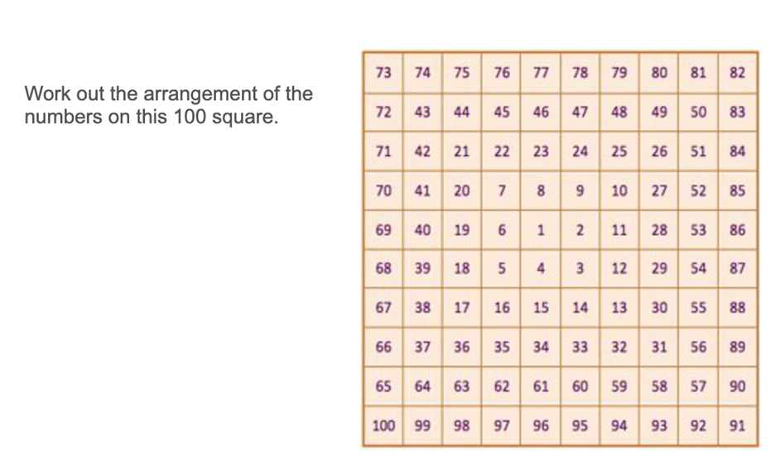
Depth
•Manipulatives can be used to support depth and challenge
https://nrich.maths.org/6554/index

Slide 36
Depth
•An effective way to ensure depth/challenge is choosing questions carefully.
•E.g. Which question was most difficult? Why?
•Rank the questions you did in order of difficulty
•‘Ooops I forgot’ http://natbanting.com/oops-i-forgot/
•Where might someone go wrong with this question?
•What would my next question be? Write it
•Why did I choose these numbers for this question?
•Plan questions before the lesson for challenge

Slide 37
Break out rooms
Manipulatives
- Choose one manipulative or concrete resource
- Start to map in detail like we did with a hundred square from early years to KS2
- How would it fit alongside your curriculum?
- What sort of visualisations would there be?
- What does the progression look like?
- How will this help children to see the maths?

Slide 38
Evaluation
What would you like to focus on next time?
https://www.hounsloweducationpartnership.co.uk/survey/primary-subject-network-evaluation-2-2/
Thank-you for all your contributions.

