Slide 1
How to deliver a quality leadership
programme in Primary Schools
cking@sportimpact.co.uk
pwhitfield@sportimpact.co.uk
LEADERSHIP
Supporting,
Encouraging and
Developing
others
Notes:
Introductions Clare and Pete
We are going to discuss how to deliver quality leadership in your school
Emails
Discussion around the definition of leadership

Slide 2
Outline
Delivering Leadership at KS1 and KS2.
Celebrating Leadership in a school community
Sharing good practice with colleagues.
Notes:
Lots of good ideas out there to share..

Slide 3
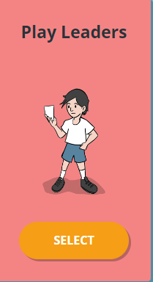
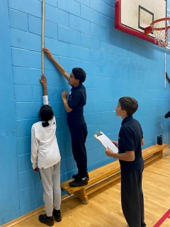
Primary
Secondary
Competitions
Football
Notes:
WHY?
Develop life skills communication teamwork creativity and confidence- Character education ….
Develops Pupil Voice
Build and PE and School Sport Workforce
Qualifications and Employability skills

Slide 4
KS1 Leadership
Teachers select pupils that would benefit from being a playleader.
The training is 6 weeks (mix of classroom based and practical).
Example sessions
What makes a good leader?
Playground games
Using equipment to make up games
Teaching your friend a game

Slide 5
Once they have trained there is a weekly rota, play leaders bags and bibs.
On their play leader day they collect the bag and bibs and return it after.
Subject leader chooses a ‘Game of the week’ which they stick up in the playground near to the friendship area/buddy bench.

Slide 6
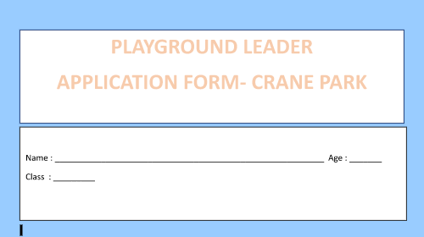
KS2 Leadership
Extra Curricular
Curriculum
Year 5 or 6 Pupils
6-8 weeks
Practical sessions
Working towards a final Leadership event
Notes:
Delivery:
Option to deliver in curriculum time vs intervention groups…Pros and Cons
Both styles of training follow the same format. Sessions are as practical as possible. Optional workbooks

Slide 7
Example session
Notes:
Here is an example session where children are taught how to teach younger children a new game using the ‘Introduce demonstrate Play’ method.

Slide 8
Notes:
In another practical session leaders are taught how to use STEP to make playground games easier and harder
Link to gaming

Slide 9
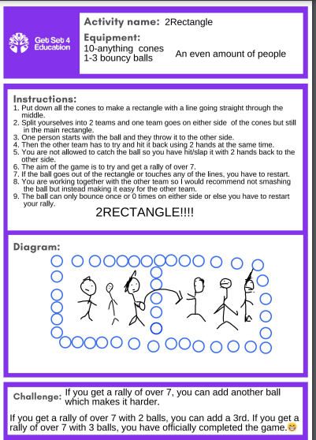
Playground Games Card:
Notes:
Working in small groups of 2-3 the Leaders devise their own playground game. This was done as homework

Slide 10
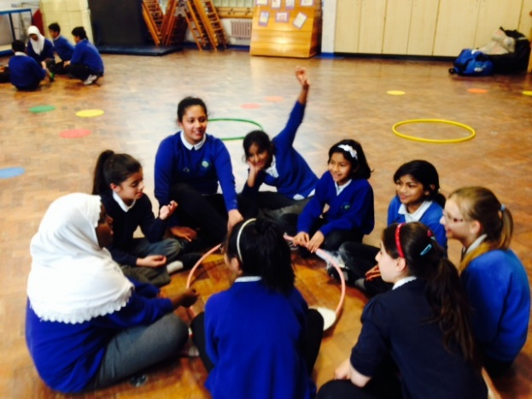
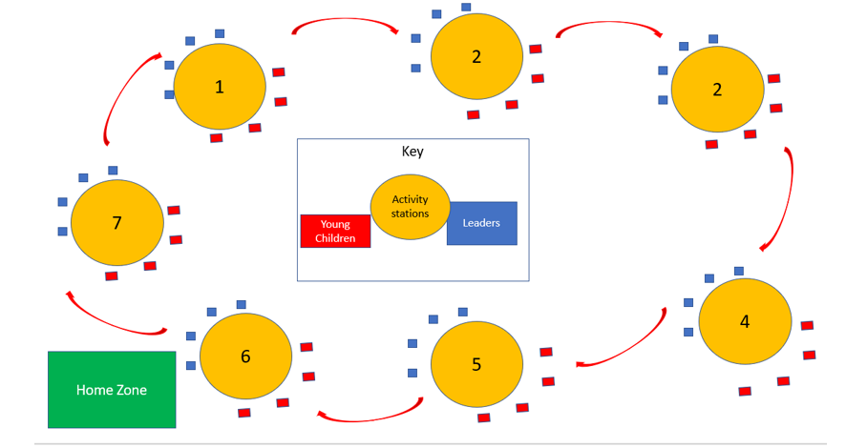
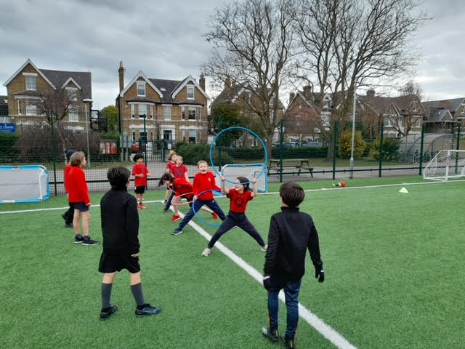
Leadership Event
Notes:
Leadership Event
In the final leaders event they deliver their playground game to a class of either year 2 or year 3.
Small blue squares are leaders, small red squares year 2 pupils.
In a class of 30 you usually have 6-7 different games/stations.
The younger children play each game for 8-10 mins then move round
This format gives the leaders lots of experience in teaching their playground game to the younger children
The younger children also learn lots of new fun playground games.
Event can be indoors or outside can be anything from 1-2 hrs.

Slide 11
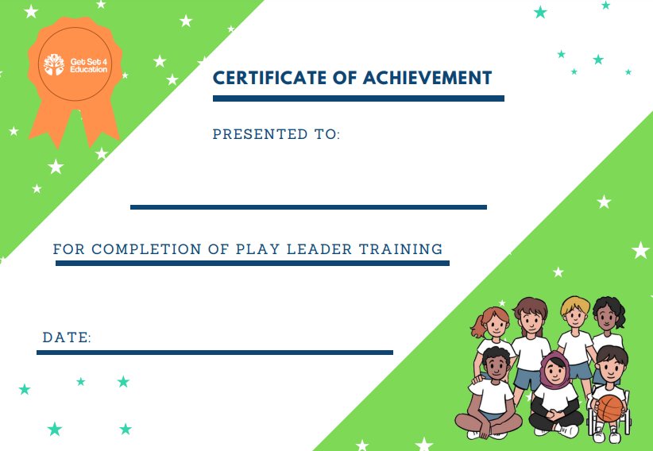
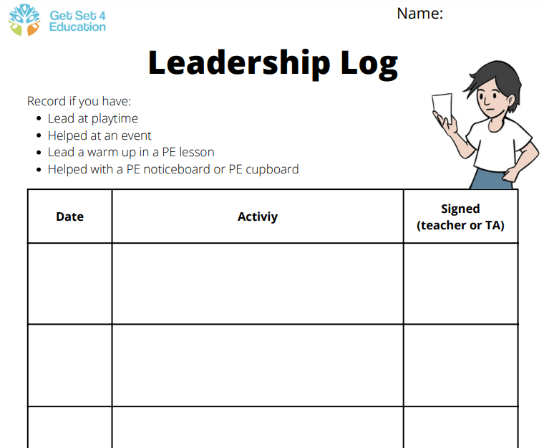
Leadership…next steps
Celebrate their success:
Certificates
Newsletter
Photos
Badges
Leaders section on your Noticeboard
2) Use Leadership logbooks
Notes:
Thank you Clare, I am going to talk to you about the next steps available. I think its really important first and foremost to celebrate the success of your young leaders through Certificates or in the Newsletter. An example might be, A specific section on your PE noticeboard could highlight what they have done and the timetable. Another good checking in tool is the leadership logs which are available on getset where your young leaders could get the lunchtime supervisors to sign everytime they have done an activity.

Slide 12
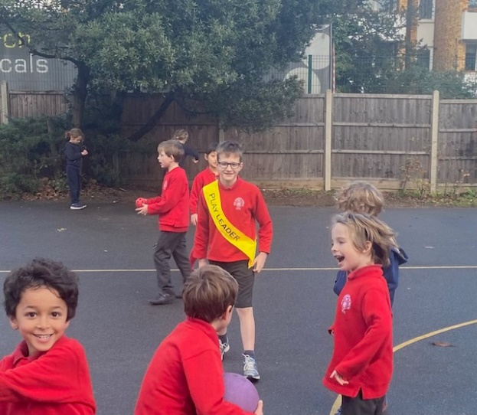
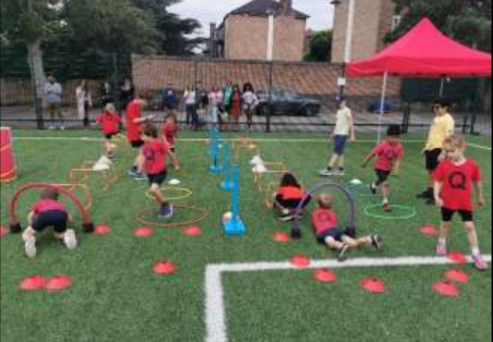
3) Set up a Leaders Zone in
The KS1 Playground
4) Use your leaders to support
KS1 or Lower KS2 Sports Day
Notes:
Here are some more examples of what you could do once your leadership course has finished. Once a leadership zone has been established, your leaders could come and collect a playtime equipment bag and support specific groups of children within the playground (non active ect).
You could also use them to help deliver some of your stations at Sportsday

Slide 13
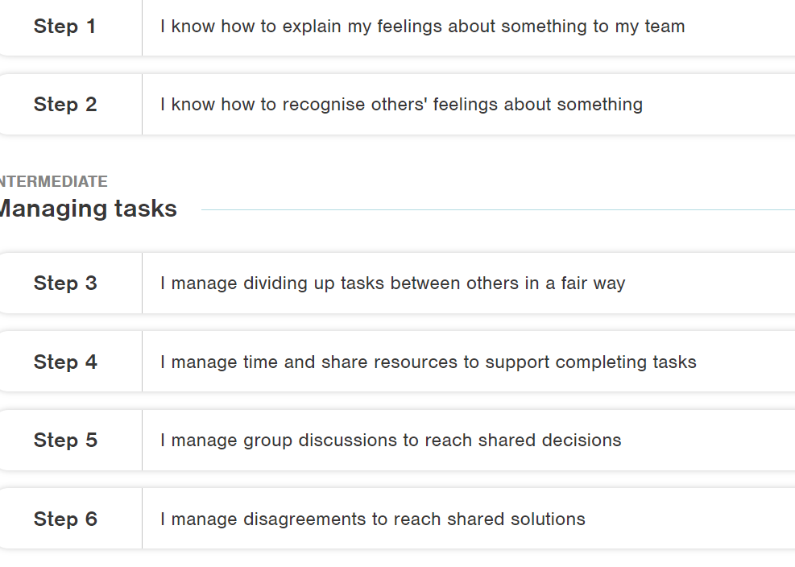
5) Start a Skillsbuilder Leadership Course in your school.
Notes:
Another option you have is to ask your Sport Impact Colleague who is in your school about Skillsbuilder.
Skillsbuilder is a company we are partnered with to deliver a similar leadership course that Clare has mentioned but the focus is slightly different. Each lesson Children are working towards a different level as part of a framework and you can see some examples on the screen above

Slide 14
Breakout room:
We are keen to hear anyone delivering or planning to deliver Leadership in a different way?
What works well in your school?
Lets share some ideas…..
If sharing an idea please include your name and school so we can build up a resource of sharing good practice in the borough.
Notes:
Explain roles

Slide 15
Thankyou

