Slide 1
Maths Subject Leadership meeting
H.E.P.
23.05.2023

Slide 2
Agenda
Welcome and introductions
Subject resources
Break out rooms to share resources
Assessment
Break out rooms. What is working well in your school?
Meeting the needs of all children
Break out rooms. What is working well in your school?
Leading Sustainable Change
Close – focus for future meetings
Evaluation

Slide 3
Welcome and Introductions
Name
School
Role and year group that you are working in

Slide 4
Etiquette for virtual meetings
Please ensure you are muted when the speaker/another participant is speaking.
Please keep cameras on.
Please use the chat function for questions or un-mute yourself to ask questions.
Please be as active as possible to make this worthwhile.

Slide 5
Subject Resources update
Number Sense Maths Early Years Number Sense, Number Facts Fluency, Times Table fluency.
Mastering Number Programme Reception and KS1. Supporting pupils to develop good number sense.
Evidence Snacks by Peps McCrea Bitesize pieces of research to support evidence informed work.
Counting Collections Supports subitising among other number skills
Counting Collections website Full of ideas

Slide 6
Further resources
Early Childhood Maths Group
Useful tips for tackling multiplicative thinking
EEF blog: purposeful, playful practice

Slide 7
Break out rooms
An opportunity to share subject resources and what has been working well in your setting.

Slide 8
Assessment
Assessment should involve teachers explaining how well their pupils are able to demonstrate that they have:
become fluent in the fundamentals of mathematics
can reason mathematically by following a line of enquiry, conjecturing relationships and generalisations, and developing an argument, justification or proof using mathematical language
can solve problems by applying their mathematics to a variety of routine and non-routine problems with increasing sophistication, including breaking down problems into a series of simpler steps and preserving in seeking solutions.

Slide 11
Mason (1998)
The starting point is important – the smaller the distance between the new knowledge and the existing knowledge the greater the success
It was noticed that when the potential distance is too long, a majority of students have difficulties in approaching the new knowledge, which we conjectured was due to heavy cognitive load (Gu, 1994).

Slide 12
Coherence, anchor point and depth of learning
Look at the specific RtP for your year group
Use the assessment questions for that RtP to presuppose what responses you would want from pupils who are demonstrating depth of understanding
Consider the previous learning that they would be building upon.
Identify the key aspects that teachers could miss.

Slide 13
Identifying where children are at
Before teaching a unit children complete a pre-unit test.
Adapt teaching based on the needs of the children. Are there any gaps that need to be addressed?
Post-unit test to see what children have learnt
How is this done in your school? How is it evidenced?

Slide 14
Break out rooms
Reflecting on our practice
How are assessments completed in your school?
Do processes allow for depth of understanding to be shown/captured?

Slide 15
Meeting the needs of all learners
Differentiation should be carefully planned and should come through depth of mathematical thinking, understanding and language and not be through accelerating through the curriculum or task modification in the traditional sense.
Depth of mathematical thinking
• Open-ended questioning that requires pupils to explain their thinking fully, e.g. How many combinations can you find?
How do you know you’ve got all the possibilities? What might the answers be?
• Seeking patterns and finding general rules: Can you see a pattern in the numbers? Can you see a pattern in the answers? What do you notice about the numbers? Continuing this pattern, what would happen if...?
• Creating their own examples, linking the numbers, equations to stories and the real world. • Predict the outcome of future mathematical learning, equations and patterns • Asking “How can you show me you understand?” • Missing number equations, e.g. 3 + 4 = _ , 3 + _= 7, _ + _ + _= 9

Slide 16
Depth of mathematical understanding
• Concrete: Show me what you have done using [cubes].
• Concrete: Prove to me you are right by using [counters]?
• Concrete: Could you use [a bead string] to represent the same idea? How?
• Concrete: How could [unifix] help explain what's the same and what's different?
• Pictorial: Draw a diagram to explain or demonstrate what you have worked out.
• Pictorial: Which picture shows the correct answer? • Pictorial: Which representation is the odd one out?
• Abstract: What could the equation or expression be to accompany your model (picture)?
• Abstract: What is wrong with this equation? • Abstract: Can you match the equation to the representation?
Depth of mathematical language
• Increase or reduce scaffold of sentence structures
• Use close procedures with extended sentences e.g. There are _____ ways to make 5. There are _____ (the same, fewer, more) ways to make 5 than to make 6.
• Explain to your partner how you know
• Make up a real-life story using these numbers or shapes • List all the other words for [plus].

Slide 17
Questioning:
•Asking mathematical questions mathematically (Mason, 1998)
•“My claim is that by paying attention to the types of questions we ask, we can influence the development of students’ awareness of mathematical thinking.”

Slide 18
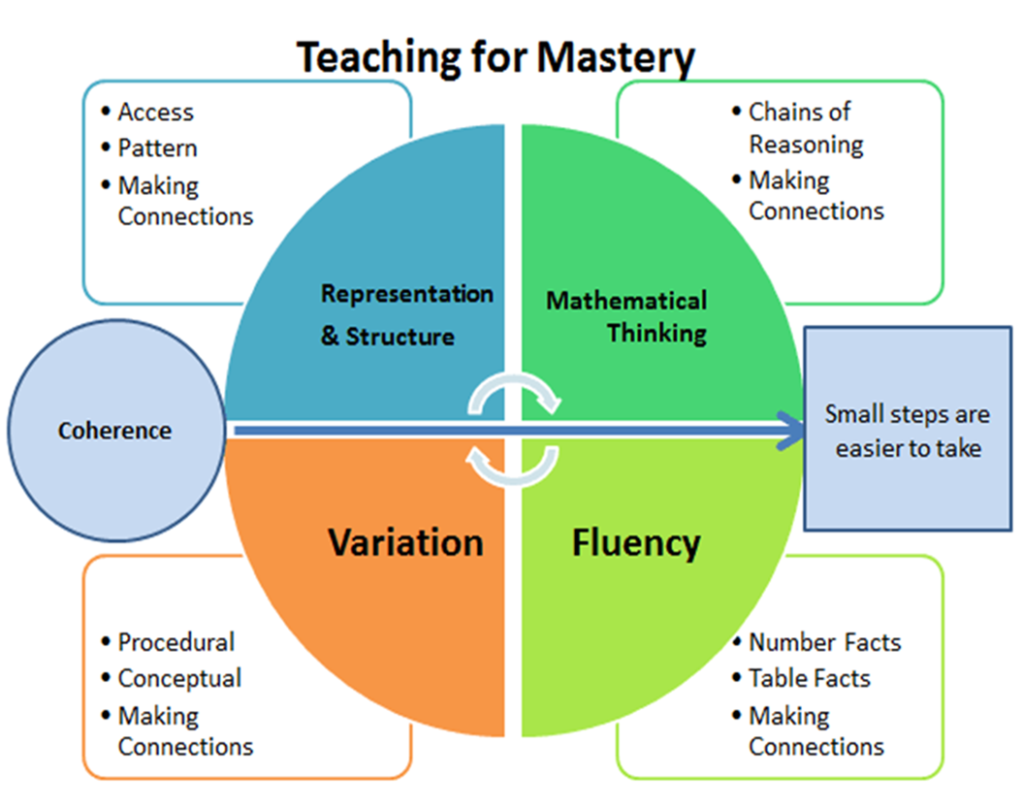
NCETM - Five Big Ideas

Slide 19
Planning questioning
Plan the questions before the lesson for challenge
Choose the questions carefully to ensure depth/challenge
When observing learning :
How does the teacher use questioning to draw out pupil understanding?
Focus on pupil responses and how did the teacher respond to this

Slide 20
Questions
Questions and answers on raising the bar in mathematics with Andrew Jeffrey

Slide 22
Deep learning
A pupil really understands a mathematical concept, idea or technique if he or she can:
•describe it in his or her own words;
•represent it in a variety of ways (e.g. using concrete materials, pictures and symbols – the CPA approach)
•explain it to someone else;
•make up his or her own examples (and non-examples) of it;
•see connections between it and other facts or ideas;
•recognise it in new situations and contexts;
•make use of it in various ways, including in new situations.
NCETM (2015)

Slide 23
Deeper learning
Developing mastery with greater depth is characterised by:
•pupils’ ability to solve problems of greater complexity (i.e. where the approach is not immediately obvious), demonstrating creativity and imagination;
•independently explore and investigate mathematical contexts and structures
•communicate results clearly and systematically explain and generalise the mathematics.
NCETM, 2015

Slide 24
Scaffolding
Some ideas for scaffolding:
Partially completing examples. This could be the completion of a small number of examples to act as a model or reduce the demand of the task.
Adding representations that support conceptual understanding.For tasks which require pupils to connect concrete manipulatives with abstract numerals, pictorial representations can be a supportive intermediate step.
Reducing number of examples.It is important to ensure that pupils complete enough examples to have had adequate practice and consolidation; however, some pupils work at a slower pace and will be overwhelmed if presented with too many questions.
Providing a scaffolded frame for pupils to record. E.g. a blank table/partially completed table/equation frame.
Providing additional information that supports independent completion of tasks. For example, providing a brief glossary of key mathematical vocabulary or images linking concrete representations used by the teacher and the abstract or pictorial representations used on the task sheet.

Slide 25
How can we support staff?
Planning with year group teams
Team teaching lessons. Planning a lesson and delivering it together
Modelling lessons
ECTs observing more experienced teachers
Lesson study approach. Planning the same lesson together and observing each other. Focusing on particular pupils
Professional development for teaching assistants
Inset focused on scaffolding and constraints
Maths moderation

Slide 26
Further support
Nrich Framework ‘low-threshold, high-ceiling’ tasks, meaning they are suitable for most pupils: pupils who struggle can be supported easily through inbuilt questioning and techniques, but for those who need it there is a high level of challenge
NCETM Assessment materials
The Shanghai Maths Project

Slide 27
Break out rooms
How do you meet the needs of all learners in your setting?
What is working well?

Slide 28
Leading sustainable change
Sch“Over the years, we have come to realise that teacher development does not come about through repeated attempts to persuade but through opportunities for individual teachers ‘to doubt, reflect and reconstruct’ in unhurried, 'safe' environments”.
Malcolm (2011)
“Constructing Knowledge for Teaching Secondary Mathematics: Tasks to enhance prospective and practicing teacher learning (Mathematics Teacher Education)” Ed. Orit Zaslavsky and Peter Sullivan (Springer 2011).
“Teachers learn by taking risks, adopting new practices and reflecting on their experiences.” (Fullan, 1991).
EEF Guide To Implementation 2nd Ed 2019
ols are learning organisations. They continuously strive to do better for the children and young people in their charge. In doing so, they try new things, seek to learn from those experiences, and work to adopt and embed the practices that work best. EEF Guide To Implementation 2nd Ed 2019

Slide 29
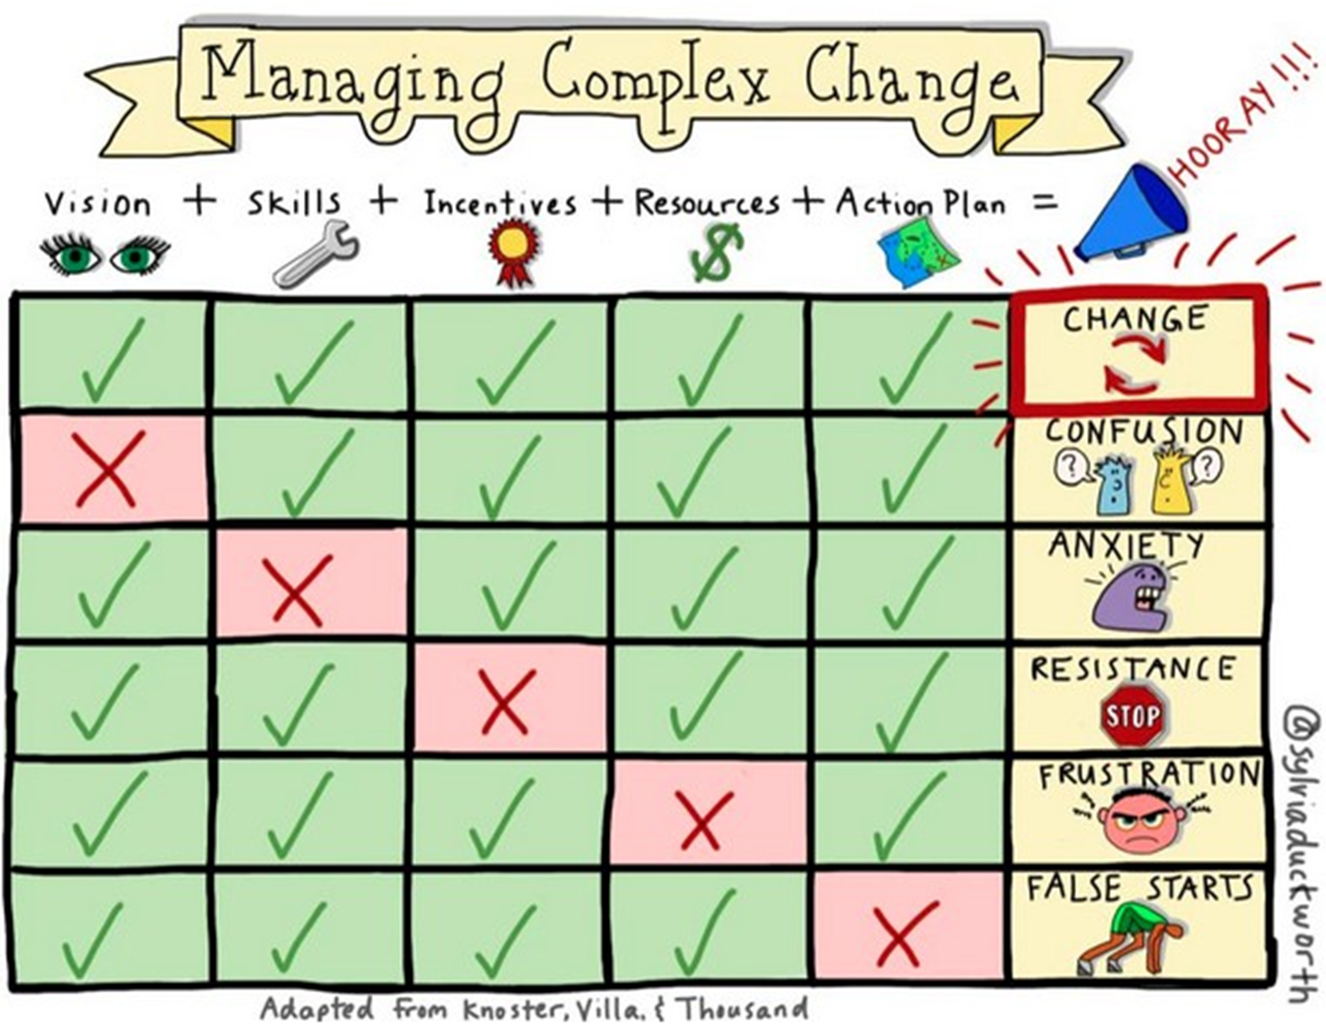
.

Slide 30
Components of change

Slide 31
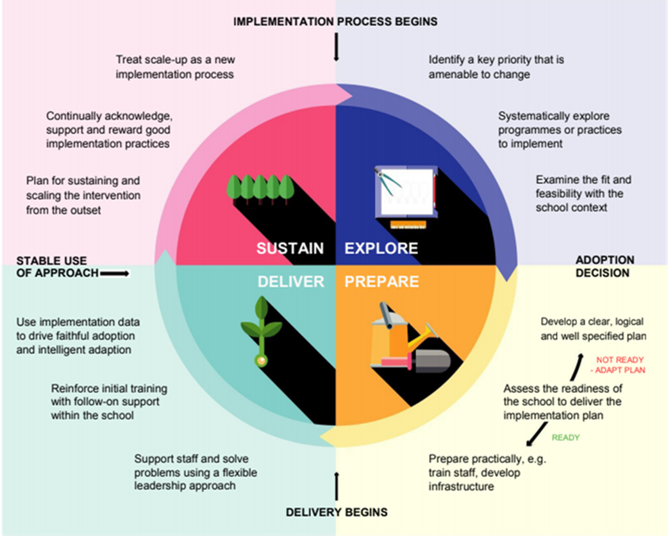

Slide 32
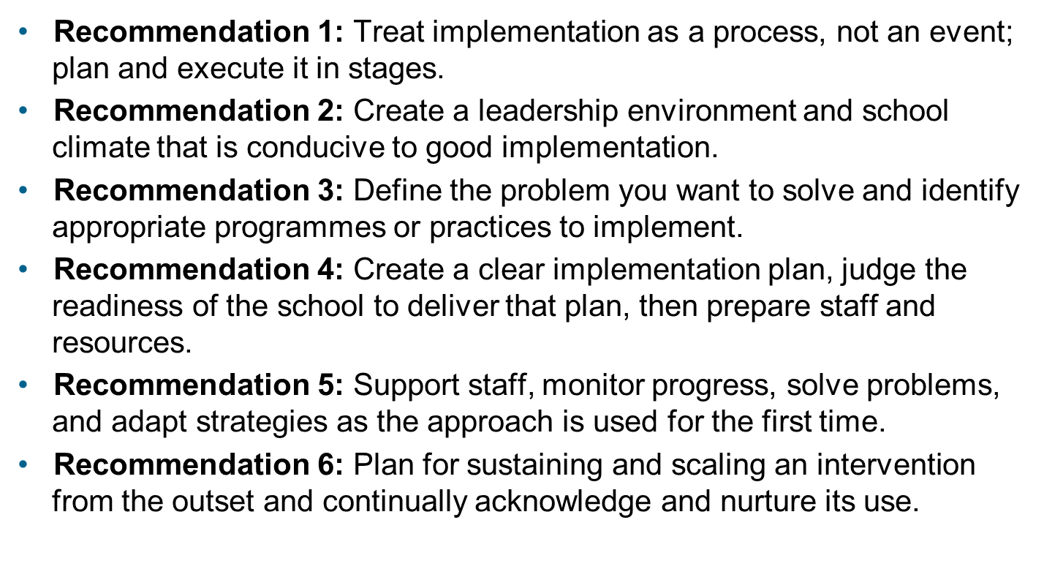
Digging deeper

Slide 33
Understanding change
•There will be initial success.
•There will be a dip.
•There will be challenges.
•There will be the temptation to take a U-turn.

Slide 34
Systems which may need reviewing
•Lesson design including resourcing, meeting the needs of all learners and practice
•Curriculum design
•Intervention
•Assessment
•Tracking
•Monitoring
•Evaluation
•Marking or evidence in books
•Timetabling
•Working with parents
•Professional development of staff – ongoing CPD and induction of teaching/non-teaching staff
•Collaborative working practices, e.g. planning, observing learning and moderating

Slide 35
Systems which are conducive to TfM principles
System | What could this look like in a school which has the fidelity to the principles of teaching for mastery?
Timetabling of Maths | Separate fluency sessions for all pupils such as the Mastering Number programme.
 | Shorter main maths sessions with time for individual intelligent practice and identifying pupils who need intervention within the lesson.
 | Pre-teaching slot with the teacher at the beginning of the week
 | Any additional intervention is timely and brief. If it is not delivered by the teacher, there is time for discussion with the class teacher.

Slide 36
Break out rooms
•What systems have changed in your setting as a result of adopting a teaching for mastery approach?
•Which of these, if any, did you need to refine after trying a new approach?
What is your focus going forward?

Slide 37
Evaluation
What would you like to focus on next time?
Thank-you for all your contributions.
https://www.hounsloweducationpartnership.co.uk/survey/primary-subject-network-evaluation-3-2/

