Slide 1
SENCOs network
Tuesday 23rd May 2023
4 – 5.30pm
Alex Grady, Head of Education and
Whole School SEND

Slide 2
Our session today:
Welcome and introductions
News and updates
Sharing effective practice: Transition
Spotlight theme: Speech, Language and Communication Needs
Breakout rooms: Your opportunity to talk to other SENCOs
Resources: Free and paid-for Transition and SLCN resources
What focus would you like for future meetings?

Slide 3
News and updates
Hear Education Minister with responsibility for SEND, Claire Coutinho, discuss the SEND&AP Improvement Plan:
https://nasen.org.uk/news/minister-talks-about-send-and-ap-improvement-plan
nasen Live 7th July tickets on sale:
https://nasen.org.uk/nasenlive-2023
Free Whole School SEND webinars in May and June:
https://www.wholeschoolsend.org.uk/events
nasen SEND CPD on Demand – access to 70+ recorded webinars
(£199 for individuals, £750 for whole school):
https://nasen.org.uk/send-cpd-on-demand
Notes:
https://nasen.org.uk/news/minister-talks-about-send-and-ap-improvement-plan
https://nasen.org.uk/nasenlive-2023
https://www.wholeschoolsend.org.uk/events
https://nasen.org.uk/send-cpd-on-demand

Slide 4
Sharing effective practice:
Transition
What do we mean by ‘transition’?
What are the issues?
What have you done that works well?

Slide 5
Spotlight theme: Speech, Language and Communication Needs
Introducing Sam….
Age 3
Age 8
Age 13
Age 16

Slide 6
Some statistics…
1 in 4 children who struggled with language at the age of 5 did not reach the expected standard in English at the end of primary school, compared with 1 in 25 children who had good language skills
81% of children with emotional or behavioural ‘disorders’ have unidentified SLCN
Children with vocabulary difficulties at age 5 are 3 times more likely to have mental health problems in adulthood and twice as likely to be unemployed when they reach adulthood
60% of young offenders have low language skills
Source: Public Health England, 2020

Slide 7
Communication and Interaction needs: SLCN
Speech sound production
Expressive language
Receptive language
Pragmatics or social use of language

Slide 8
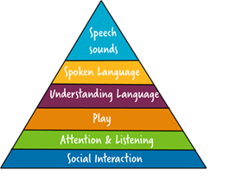
Creating communication friendly environments

Slide 9
Stages of attention and listening
How long should we expect children to attend (concentrate/listen) for?
Rule of thumb: as many minutes as their age
Consider: What implications does this have for ‘carpet time’?

Slide 10
The importance of play for language development
There are developmental stages for play just as there are for listening and attention.
A typically-developing child does not usually play with (rather than alongside) peers until the age of 3-4.
Many children are not at this stage of development – this will impact on their language development too, as they are less likely to be using language to negotiate, argue, take turns, give opinions etc.
Consider: Do children in your classrooms/playgrounds have the opportunity to develop their play skills?

Slide 11
How can you support receptive language development?
Support listening:
Adapt adult language
Use effective non-verbal communication
Minimise distractions including noise levels
Reduce cognitive load
Use visual support:
Objects
Photos
Pictures
Icons
Written prompts
Develop vocabulary:
Clap syllables
Think of a rhyme
Draw a picture
Put it in a sentence
Follow specific recommendations from SaLT

Slide 12
How can you support expressive language development?
Word-finding difficulties:
Describe/Cue
Categories to make links
Word displays with visual keys
‘Forced alternatives’
Limited vocabulary:
Categories to make links
Word displays with visual keys
Pre-teaching
Word-order difficulties:
Model the accurate word-order but do not correct or make them repeat it
Grammatical markers:
Model the accurate marker but do not correct or make them repeat it
Follow specific recommendations from SaLT

Slide 13
How can you support the social use of language (pragmatics)?
Conversational rules
Treat with understanding
Make and maintain friendships
Jokes and sarcasm
Make others aware, with consent
Appear rude and uninterested
Social skills groups
In/appropriate language
Flat intonation
Social stories
Follow specific recommendations from SaLT

Slide 14
How can you support speech sound production difficulties?
Listen to content
i.e. the message
Wait if necessary - don’t speak for them
Model the sound accurately without correcting them
Ask the child what they prefer
Follow specific recommendations from SaLT

Slide 15
SLCN and the link to behaviour
All behaviour is a way of communicating about an unmet need
We need language to:
Communicate our needs and wants
Deal with difficult situations
Understand and interpret other people’s thoughts and feelings
Understand rules and consequences
Reason with ourselves
Resolve conflicts
Manage social relationships
Two-thirds of pupils at risk of exclusion from school have language difficulties.
Clegg et al. (2009) Language Abilities of secondary age pupils at risk of school exclusion

Slide 16
Discussion time:
Breakout rooms

Slide 17
FREE membership
About nasen
Find out more: www.nasen.org.uk
nasen is a not for profit organisation that supports ALL education practitioners to meet the needs of all pupils, including those with learning differences.
^{CPDL}
Enhance your professional portfolio and development with our premium training courses and events
^{Informed}
Providing the latest news and policy updates in the SEND sector as well as helping to inform decisions at government policy level
^{Networking}
Online and face-to-face networking opportunities available so you can share and learn from other like-minded professionals
Notes:
https://nasen.org.uk/register

Slide 18
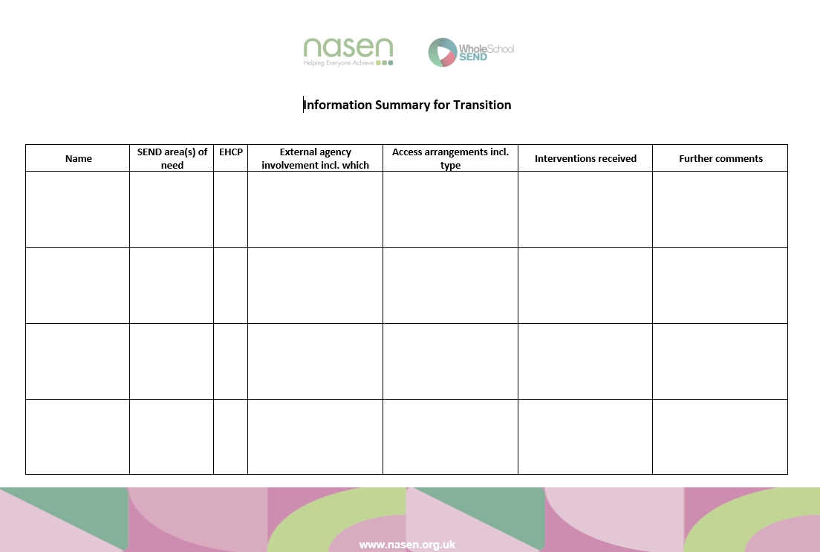
Free resources: Transition
https://nasen.org.uk/resources?title=TRansition
https://nasen.org.uk/resources/transition
nasen.org.uk
Notes:
https://nasen.org.uk/resources/transition
https://nasen.org.uk/resources?title=TRansition

Slide 19
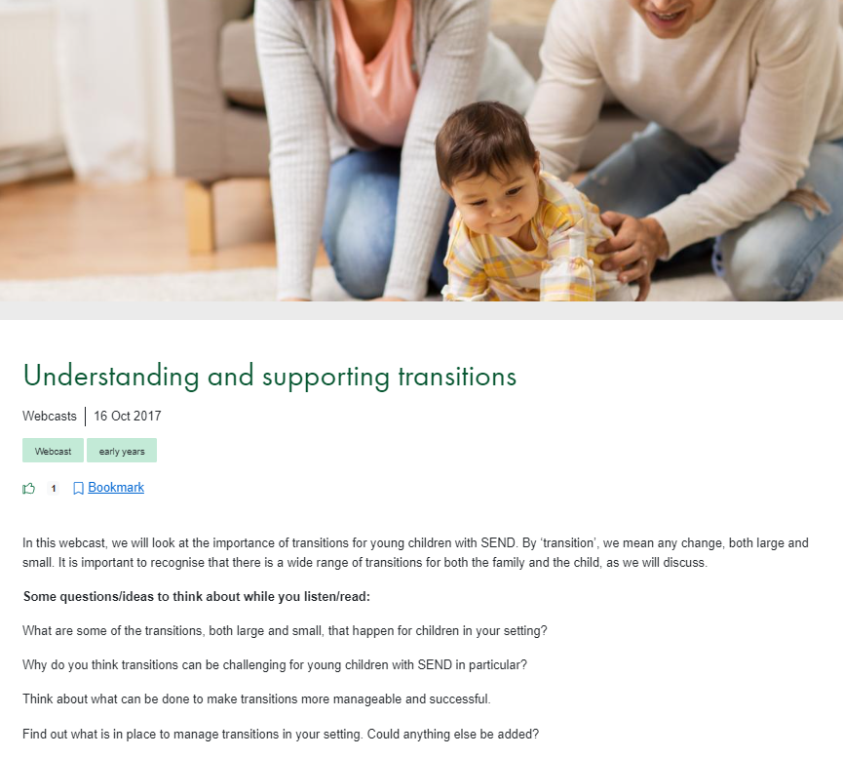
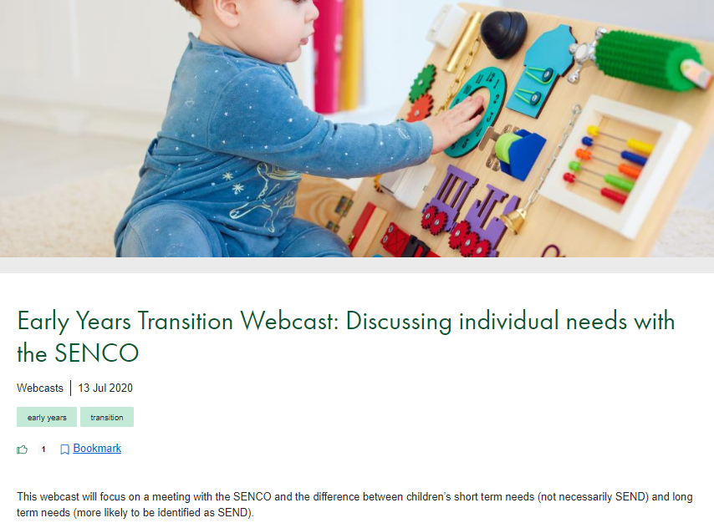
Free resources: Transition
https://nasen.org.uk/resources/understanding-and-supporting-transitions
https://nasen.org.uk/resources/early-years-transition-webcast-discussing-individual-needs-senco
nasen.org.uk
Notes:
https://nasen.org.uk/resources/understanding-and-supporting-transitions
https://nasen.org.uk/resources/early-years-transition-webcast-discussing-individual-needs-senco

Slide 20
Free resources: Transition
https://www.wholeschoolsend.org.uk/resources/webinar-supporting-successful-transitions-primary-secondary-school
https://www.wholeschoolsend.org.uk/resources/webinar-securing-good-transitions
wholeschoolsend.org.uk
Notes:
https://www.wholeschoolsend.org.uk/resources/webinar-supporting-successful-transitions-primary-secondary-school
https://www.wholeschoolsend.org.uk/resources/webinar-securing-good-transitions

Slide 21
Free resources: Transition
https://www.wholeschoolsend.org.uk/resources/ask-listen-do-transition-planning-year-11
https://www.wholeschoolsend.org.uk/resources/webinar-transition-send-pupils-mainstream-settings
wholeschoolsend.org.uk
Notes:
https://www.wholeschoolsend.org.uk/resources/webinar-transition-send-pupils-mainstream-settings
https://www.wholeschoolsend.org.uk/resources/ask-listen-do-transition-planning-year-11

Slide 22
Free resources: SLCN
https://nasen.org.uk/resources/what-isreceptive-language
https://nasen.org.uk/resources/what-isexpressive-language
nasen.org.uk
Notes:
https://nasen.org.uk/resources/what-isreceptive-language
https://nasen.org.uk/resources/what-isexpressive-language

Slide 23
Free resources: SLCN
https://nasen.org.uk/resources/speech-language-and-communication-needs-classroom
Notes:
https://nasen.org.uk/resources/speech-language-and-communication-needs-classroom

Slide 24
Paid for resources: SLCN
https://nasen.org.uk/resources?title=language
nasen.org.uk
Notes:
https://nasen.org.uk/resources?title=language

Slide 25
Paid for resources: SLCN (also included in SEND CPD on Demand)
https://nasen.org.uk/resources?title=language
nasen.org.uk
Notes:
https://nasen.org.uk/resources?title=language

Slide 26
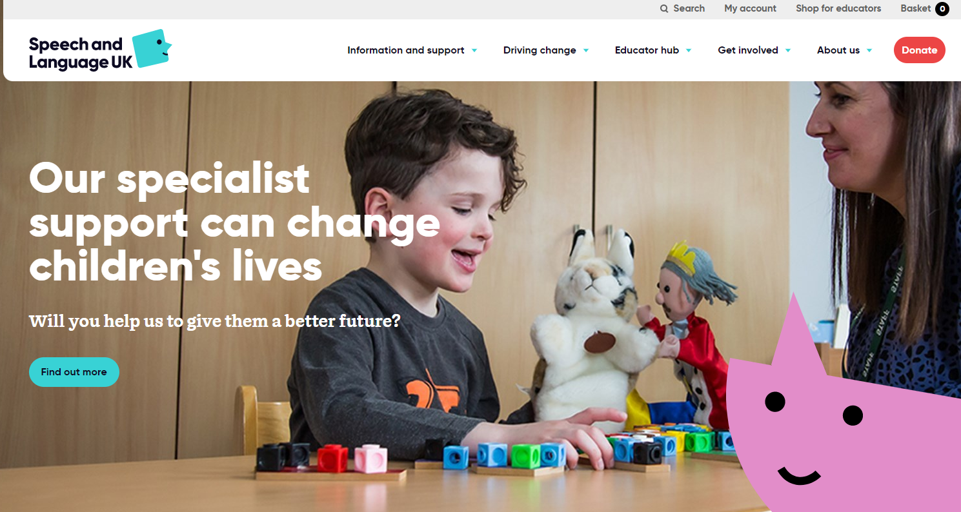
Free resources: SLCN
https://speechandlanguage.org.uk/
Notes:
https://speechandlanguage.org.uk/

Slide 27
Our session today:
Welcome and introductions
News and updates
Sharing effective practice: Transition
Spotlight theme: Speech, Language and Communication Needs
Breakout rooms: Your opportunity to talk to other SENCOs
Resources: Free and paid-for Transition and SLCN resources
What focus would you like for future meetings?

Slide 28
Thank you
Please complete the evaluation:
I will put the link in the chat
https://www.hounsloweducationpartnership.co.uk/survey/primary-subject-network-evaluation-3-2/
Stay in touch
www.nasen.org.uk
education@nasen.org.uk
@nasen_org
nasen.org
Notes:
https://www.hounsloweducationpartnership.co.uk/survey/primary-subject-network-evaluation-3-2/

