Slide 1
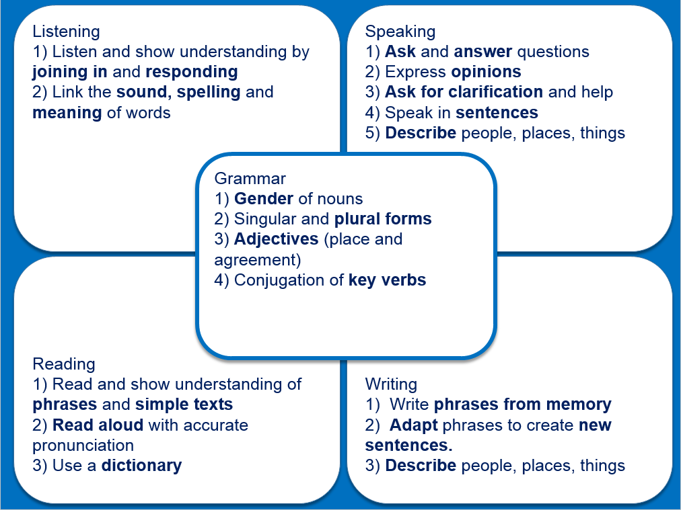
Primary Modern Foreign Languages
Subject content
Key Stage 2: Foreign languages
Teaching should focus on enabling pupils to make substantial progress in one foreign language. The teaching should provide an appropriate balance of spoken and written language and should lay the foundations for further foreign language teaching at Key Stage 3. It should enable pupils to understand and communicate ideas, facts and feelings in speech and writing, focused on familiar and routine matters, using their knowledge of phonology, grammatical structures and vocabulary.
The focus of study in modern languages will be on practical communication, while the focus in Latin or Ancient Greek will be to provide a linguistic foundation for learning modern languages and for reading comprehension. Pupils studying ancient languages may take part in simple oral exchanges, while discussion of what they read will be conducted in English.

Slide 2
Key features of the KS2 languages curriculum
Introduce, practise and develop phonics knowledge every week
Use songs, rhymes, and cultural information to practise phonics and allow for incidental vocabulary learning
Introduce a small number (3-8, average max.4) of new words each week
Practise understanding them in spoken and written modalities (i.e., when listening and reading the words, including in sentences)
Practise producing them (i.e., in speaking and writing, including in short sentences)
Systematically revisit previously taught phonics, vocabulary and grammar features regularly (e.g., after 3 and after 9 weeks)
Teach grammar in small steps – start with a short, clear explanation
Practise understanding the new grammar feature by understanding it (in listening and reading input) in contrast with one other feature
Practise producing the new grammar feature in short speaking and writing activities which ‘trap’ the new feature, making it task-essential
Say and write words and sentences from memory, using basic grammar (gender, adjectives, essential verb forms) and vocabulary to build sentences
Plan the new language (and the English) you use with pupils carefully – avoid waffling in either language – modelling an example is better than describing an activity.
Useful links National Curriculum Programme of Study Ofsted research review: languages Marc Hayes’ summary of the Ofsted languages research review RiPL White Paper KS2 Grammar presentation (Dr Rowena Kasprowicz) French and Spanish schemes of work and lesson resources German scheme of work and lesson resources

